Slide 1
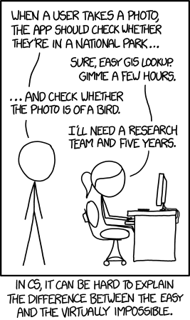
CSc 110, Spring 2018
Lecture 1: Introduction; Basic Python Programs

Slide 2
Course Staff
Allison Obourn (aeobourn@cs.arizona.edu)
Section Leaders
Your primary point of contact
Ask them about their experiences in CSc

Slide 3
Computer Science
CS is about PROCESS – describing how to accomplish tasks
"efficiently implementing automated abstractions" (Philip Guo)
Computers are a tool
Currently the best implementation platform
What kinds of problems can they solve?
How can they be made faster, cheaper, more efficient…?
Science?
More like engineering, art, magic…
Hypothesis creation, testing, refinement important
CS is still a young field finding itself

Slide 4
Why should you take Computer Science?
… like solving tricky problems
… like building things
… (will) work with large data sets
… are curious about how Facebook, Google, etc work
… are shopping around for a major
110 is a good predictor of who will enjoy and succeed in CSc

Slide 5
Are you in the right class?
CSc 101
Intro to Computer Science
CSc 110
Intro to Computer Programming I
CSc 120
Intro to Computer Programming I
You are here

Slide 6
Programming
program: A set of instructions to be carried out by a computer.
program execution: The act of carrying out the instructions contained in a program.
programming language: A systematic set of rules used to describe computations in a format that is editable by humans.

Slide 7
Some modern languages
procedural languages: programs are a series of commands
Pascal (1970): designed for education
C (1972): low-level operating systems and device drivers
functional programming: functions map inputs to outputs
Lisp (1958) / Scheme (1975), ML (1973), Haskell (1990)
object-oriented languages: programs use interacting "objects"
Smalltalk (1980): first major object-oriented language
C++ (1985): "object-oriented" improvements to C
successful in industry; used to build major OSes such as Windows
Python (1991):
The language taught in this course

Slide 8
Why Python?
Relatively simple
Pre-written software
Widely used

Slide 9
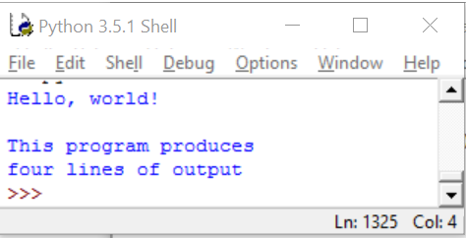
A Python program
print("Hello, world!")
print()
print("This program produces")
print("four lines of output")
Its output:
Hello, world!
This program produces
four lines of output
console: Text box into which the program's output is printed.

Slide 10
print
A statement that prints a line of output on the console.
Two ways to use print :
print("text")
Prints the given message as output.
print()
Prints a blank line of output.
Notes:
10

Slide 11
Strings and escape sequences

Slide 12
Strings
string: A sequence of characters to be printed.
Starts and ends with a " quote " character or a ' quote ' character.
The quotes do not appear in the output.
Examples: "hello" "This is a string. It's very long!" 'Here is "another" with quotes in' """I can span multiple lines because I'm surrounded by 3 quotes"""
Restrictions:
Strings surrounded by " " or ' ' may not span multiple lines "This is not a legal String."
Strings surrounded by " " may not contain a " character. "This is not a "legal" String either."
Strings surrounded by ' ' may not contain a ' character. 'This is not a 'legal' String either.'
Notes:
12

Slide 13
Escape sequences
escape sequence: A special sequence of characters used to represent certain special characters in a string.
\t tab character
\n new line character
\" quotation mark character
\' quotation mark character
\\ backslash character
Example: print("\\hello\nhow\tare \"you\"?\\\\")
Output: \hello how are "you"?\\

Slide 14
Questions
What is the output of the following print statements?
print("\ta\tb\tc")
print("\\\\")
print("'")
print("\"\"\"")
print("C:\nin\the downward spiral")
Write a print statement to produce this output:
/ \ // \\ /// \\\

Slide 15
Answers
Output of each print statement:
a b c
\\
'
"""
C:
in he downward spiral
print statement to produce the line of output:
print("/ \\ // \\\\ /// \\\\\\")

Slide 16
Questions
What print statements will generate this output?
This quote is from
Irish poet Oscar Wilde:
"Music makes one feel so romantic
- at least it always gets on one's nerves –
which is the same thing nowadays."
What print statements will generate this output?
A "quoted" String is
'much' better if you learn
the rules of "escape sequences."
Also, "" represents an empty String.
Don't forget: use \" instead of " !
'' is not the same as "

Slide 17
Answers
print statements to generate the output:
print("This quote is from")
print("Irish poet Oscar Wilde:”)
print()
print("\"Music makes one feel so romantic")
print("- at least it always gets on one's nerves -")
print("which is the same thing nowadays.\"")
print statements to generate the output:
print("A \"quoted\" String is")
print("'much' better if you learn")
print("the rules of \"escape sequences.\"")
print()
print("Also, \"\" represents an empty String.")
print("Don't forget: use \\\" instead of \" !")
print("'' is not the same as \"")

Slide 18
Keywords
keyword: An identifier that you cannot use because it already has a reserved meaning in Python.
and del from not while
as elif global or with
assert else if pass yield
break except import print
class exec in raise
continue finally is return
def for lambda try

