Slide 1
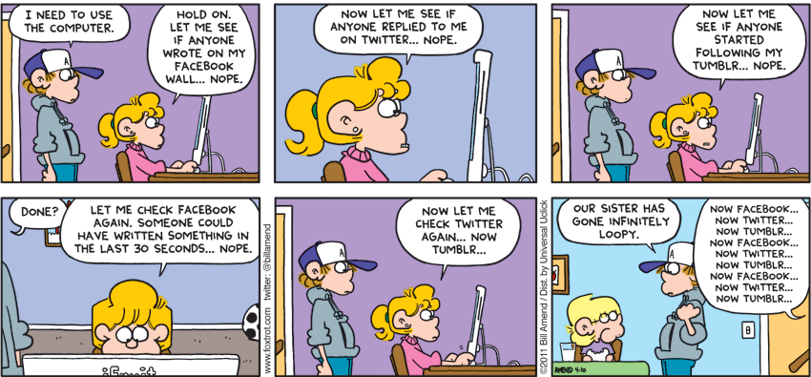
CSc 110, Spring 2018
Lecture 5: The for Loop and user input
Adapted from slides by Marty Stepp and Stuart Reges
Notes:
1

Slide 2
Variables
variable: A piece of the computer's memory that is given a name and type, and can store a value.
Like preset stations on a car stereo, or cell phone speed dial:
Steps for using a variable:
Declare/initialize it - state its name and type and store a value into it
Use it - print it or use it as part of an expression
Notes:
2

Slide 3
Declaration and assignment
variable declaration and assignment: Sets aside memory for storing a value and stores a value into a variable.
Variables must be declared before they can be used.
The value can be an expression; the variable stores its result.
Syntax:
name = expression
zipcode = 90210
myGPA = 1.0 + 2.25
zipcode | 90210
myGPA | 3.25

Slide 4
Using variables
Once given a value, a variable can be used in expressions:
x = 3 # x is 3
y = 5 * x - 1 # now y is 14
You can assign a value more than once:
x = 3 # 3 here x = 4 + 7 # now x is 11
x | 3
x | 11

Slide 5
Assignment and algebra
Assignment uses = , but it is not an algebraic equation.
= means, "store the value at right in variable at left"
The right side expression is evaluated first, and then its result is stored in the variable at left.
What happens here?
x = 3
x = x + 2 # ???
x | 3
x | 5
Notes:
5

Slide 6
Receipt question
Improve the receipt program using variables.
def main():
# Calculate total owed, assuming 8% tax / 15% tip
print("Subtotal:")
print(38 + 40 + 30)
print("Tax:")
print((38 + 40 + 30) * .08)
print("Tip:")
print((38 + 40 + 30) * .15)
print("Total:")
print(38 + 40 + 30 + (38 + 40 + 30) * .15 + (38 + 40 + 30) * .08)

Slide 7
Printing a variable's value
Use a comma to print a string and a variable's value on one line.
grade = (95.1 + 71.9 + 82.6) / 3.0
print("Your grade was", grade)
students = 11 + 17 + 4 + 19 + 14
print("There are", students,
"students in the course.")
Output:
Your grade was 83.2
There are 65 students in the course.

Slide 8
Receipt answer
def main():
# Calculate total owed, assuming 8% tax / 15% tip
subtotal = 38 + 40 + 30 # int
tax = subtotal * .08 # float
tip = subtotal * .15 # float
total = subtotal + tax + tip # float
print("Subtotal:", subtotal)
print("Tax:", tax)
print("Tip:", tip)
print("Total:", total)

Slide 9
Getting rid of repetition
Functions
Variables
String Multiplication
Allows you to print multiple occurrences of the same string without typing them all out
print("meow" * 3) # meowmeowmeow
What if you want to repeat function calls?
Notes:
also related to book exercise 1.10 about printing 1000 copies of "All work and no play makes Jack a dull boy"

Slide 10
Repetition with for loops
So far, repeating an action results in redundant code:
make_batter()
bake_cookies()
bake_cookies()
bake_cookies()
bake_cookies()
bake_cookies()
frost_cookies()
Python's for loop statement performs a task many times.
mix_batter()
for i in range(1, 6): # repeat 5 times
bake_cookies()
frost_cookies()
Notes:
also related to book exercise 1.10 about printing 1000 copies of "All work and no play makes Jack a dull boy"

Slide 11
for loop syntax
header
body
for variable in range (start, stop):
statement
statement
...
statement
Set the variable equal to the start value
Repeat the following:
Check if the variable is less than the stop. If not, stop.
Execute the statements.
Increase the variable's value by 1.

Slide 12
Control structures
Control structure: a programming construct that affects the flow of a program's execution
Controlled code may include one or more statements
The for loop is an example of a looping control structure

Slide 13
Repetition over a range
print("1 squared = " + str(1 * 1))
print("2 squared = " + str(2 * 2))
print("3 squared = " + str(3 * 3))
print("4 squared = " + str(4 * 4))
print("5 squared = " + str(5 * 5))
print("6 squared = " + str(6 * 6))
Intuition: "I want to print a line for each number from 1 to 6"
The for loop does exactly that!
for i in range(1, 7):
print(str(i) "squared = " str(i * i))
"For each integer i from 1 through 6, print ..."

Slide 14
Loop walkthrough
for i in range(1, 5):
print(str(i) + " squared = " + str(i * i))
print("Whoo!")
Output:
1 squared = 1
2 squared = 4
3 squared = 9
4 squared = 16
Whoo!

Slide 15
Multi-line loop body
print("+----+")
for i in range(1, 4):
print("\\ /")
print("/ \\")
print("+----+")
Output:
+----+
\ /
/ \
\ /
/ \
\ /
/ \
+----+

Slide 16
Expressions for counter
high_temp = 5
for i in range(-3, high_temp // 2 + 1):
print(i * 1.8 + 32)
Output:
26.6 28.4 30.2 32.0 33.8 35.6

Slide 17
Rocket Exercise
Write a method that produces the following output:
T-minus 10, 9, 8, 7, 6, 5, 4, 3, 2, 1, blastoff!
The end.

Slide 18
print (' ', end='')
Adding ,end='' allows you to print without moving to the next line
allows you to print partial messages on the same line
high_temp = 5
for i in range(-3, high_temp // 2 + 1):
print(i * 1.8 + 32, end=' ')
Output:
26.6 28.4 30.2 32.0 33.8 35.6
Either concatenate ' ' to separate the numbers or set end=' '

Slide 19
Changing step size
Add a third number to the end of range, this is the step size
A negative number will count down instead of up
print("T-minus ")
for i in range(10, 0, -1):
print(str(i) + ", ", end="")
print("blastoff!")
print("The end.")
Output:
T-minus 10, 9, 8, 7, 6, 5, 4, 3, 2, 1, blastoff!
The end.

Slide 20
Constants
constant: A fixed value visible to the whole program.
value should only be set only at declaration; shouldn't be reassigned
Syntax:
Just like declaring a normal variable:
name = value
name is usually in ALL_UPPER_CASE
Examples:
DAYS_IN_WEEK = 7
INTEREST_RATE = 3.5
SSN = 658234569

Slide 21
Constants and figures
Consider the task of drawing the following scalable figure:
+/\/\/\/\/\/\/\/\/\/\+
| |
| |
| | Multiples of 5 occur many times
| |
| |
+/\/\/\/\/\/\/\/\/\/\+
+/\/\/\/\+
| |
| | The same figure at size 2
+/\/\/\/\+
Notes:
21

Slide 22
Constant tables
SIZE = ...
What equation would cause the code to print:
2 7 12 17 22
To see patterns, make a table of SIZE and the numbers.
Each time SIZE goes up by 1, the number should go up by 5.
But SIZE * 5 is too great by 3, so we subtract 3.
SIZE | number to print | 5 * SIZE
1 | 2 | 5
2 | 7 | 10
3 | 12 | 15
4 | 17 | 20
5 | 22 | 25
5 * SIZE - 3
2
7
12
17
22

Slide 23
Constant tables question
What equation would cause the code to print:
17 13 9 5 1
Let's create the constant table together.
Each time SIZE goes up 1, the number printed should ...
But this multiple is off by a margin of ...
SIZE | number to print
1 | 17
2 | 13
3 | 9
4 | 5
5 | 1
-4 * SIZE | -4 * SIZE+ 21
-4 | 17
-8 | 13
-12 | 9
-16 | 5
-20 | 1
-4 * SIZE
-4
-8
-12
-16
-20

Slide 24
Interactive programs
interactive program: Reads input from the console.
While the program runs, it asks the user to type input.
The input typed by the user is stored in variables in the code.
Can be tricky; users are unpredictable and misbehave.
But interactive programs have more interesting behavior.

Slide 25
input
input: An function that can read input from the user.
Using an input object to read console input:
name = input(prompt)
Example:
name = input("type your name: ")
The variable name will store the value the user typed in

Slide 26
input example
def main():
age = input("How old are you? ")
years = 65 - age
print(years, " years until retirement!")
Console (user input underlined):
How old are you?
age | 29
29
Traceback (most recent call last):
File "<pyshell#13>", line 1, in <module>
print(65 - age)
TypeError: unsupported operand type(s) for -: 'int' and 'str'
Notes:
It's also useful to write a program that prompts for multiple values, both on the same line or each on its own line.

Slide 27
input example
def main():
age = int(input("How old are you? "))
years = 65 - age
print(years, "years until retirement!")
Console (user input underlined):
How old are you?
36 years until retirement!
age | 29
years | 36
29
Notes:
It's also useful to write a program that prompts for multiple values, both on the same line or each on its own line.

Slide 28
Modify-and-assign operators
shortcuts to modify a variable's value
Shorthand Equivalent longer version
variable += value variable = variable + value
variable -= value variable = variable - value
variable *= value variable = variable * value
variable /= value variable = variable / value
variable //= value variable = variable // value
variable %= value variable = variable % value
x += 3 # x = x + 3
gpa -= 0.5 # gpa = gpa - 0.5
number *= 2 # number = number * 2

