Slide 1
CSc 110, Spring 2018
Lecture 14: Booleans and Strings
Adapted from slides by Marty Stepp and Stuart Reges

Slide 2
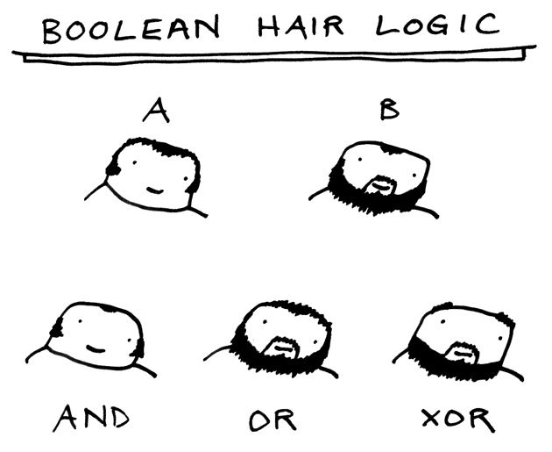
Exercise: Logical questions
What is the result of each of the following expressions?
x = 42
y = 17
z = 25
y < x and y <= z
x % 2 == y % 2 or x % 2 == z % 2
x <= y + z and x >= y + z
not(x < y and x < z)
(x + y) % 2 == 0 or not((z - y) % 2 == 0)
Answers: True, False, True, True, False

Slide 3
Type bool
bool: A logical type whose values are True and False.
A logical test is actually a Boolean expression.
Like other types, it is legal to:
create a bool variable
pass a bool value as a parameter
return a bool value from function
call a function that returns a bool and use it as a test
minor = age < 21
is_prof = "Prof" in name
loves_csc = True
# allow only CS-loving students over 21
if minor or is_prof or not loves_csc:
print("Can't enter the club!")

Slide 4
Using bool
Why is type bool useful?
Can capture a complex logical test result and use it later
Can write a function that does a complex test and returns it
Makes code more readable
Can pass around the result of a logical test (as param/return)
good_age = age >= 27 and age < 39
good_height = height >= 78 and height < 84
rich = salary >= 100000.0
if (goodAge and goodHeight) or rich:
print("Okay, let's go out!")
else:
print("It's not you, it's me...")

Slide 5
Returning bool
Is this good style?
def is_prime(n):
factors = 0;
for i in range(1, n + 1):
if (n % i == 0):
factors += 1
if factors == 2:
return True
else:
return False
Calls to functions returning bool can be used as tests:
if is_prime(57):
...

Slide 6
"Boolean Zen", part 1
Students new to boolean often test if a result is True:
if is_prime(57) == True: # bad
...
But this is unnecessary and redundant. Preferred:
if is_prime(57): # good
...
A similar pattern can be used for a False test:
if is_prime(57) == False: # bad
if not is_prime(57): # good

Slide 7
"Boolean Zen", part 2
Functions that return bool often have an if/else that returns True or False:
def both_odd(n1, n2):
if n1 % 2 != 0 and n2 % 2 != 0:
return True
else:
return False
But the code above is unnecessarily verbose.

Slide 8
Solution w/ bool variable
We could store the result of the logical test.
def both_odd(n1, n2):
test = (n1 % 2 != 0 and n2 % 2 != 0)
if test: # test == True
return True
else: # test == False
return False
Notice: Whatever test is, we want to return that.
If test is True, we want to return True.
If test is False, we want to return False.

Slide 9
Solution w/ "Boolean Zen"
Observation: The if/else is unnecessary.
The variable test stores a bool value; its value is exactly what you want to return. So return that!
def both_odd(n1, n2):
test = (n1 % 2 != 0 and n2 % 2 != 0)
return test
An even shorter version:
We don't even need the variable test. We can just perform the test and return its result in one step.
def both_odd(n1, n2):
return (n1 % 2 != 0 and n2 % 2 != 0)

Slide 10
"Boolean Zen" template
Replace
def name(parameters):
if test:
return True
else:
return False
with
def name(parameters):
return test

Slide 11
Improve the is_prime function
How can we fix this code?
def is_prime(n):
factors = 0;
for i in range(1, n + 1):
if n % i == 0:
factors += 1
if factors != 2:
return False
else:
return True

Slide 12
De Morgan's Law
De Morgan's Law: Rules used to negate boolean tests.
Useful when you want the opposite of an existing test.
Example:
Original Expression | Negated Expression | Alternative
a and b | not a or not b | not(a and b)
a or b | not a and not b | not(a or b)
Original Code | Negated Code
if x == 7 and y > 3: ... | if x != 7 or y <= 3: ...

Slide 13
Boolean practice questions
Write a function named is_vowel that returns whether a str is a vowel (a, e, i, o, or u), case-insensitively.
is_vowel("q") returns False
is_vowel("A") returns True
is_vowel("e") returns True
Change the above function into an is_non_vowel that returns whether a str is any character except a vowel.
is_non_vowel("q") returns True
is_non_vowel("A") returns False
is_non_vowel("e") returns False

Slide 14
Boolean practice answers
# Enlightened version. I have seen the true way (and false way)
def is_vowel(s):
return s == 'a' or s == 'A' or s == 'e' or s == 'E' or s =='i' or s == 'I'
or s == 'o' or s == 'O' or s == 'u' or s =='U'
# Enlightened "Boolean Zen" version
def is_non_vowel(s):
return not(s == 'a') and not(s == 'A') and not(s == 'e') and not(s == 'E')
and not(s =='i') and not(s == 'I') and not(s == 'o') and
not(s == 'O') and not(s == 'u') and not(s =='U')
# or, return not is_vowel(s)

Slide 15
Strings
string: a type that stores a sequence of text characters.
name = "text"
name = expression
Examples: name = "Daffy Duck" x = 3 y = 5 point = "(" + str(x) + ", " + str(y) + ")"

Slide 16
Indexes
index | 0 | 1 | 2 | 3 | 4 | 5 | 6 | 7
 | -8 | -7 | -6 | -5 | -4 | -3 | -2 | -1
character | U | l | t | i | m | a | t | e
Characters of a string are numbered with 0-based indexes:
name = "Ultimate"
First character's index : 0
Last character's index : 1 less than the string's length

Slide 17
Accessing characters
You can access a character with string[index]:
name = "Merlin"
print(name[0])
Output: M

Slide 18
Accessing substrings
Syntax:
part = string[start:stop]
Example:
s = "Merlin"
mid = [1:3] # er
If you want to start at the beginning you can leave off start
mid = [:3] # Mer
If you want to start at the end you can leave off the stop
mid = [1:] # erlin

Slide 19
String methods
Method name | Description
find(str) | index where the start of the given string appears in this string (-1 if not found)
substring(index1, index2) or substring(index1) | the characters in this string from index1 (inclusive) to index2 (exclusive); if index2 is omitted, grabs till end of string
lower() | a new string with all lowercase letters
upper() | a new string with all uppercase letters
These methods are called using the dot notation below:
starz = "Biles & Manuel"
print(starz.lower()) # biles & manuel

Slide 20
String method examples
# index 012345678901
s1 = "Allison Obourn"
s2 = "Merlin The Cat"
print(s1.find("o")) # 5
print(s2.lower()) # "merlin the cat"
Given the following string:
# index 012345678901234567890123
book = "Building Python Programs"
How would you extract the word "Python" ?

Slide 21
Modifying strings
String operations and functions like lowercase build and return a new string, rather than modifying the current string.
s = "Aceyalone"
s.upper()
print(s) # Aceyalone
To modify a variable's value, you must reassign it:
s = "Aceyalone"
s = s.upper()
print(s) # ACEYALONE

Slide 22
Name border
ALLISON
LLISON
LISON
ISON
SON
ON
N
A
AL
ALL
ALLI
ALLIS
ALLISO
ALLISON
OBOURN
BOURN
OURN
URN
RN
N
O
OB
OBO
OBOU
OBOUR
OBOURN
Prompt the user for full name
Draw out the pattern to the left
This should be resizable. Size 1 is shown and size 2 would have the first name twice followed by last name twice

Slide 23
Other String operations - length
Syntax:
length = len(string)
Example:
s = "Merlin"
count = len(s) # 6

Slide 24
Looping through a string
The for loop through a string using range:
major = "CSc"
for letter in range(0, len(major)):
print(major[letter])
You can also use a for loop to print or examine each character without range.
major = "CSc"
for letter in major:
print(letter)
Output:
C
S
c

Slide 25
String tests
Method | Description
startswith(str) | whether one contains other's characters at start
endswith(str) | whether one contains other's characters at end
name = "Voldermort"
if name.startswith("Vol"):
print("He who must not be named")
The in keyword can be used to test if a string contains another string.
example: "er" in name # true

Slide 26
String question
A Caesar cipher is a simple encryption where a message is encoded by shifting each letter by a given amount.
e.g. with a shift of 3, A → D, H → K, X → A, and Z → C
Write a program that reads a message from the user and performs a Caesar cipher on its letters:
Your secret message: Brad thinks Angelina is cute
Your secret key: 3
The encoded message: eudg wklqnv dqjholqd lv fxwh

Slide 27
Strings and ints
All char values are assigned numbers internally by the computer, called ASCII values.
Examples:
'A' is 65, 'B' is 66, ' ' is 32
'a' is 97, 'b' is 98, '*' is 42
One character long Strings and ints can be converted to each other
ord('a') is 97, chr(103) is 'g'
This is useful because you can do the following:
chr(ord('a' + 2)) is 'c'

