Slide 1
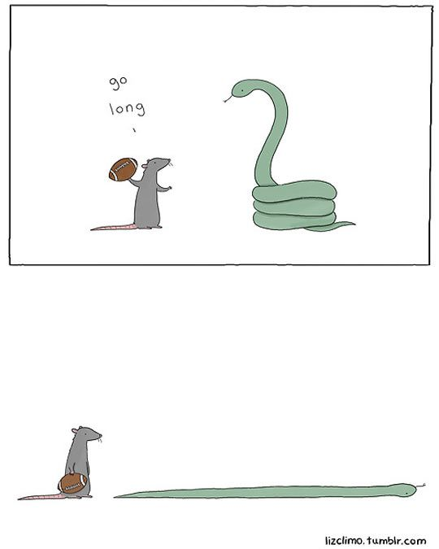
CSc 110, Spring 2018
Lecture 23: lists as Parameters
Adapted from slides by Marty Stepp and Stuart Reges

Slide 2
"list mystery" problem
traversal: An examination of each element of an list.
What element values are stored in the following list?
a = [1, 7, 5, 6, 4, 14, 11]
for i in range(0, len(a) – 1):
if a[i] > a[i + 1]:
a[i + 1] = a[i + 1] * 2
index | 0 | 1 | 2 | 3 | 4 | 5 | 6
value
index | 0 | 1 | 2 | 3 | 4 | 5 | 6
value | 1 | 7 | 10 | 12 | 8 | 14 | 22

Slide 3
List reversal question
Write code that reverses the elements of a list.
For example, if the array initially stores:
[11, 42, -5, 27, 0, 89]
Then after your reversal code, it should store:
[89, 0, 27, -5, 42, 11]
The code should work for a list of any size.
Hint: think about swapping various elements...

Slide 4
Algorithm idea
Swap pairs of elements from the edges; work inwards:
index | 0 | 1 | 2 | 3 | 4 | 5
value | 11 | 42 | -5 | 27 | 0 | 89
index | 0 | 1 | 2 | 3 | 4 | 5
value | 89 | 42 | -5 | 27 | 0 | 11
index | 0 | 1 | 2 | 3 | 4 | 5
value | 89 | 0 | -5 | 27 | 42 | 11
index | 0 | 1 | 2 | 3 | 4 | 5
value | 89 | 0 | 27 | -5 | 42 | 11

Slide 5
Swapping values
def main():
a = 7
b = 35
# swap a with b?
a = b
b = a
print(a, b)
What is wrong with this code? What is its output?
The red code should be replaced with:
temp = a
a = b
b = temp

Slide 6
Flawed algorithm
What's wrong with this code?
numbers = [11, 42, -5, 27, 0, 89]
# reverse the list
for i in range(0, len(numbers)):
temp = numbers[i]
numbers[i] = numbers[len(numbers) - 1 - i]
numbers[len(numbers) - 1 - i] = temp
The loop goes too far and un-reverses the array! Fixed version:
for i in range(0, len(numbers) // 2):
temp = numbers[i]
numbers[i] = numbers[len(numbers) - 1 - i]
numbers[len(numbers) - 1 - i] = temp

Slide 7
List reverse question 2
Turn your list reversal code into a reverse function.
Accept the list of integers to reverse as a parameter.
numbers = [11, 42, -5, 27, 0, 89]
reverse(numbers)
How do we write functions that accept lists as parameters?
Will we need to return the new list contents after reversal?
...

Slide 8
A swap function?
Does the following swap function work? Why or why not?
def main():
a = 7
b = 35
# swap a with b?
swap(a, b)
print(a, b)
def swap(a, b):
temp = a
a = b
b = temp
Notes:
It's basically not possible to write a swap method that accepts two ints.
swap can't escape from itself to modify the outside world.
(sort of like the villains in the holodeck on Star Trek; they can wreak havoc in their holo-world, but they can't leave and attack the real Enterprise outside.)

Slide 9
Mutability
Mutability: The ability to be changed or mutated
ints, floats, strs and bools are immutable.
lists and objects are mutable

Slide 10
Immutable types
ints, floats, strs and bools are immutable.
Modifying the value of one variable does not affect others.
x = 5
y = x # x = 5, y = 5
y = 17 # x = 5, y = 17
x = 8 # x = 8, y = 17

Slide 11
Mutable types
lists and DrawingPanel are mutable.
Modifying the value of one variable does affect others.
a1 = [4, 15, 8]
a2 = a1 # refer to same list as a1
a2[0] = 7
print(a1) # [7, 15, 8]
index | 0 | 1 | 2
value | 7 | 15 | 8
a1
a2

Slide 12
Mutability and objects
Lists and objects are mutable. Why?
efficiency. Copying large objects slows down a program.
sharing. It's useful to share an object's data among functions.
panel1 = DrawingPanel(80, 50)
panel2 = panel1 # same window
panel2.draw_rect(0, 0, 80, 50, "cyan")
panel1
panel2

Slide 13
Objects as parameters
When a mutable object is passed as a parameter the function can change it.
If the parameter is modified, it will affect the original object.
def main():
window = DrawingPanel(80, 50)
window.draw_rect(0, 0, 80, 50, "yellow")
example(window)
def example(panel):
panel.draw_rect(0, 0, 80, 50, "cyan") ...
window
panel
Notes:
Note: This is also the reason that it works when you pass the Graphics g as a parameter to a method, because it is drawing with the same pen object onto the same window.

Slide 14
Lists as parameters
Lists are mutable too.
Changes made in the function are also seen by the caller.
def main():
iq = [126, 167, 95]
increase(iq)
print(iq)
def increase(a):
for i in range(0, len(a)):
a[i] = a[i] * 2
Output:
[252, 334, 190]
iq
index | 0 | 1 | 2
value | 126 | 167 | 95
index | 0 | 1 | 2
value | 252 | 334 | 190
a

Slide 15
List reverse question 2
Turn your list reversal code into a reverse function.
Accept the list of integers to reverse as a parameter.
numbers = [11, 42, -5, 27, 0, 89]
reverse(numbers)
Solution:
def reverse(numbers):
for i in range(0, len(numbers) // 2):
temp = numbers[i]
numbers[i] = numbers[len(numbers) - 1 - i]
numbers[len(numbers) - 1 - i] = temp

Slide 16
List parameter questions
Write a function swap that accepts a list of integers and two indexes and swaps the elements at those indexes.
a1 = [12, 34, 56]
swap(a1, 1, 2)
print(a1) # [12, 56, 34]
Write a function swap_all that accepts two lists of integers as parameters and swaps their entire contents.
Assume that the two lists are the same length.
a1 = [12, 34, 56]
a2 = [20, 50, 80]
swap_all(a1, a2)
print(a1) # [20, 50, 80]
print(a2) # [12, 34, 56]

Slide 17
List parameter answers
# Swaps the values at the given two indexes.
def swap(a, i, j):
temp = a[i]
a[i] = a[j]
a[j] = temp
# Swaps the entire contents of a1 with those of a2.
def swap_all(a1, a2):
for i in range(0, len(a1)):
temp = a1[i]
a1[i] = a2[i]
a2[i] = temp

Slide 18
List return question
Write a function merge that accepts two lists of integers and returns a new list containing all elements of the first list followed by all elements of the second.
a1 = [12, 34, 56]
a2 = [7, 8, 9, 10]
a3 = merge(a1, a2)
print(a3)
# [12, 34, 56, 7, 8, 9, 10]
Write a function merge3 that merges 3 lists similarly.
a1 = {12, 34, 56]
a2 = {7, 8, 9, 10]
a3 = {444, 222, -1]
a4 = merge3(a1, a2, a3)
print(a4)
# [12, 34, 56, 7, 8, 9, 10, 444, 222, -1]
Notes:
I probably won't reach this in lecture; it's here just in case.

Slide 19
List return answer 1
# Returns a new list containing all elements of a1
# followed by all elements of a2.
def merge(a1, a2):
result = [0] * (len(a1) + len(a2))
for i in range(0, len(a1)):
result[i] = a1[i]
for i in range(0, len(a2)):
result[len(a1) + i] = a2[i]
return result

Slide 20
List return answer 2
# Returns a new list containing all elements of a1,a2,a3.
def merge3(a1, a2, a3):
a4 = [0] * (len(a1) + len(a2) + len(a3)
for i in range(0, len(a1)):
a4[i] = a1[i]
for i in range(0, len(a2)):
a4[len(a1) + i] = a2[i]
for i in range(0, len(a3)):
a4[len(a1) + len(a2) + i] = a3[i]
return a4
# Shorter version that calls merge.
def merge3(a1, a2, a3):
return merge(merge(a1, a2), a3)

