Slide 1
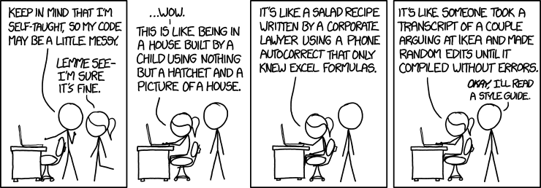
CSc 110, Spring 2018
Lecture 27: Lists Tuples
Adapted from slides by Marty Stepp and Stuart Reges

Slide 2
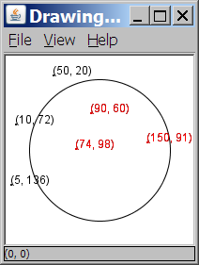
A programming problem
Given a file of cities' names and (x, y) coordinates:
Winslow 50 20
Tucson 90 60
Phoenix 10 72
Bisbee 74 98
Yuma 5 136
Page 150 91
Write a program to draw the cities on a DrawingPanel, then simulates an earthquake that turns all cities red that are within a given radius:
Epicenter x? 100
Epicenter y? 100
Affected radius? 75

Slide 3
A bad solution
lines = open("cities.txt").readlines()
names = [0] * len(lines)
x_coords = [0] * len(lines)
y_coords = [0] * len(lines)
for i in range(0, len(lines)):
parts = lines[i].split()
names[i] = parts[0]
x_coords[i] = parts[1] # read each city
y_coords[i] = parts[2]
...
parallel lists: 2+ lists with related data at same indexes.
Considered poor style.

Slide 4
Observations
The data in this problem is a set of points.
It would be better stored together

Slide 5
Tuples
A sequence similar to a list but it cannot be altered
Good for storing related data
We mainly store the same type of data in a list
We usually store related things in tuples
Creating tuples
name = (data, other_data, … , last_data)
tuple = ("Tucson", 80, 90)

Slide 6
Using tuples
You can access elements using [] notation, just like lists and strings
tuple = ("Tucson", 80, 90)
low = tuple[1]
You cannot update a tuple!
Tuples are immutable
You can loop through tuples
the same as lists
operation | call | result
len() | len((1, 2, 3)) | 3
+ | (1, 2, 3) + (4, 5, 6) | (1, 2, 3, 4, 5, 6)
* | ('Hi!',) * 4 | ('Hi!', 'Hi!', 'Hi!', 'Hi!')
in | 3 in (1, 2, 3) | True
for | for x in (1,2,3): print x, | 1 2 3
min() | min((1, 3)) | 1
max() | max((1, 3)) | 3

Slide 7
Days till
Write a function called days_till that accepts a start month and day and a stop month and day and returns the number of days between them
call return
days_till("december", 1, "december", 10) 9
days_till("novembeR", 15, "december", 10) 25
days_till("OCTober", 6, "december", 17) 72
days_till("october", 6, "ocTober", 1) 360

Slide 8
Days till solution
def days_till(start_month, start_day, stop_month, stop_day):
months = (('january', 31),('february', 28),('march', 31),('april', 30), ('may', 31),('june', 30),
('july', 31), ('august', 31),('september', 30), ('october', 31), ('november', 30), ('december', 31))
if start_month.lower() == stop_month.lower() and stop_day >= start_day:
return stop_day - start_day
days = 0
for i in range(0, len(months)):
month = months[i]
if month[0] == start_month.lower():
days = month[1] - start_day
i += 1
while months[i % 12][0] != stop_month.lower():
days += months[i % 12][1]
i += 1
days += stop_day
return days

Slide 9
Output to files
Open a file in write or append mode
'w' - write mode – replaces everything in the file
'a' – append mode – adds to the bottom of the file preserving what is already in it
name = open("filename", "w") # write
name = open("filename", "a") # append

Slide 10
Output to files
name.write(str) - writes the given string to the file
name.close() - closes file once writing is done
Example:
out = open("output.txt", "w")
out.write("Hello, world!\n")
out.write("How are you?")
out.close()
text = open("output.txt").read() # Hello, world!\nHow are you?
Notes:
common PrintStream bug:
- declaring it in a method that gets called many times. This causes the file to be re-opened and wipes the past contents. So only the last line shows up in the file.

