Slide 1
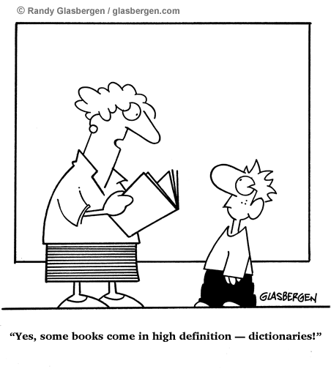
CSc 110, Spring 2018
Lecture 32: Sets and Dictionaries
Adapted from slides by Marty Stepp and Stuart Reges

Slide 2
Exercise
Write a program that counts the number of unique words in a large text file (say, Moby Dick or the King James Bible).
Store the words in a structure and report the # of unique words.
Once you've created this structure, allow the user to search it to see whether various words appear in the text file.
What structure is appropriate for this problem? List? Tuple?

Slide 3
Sets
set: A collection of unique values (no duplicates allowed) that can perform the following operations efficiently:
add, remove, search (contains)
We don't think of a set as having indexes; we just add things to the set in general and don't worry about order
"the"
"of"
"if"
"to" in set
"to"
"down"
"from"
true
"by"
"she"
"be" in set
"you"
false
"in"
"why"
"him"
set

Slide 4
Creating a Set
An empty set:
a = set()
A set with elements in it:
b = {"the", "hello", "happy"}
a.add(val) | adds element val to a
a.discard(val) | removes val from a if present
a.pop() | removes and returns a random element from a
a - b | returns a new set containing values in a but not in b
a | b | returns a new set containing values in either a or b
a & b | returns a new set containing values in both a and b
a ^ b | returns a new set containing values in a or b but not both
You can also use in, len(), etc.

Slide 5
Looping over a set?
You must use a for element in structure loop
needed because sets have no indexes; can't get element i

Slide 6
Exercise
Write a program to count the number of occurrences of each unique word in a large text file (e.g. Moby Dick ).
Allow the user to type a word and report how many times that word appeared in the book.
Report all words that appeared in the book at least 500 times.
What structure is appropriate for this problem?

Slide 7
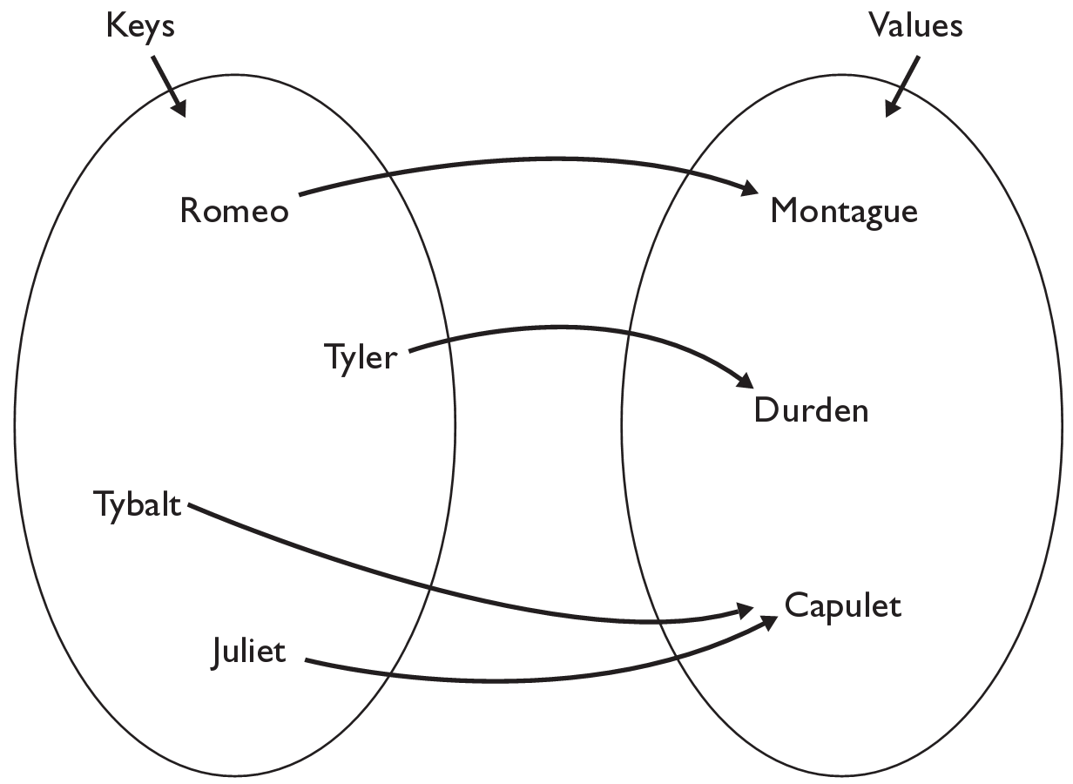
Dictionaries
dictionary: Holds a set of unique keys and a collection of values, where each key is associated with one value.
a.k.a. "map", "associative array", "hash"
basic dictionary operations:
put(key, value ): Adds a mapping from a key to a value.
get(key ): Retrieves the value mapped to the key.
remove(key ): Removes the given key and its mapped value.
my_dict["Juliet"] returns "Capulet"

Slide 8
Dictionary functions
my_dict[key] = value | adds a mapping from the given key to the given value; if the key already exists, replaces its value with the given one
my_dict[key] | returns the value mapped to the given key (error if key not found)
items() | return a new view of the dictionary’s items ((key, value) pairs)
pop(key) | removes any existing mapping for the given key and returns it (error if key not found)
popitem() | removes and returns an arbitrary (key, value) pair (error if empty)
keys() | returns the dictionary's keys
values() | returns the dictionary's values
You can also use in, len(), etc.

Slide 9
Using dictionaries
A dictionary allows you to get from one half of a pair to the other.
Remembers one piece of information about every index (key).
Later, we can supply only the key and get back the related value:
Allows us to ask: What is Suzy's phone number?
# key value
my_dict["Suzy"] = "206-685-2181"
Dictionary
my_dict["Suzy"]
Dictionary
"206-685-2181"

Slide 10
Maps and tallying
a map can be thought of as generalization of a tallying list
the "index" (key) doesn't have to be an int
count digits: 22092310907
# (T)rump, (C)linton, (I)ndependent
count votes: "TCCCCCCTTTTTCCCCCCTCTTITCTTITCCTIC"
index | 0 | 1 | 2 | 3 | 4 | 5 | 6 | 7 | 8 | 9
value | 3 | 1 | 3 | 0 | 0 | 0 | 0 | 1 | 0 | 2
"T"
15
key | "T" | "C" | "I"
value | 15 | 15 | 3
"C"
3
"I"
15
keys
values

Slide 11
items, keys and values
items function returns tuples of each key-value pair
can loop over the keys in a for loop
ages = {}
ages["Merlin"] = 4
ages("Chester"] = 2
ages["Percival"] = 12
for cat, age in ages.items()):
print(name + " -> " + str(age))
values function returns all values in the dictionary
no easy way to get from a value to its associated key(s)
keys function returns all keys in the dictionary

