Slide 1
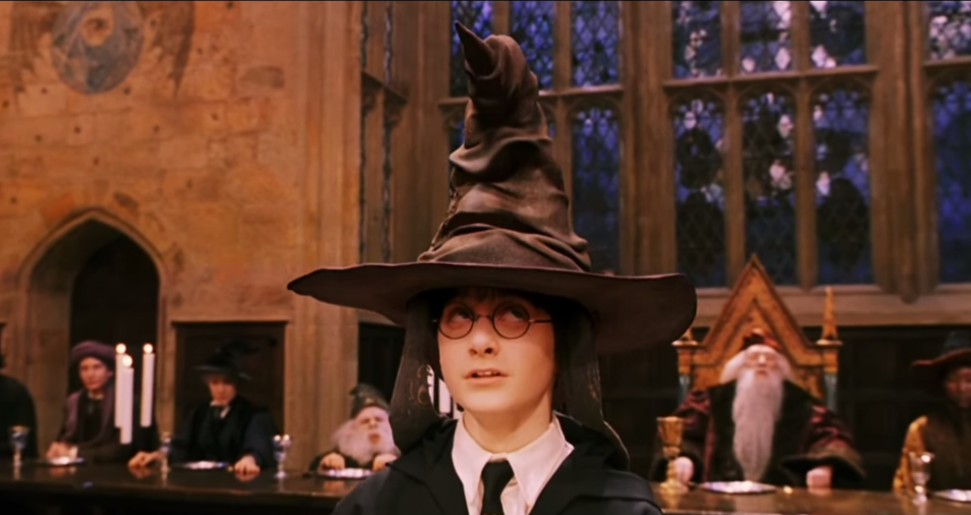
CSc 110, Spring 2018
Lecture 40: Sorting
Adapted from slides by Marty Stepp and Stuart Reges

Slide 2
Selection sort
selection sort: Orders a list of values by repeatedly putting the smallest or largest unplaced value into its final position.
The algorithm:
Look through the list to find the smallest value.
Swap it so that it is at index 0.
Look through the list to find the second-smallest value.
Swap it so that it is at index 1.
...
Repeat until all values are in their proper places.

Slide 3
Activity
Initial list:
After 1st, 2nd, and 3rd passes:
index | 0 | 1 | 2 | 3 | 4 | 5 | 6 | 7 | 8 | 9 | 10 | 11 | 12 | 13 | 14 | 15 | 16
value | 2 | 8 | -2 | 4 | 7 | 0 | -6 | 50 | 70 | -8 | 1 | 6 | 21 | 5 | 42 | 9 | -5
index | 0 | 1 | 2 | 3 | 4 | 5 | 6 | 7 | 8 | 9 | 10 | 11 | 12 | 13 | 14 | 15 | 16
value | -8 | 8 | -2 | 4 | 7 | 0 | -6 | 50 | 70 | 2 | 1 | 6 | 21 | 5 | 42 | 9 | -5
index | 0 | 1 | 2 | 3 | 4 | 5 | 6 | 7 | 8 | 9 | 10 | 11 | 12 | 13 | 14 | 15 | 16
value | -8 | -6 | -2 | 4 | 7 | 0 | 8 | 50 | 70 | 2 | 1 | 6 | 21 | 5 | 42 | 9 | -5
index | 0 | 1 | 2 | 3 | 4 | 5 | 6 | 7 | 8 | 9 | 10 | 11 | 12 | 13 | 14 | 15 | 16
value | -8 | -6 | -5 | 4 | 7 | 0 | 8 | 50 | 70 | 2 | 1 | 6 | 21 | 5 | 42 | 9 | -2

Slide 4
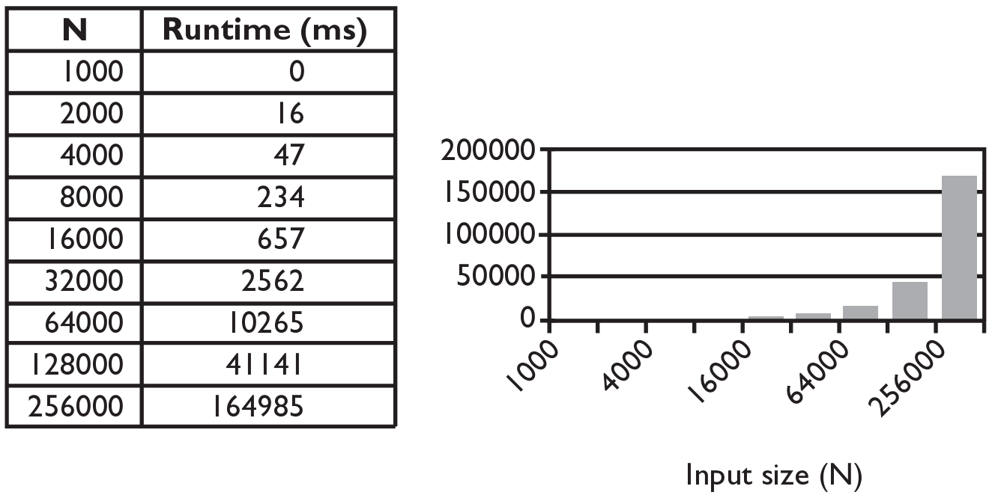
Selection sort runtime (Fig. 13.6)
How many comparisons does selection sort have to do?

Slide 5
Merge sort
merge sort: Repeatedly divides the data in half, sorts each half, and combines the sorted halves into a sorted whole.
The algorithm:
Divide the list into two roughly equal halves.
Sort the left half.
Sort the right half.
Merge the two sorted halves into one sorted list.
Often implemented recursively.
An example of a "divide and conquer" algorithm.
Invented by John von Neumann in 1945

Slide 6
Merge sort example
index | 0 | 1 | 2 | 3 | 4 | 5 | 6 | 7
value | 22 | 18 | 12 | -4 | 58 | 7 | 31 | 42
split
22 | 18 | 12 | -4
58 | 7 | 31 | 42
split
split
22 | 18
12 | -4
58 | 7
31 | 42
split
split
split
split
22
18
12
-4
58
7
31
42
merge
merge
merge
merge
18 | 22
-4 | 12
7 | 58
31 | 42
merge
merge
-4 | 12 | 18 | 22
7 | 31 | 42 | 58
merge
-4 | 7 | 12 | 18 | 22 | 31 | 42 | 58

Slide 7
Merge halves code
# Merges the left/right elements into a sorted result.
# Precondition: left/right are sorted
def merge(result, left, right):
i1 = 0 # index into left list
i2 = 0 # index into right list
for i in range(0, len(result)):
if i2 >= len(right) or (i1 < len(left) and left[i1] <= right[i2]):
result[i] = left[i1] # take from left
i1 += 1
else:
result[i] = right[i2] # take from right
i2 += 1

Slide 8
Merge sort code
# Rearranges the elements of a into sorted order using
# the merge sort algorithm.
def merge_sort(a):
if len(a) >= 2:
# split list into two halves
left = a[0, len(a)//2]
right = a[len(a)//2, len(a)]
# sort the two halves
merge_sort(left)
merge_sort(right)
# merge the sorted halves into a sorted whole
merge(a, left, right)

Slide 9
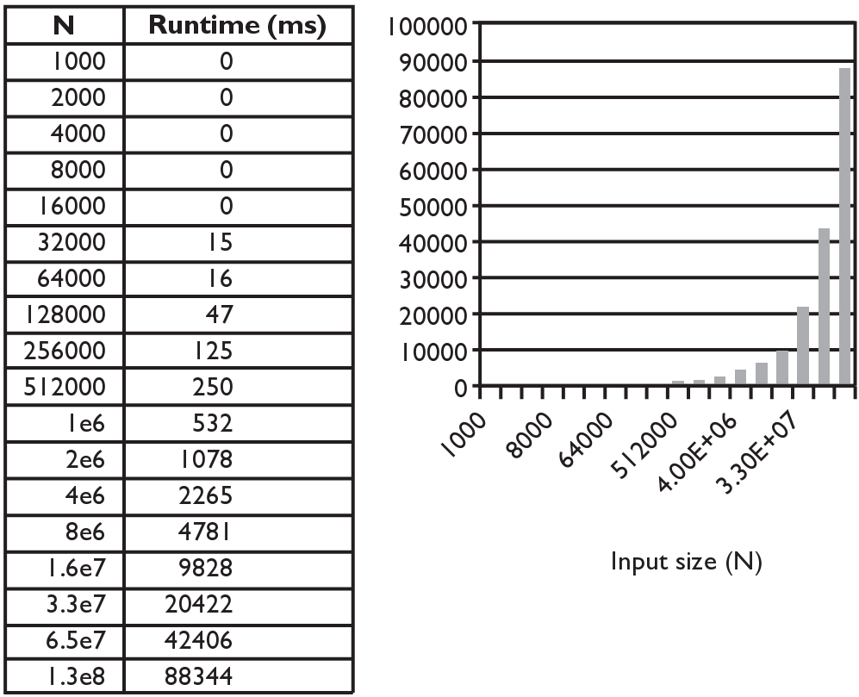
Merge sort runtime
How many comparisons does merge sort have to do?

Slide 10
Activity
merge sort the following list:
index | 0 | 1 | 2 | 3 | 4 | 5 | 6 | 7
value | 2 | 11 | 6 | 4 | -8 | 7 | 3 | 42

Slide 11
Sorting algorithms
bogo sort: shuffle and pray
bubble sort: swap adjacent pairs that are out of order
selection sort: look for the smallest element, move to front
insertion sort: build an increasingly large sorted front portion
merge sort: recursively divide the list in half and sort it
heap sort: place the values into a sorted tree structure
quick sort: recursively partition list based on a middle value
other specialized sorting algorithms:
bucket sort: cluster elements into smaller groups, sort them
radix sort: sort integers by last digit, then 2nd to last, then ...
...

