Slide 1
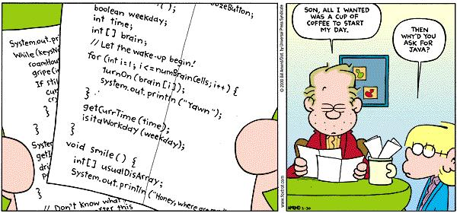
CS 142, Spring 2024
Lecture 1: introductions, review
Thank you to Marty Stepp and Stuart Reges for parts of these slides

Slide 2
Welcome to CS 142!
I'm Allison Obourn
Email: allison.obourn@edmonds.edu
Course website: https://allisonobourn.com/edmonds/142

Slide 3
CS 142
141: can automate basic tasks using a programming language (logic, control flow, decomposition)
142: can work with and create your own object classes and create graphical user interfaces
143: learn tools for automating complex tasks efficiently
  Reinforce abstraction (client vs. implementation)
  Data structures
  Algorithms

Slide 4
Being Successful
Determination, hard work, focus
Investing time (~15 hours a week)
  Starting early
  Developing problem-solving strategies
Knowing when to ask for help
  Talk to me after class, during office hours
  Go to the STEM study room or MESA study center
Studying together
  Projects 1 - 5 are individual but studying in groups pays off

Slide 5

Every quarter a few students complete everything EXCEPT the projects and are surprised they fail the class.
YOU CAN’T PASS UNLESS YOU DO THE PROJECTS

Slide 6
Logistics
Get to know https://allisonobourn.com/edmonds/142
Lab activities
  We will do lab activities every class. If you attend and participate you will get credit regardless of how many problems you complete.
Exercises
  Due Fridays and Mondays
  Meant as a practice aid
  Half credit if late
Quizzes

Slide 7


Programming projects 1 - 5
  Must be complete individually
  4 "free late days“; you can use a max of 3 on one assignment; -1 for subsequent days late

Slide 8
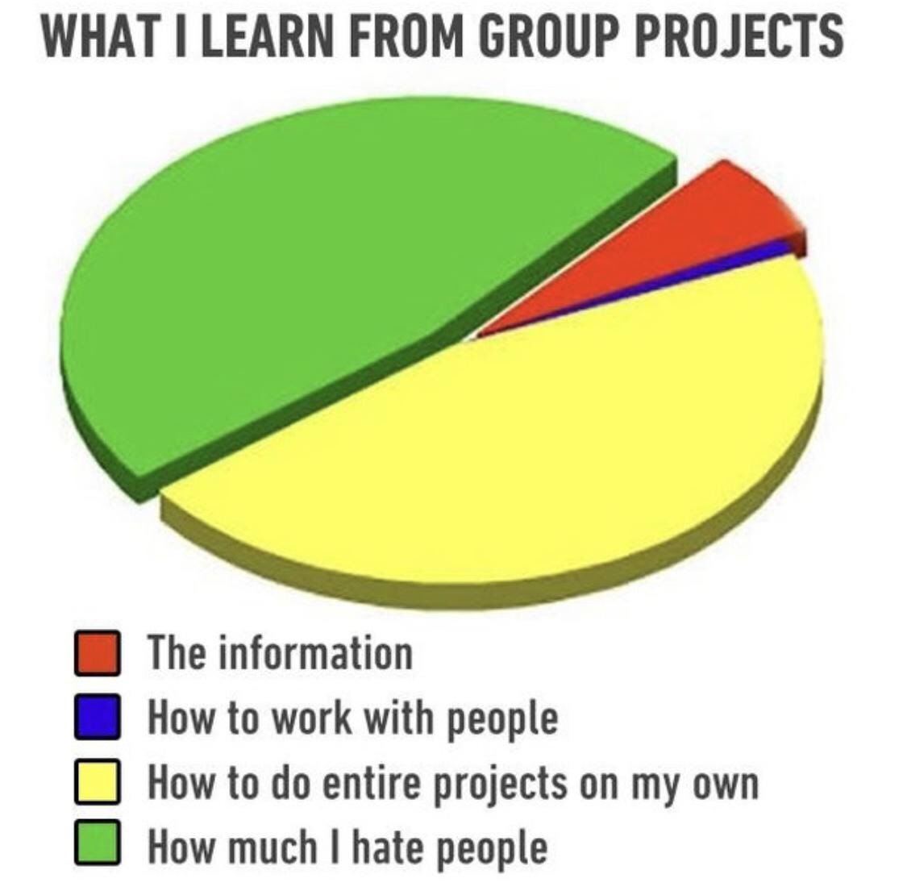

Group final project
  You will work in groups of 2 - 3
  Your group will create an animated simulation of your choosing.
  To improve your group work experience, there will be several intermediate deadlines to help you stay on track
  Your experience and final product will be much better if you write code together (viewing the same screen at the same time)

Slide 9
What are you still confused about?
  Although we expect you to be familiar with the material, we know everyone has areas where they struggle.
    141 Topics
    variables and expressions
    string manipulation
    boolean expressions
    if statements
    while loops
    for loops
    file I/O and reading from the console with Scanner
    arrays
    using objects like Scanner and Random
    creating your own objects

Slide 10
Array Review
index | 0 | 1 | 2 | 3 | 4 | 5 | 6 | 7 | 8 | 9
value | 12 | 49 | -2 | 26 | 5 | 17 | -6 | 84 | 72 | 3
element 0
element 4
element 9
array: object that stores many values of the same type.
  element: One value in an array.
  index: A 0-based integer to access an element from an array.

Slide 11
Array declaration
index | 0 | 1 | 2 | 3 | 4 | 5 | 6 | 7 | 8 | 9
value | 0 | 0 | 0 | 0 | 0 | 0 | 0 | 0 | 0 | 0
type[] name = new type[length];
  Example:
  int[] numbers = new int[10];

Slide 12
Array declaration, cont.
Type | Default value
int | 0
double | 0.0
boolean | false
String or other object | null (means, "no object")
The length can be any integer expression.
  int x = 2 * 3 + 1;
  int[] data = new int[x % 5 + 2];
Each element initially gets a "zero-equivalent" value.

Slide 13
Accessing elements
name[index] // access
name[index] = value; // modify
  Example:
  numbers[0] = 27;
  numbers[3] = -6;
  System.out.println(numbers[0]);
  if (numbers[3] < 0) {
  System.out.println("Element 3 is negative.");
  }
index | 0 | 1 | 2 | 3 | 4 | 5 | 6 | 7 | 8 | 9
value | 27 | 0 | 0 | -6 | 0 | 0 | 0 | 0 | 0 | 0
index | 0 | 1 | 2 | 3 | 4 | 5 | 6 | 7 | 8 | 9
value | 0 | 0 | 0 | 0 | 0 | 0 | 0 | 0 | 0 | 0

Slide 14
Accessing array elements
x
x | 3
index | 0 | 1 | 2 | 3 | 4 | 5 | 6 | 7
value
index | 0 | 1 | 2 | 3 | 4 | 5 | 6 | 7
value | 0 | 3 | 11 | 42 | 99 | 0 | 2 | 0
numbers
  int[] numbers = new int[8];
  numbers[1] = 3;
  numbers[4] = 99;
  numbers[6] = 2;
  int x = numbers[1];
  numbers[x] = 42;
  numbers[numbers[6]] = 11; // use numbers[6] as index

Slide 15
Arrays of other types
index | 0 | 1 | 2 | 3 | 4
value | 0.0 | 0.0 | 3.4 | 0.0 | -0.5
index | 0 | 1 | 2 | 3 | 4 | 5
value | false | false | false | true | false | false
  double[] results = new double[5];
  results[2] = 3.4;
  results[4] = -0.5;
  boolean[] tests = new boolean[6];
  tests[3] = true;

Slide 16
Out-of-bounds
index | 0 | 1 | 2 | 3 | 4 | 5 | 6 | 7 | 8 | 9
value | 0 | 0 | 0 | 0 | 0 | 0 | 0 | 0 | 0 | 0
Legal indexes: between 0 and the array's length - 1.
  Reading or writing any index outside this range will throw an ArrayIndexOutOfBoundsException.
Example:
  int[] data = new int[10];
  System.out.println(data[0]); // okay
  System.out.println(data[9]); // okay
  System.out.println(data[-1]); // exception
  System.out.println(data[10]); // exception

Slide 17
Arrays and for loops
index | 0 | 1 | 2 | 3 | 4 | 5 | 6 | 7
value | 0 | 2 | 4 | 6 | 8 | 10 | 12 | 14
It is common to use for loops to access array elements.
  for (int i = 0; i < 8; i++) {
  System.out.print(numbers[i] + " ");
  }
  System.out.println(); // output: 0 4 11 0 44 0 0 2
Sometimes we assign each element a value in a loop.
  for (int i = 0; i < 8; i++) {
  numbers[i] = 2 * i;
  }

Slide 18
The length field
An array's length field stores its number of elements.
  name.length
  for (int i = 0; i < numbers.length; i++) {
  System.out.print(numbers[i] + " ");
  }
  // output: 0 2 4 6 8 10 12 14
  It does not use parentheses like a String's .length().
What expressions refer to:
  The last element of any array?
  The middle element?

Slide 19
Limitations of arrays
You cannot resize an existing array:
  int[] a = new int[4];
  a.length = 10; // error
You cannot compare arrays with == or equals:
  int[] a1 = {42, -7, 1, 15};
  int[] a2 = {42, -7, 1, 15};
  if (a1 == a2) { ... } // false!
  if (a1.equals(a2)) { ... } // false!
An array does not know how to print itself:
  int[] a1 = {42, -7, 1, 15};
  System.out.println(a1); // [I@98f8c4]

Slide 20
The Arrays class
Method name | Description
binarySearch(array, value) | returns the index of the given value in a sorted array (or < 0 if not found)
copyOf(array, length) | returns a new copy of an array
equals(array1, array2) | returns true if the two arrays contain same elements in the same order
fill(array, value) | sets every element to the given value
sort(array) | arranges the elements into sorted order
toString(array) | returns a string representing the array, such as "[10, 30, -25, 17]"
Class Arrays in package java.util has useful static methods for manipulating arrays:
Syntax: Arrays.methodName(parameters)

Slide 21
Arrays.toString
Arrays.toString accepts an array as a parameter and returns a String representation of its elements.
  int[] e = {0, 2, 4, 6, 8};
  e[1] = e[3] + e[4];
  System.out.println("e is " + Arrays.toString(e));
  Output:
  e is [0, 14, 4, 6, 8]
  Must import java.util.*;

Slide 22
Weather question
Use an array to solve the weather problem:
  How many days' temperatures? 7
  Day 1's high temp: 45
  Day 2's high temp: 44
  Day 3's high temp: 39
  Day 4's high temp: 48
  Day 5's high temp: 37
  Day 6's high temp: 46
  Day 7's high temp: 53
  Average temp = 44.6
  4 days were above average.

Slide 23
Weather answer
// Reads temperatures from the user, computes average and # days above average.
import java.util.*;
public class Weather {
public static void main(String[] args) {
Scanner console = new Scanner(System.in);
System.out.print("How many days' temperatures? ");
int days = console.nextInt();
int[] temps = new int[days]; // array to store days' temperatures
int sum = 0;
for (int i = 0; i < days; i++) { // read/store each day's temperature
System.out.print("Day " + (i + 1) + "'s high temp: ");
temps[i] = console.nextInt();
sum += temps[i];
}
double average = (double) sum / days;
int count = 0; // see if each day is above average
for (int i = 0; i < days; i++) {
if (temps[i] > average) {
count++;
}
}
// report results
System.out.printf("Average temp = %.1f\n", average);
System.out.println(count + " days above average");
}
}

Slide 24
Quick array initialization
index | 0 | 1 | 2 | 3 | 4 | 5 | 6
value | 12 | 49 | -2 | 26 | 5 | 17 | -6
  type[] name = {value, value, … value};
  Example:
  int[] numbers = {12, 49, -2, 26, 5, 17, -6};
  Useful when you know what the array's elements will be
  The compiler figures out the size by counting the values

Slide 25
"Array mystery" problem
traversal: An examination of each element of an array.
What element values are stored in the following array?
  int[] a = {1, 7, 5, 6, 4, 14, 11};
  for (int i = 0; i < a.length - 1; i++) {
  if (a[i] > a[i + 1]) {
  a[i + 1] = a[i + 1] * 2;
  }
  }
index | 0 | 1 | 2 | 3 | 4 | 5 | 6
value
index | 0 | 1 | 2 | 3 | 4 | 5 | 6
value | 1 | 7 | 10 | 12 | 8 | 14 | 22

Slide 26
Weather question 2
Modify the weather program to print the following output:
  How many days' temperatures? 7
  Day 1's high temp: 45
  Day 2's high temp: 44
  Day 3's high temp: 39
  Day 4's high temp: 48
  Day 5's high temp: 37
  Day 6's high temp: 46
  Day 7's high temp: 53
  Average temp = 44.6
  4 days were above average.
  Temperatures: [45, 44, 39, 48, 37, 46, 53]
  Two coldest days: 37, 39
  Two hottest days: 53, 48

Slide 27
Weather answer 2
// Reads temperatures from the user, computes average and # days above average.
import java.util.*;
public class Weather2 {
public static void main(String[] args) {
...
int[] temps = new int[days]; // array to store days' temperatures
... (same as Weather program)
// report results
System.out.printf("Average temp = %.1f\n", average);
System.out.println(count + " days above average");
System.out.println("Temperatures: " + Arrays.toString(temps));
Arrays.sort(temps);
System.out.println("Two coldest days: " + temps[0] + ", " + temps[1]);
System.out.println("Two hottest days: " + temps[temps.length - 1] +
", " + temps[temps.length - 2]);
}
}

Slide 28
Array reversal question
Write code that reverses the elements of an array.
  For example, if the array initially stores:
  [11, 42, -5, 27, 0, 89]
  Then after your reversal code, it should store:
  [89, 0, 27, -5, 42, 11]
    The code should work for an array of any size.
    Hint: think about swapping various elements...

Slide 29
Algorithm idea
Swap pairs of elements from the edges; work inwards:
index | 0 | 1 | 2 | 3 | 4 | 5
value | 11 | 42 | -5 | 27 | 0 | 89
index | 0 | 1 | 2 | 3 | 4 | 5
value | 89 | 42 | -5 | 27 | 0 | 11
index | 0 | 1 | 2 | 3 | 4 | 5
value | 89 | 0 | -5 | 27 | 42 | 11
index | 0 | 1 | 2 | 3 | 4 | 5
value | 89 | 0 | 27 | -5 | 42 | 11

Slide 30
Swapping values
  public static void main(String[] args) {
  int a = 7;
  int b = 35;
  // swap a with b?
  a = b;
  b = a;
  System.out.println(a + " " + b);
  }
  What is wrong with this code? What is its output?
The red code should be replaced with:
  int temp = a;
  a = b;
  b = temp;

Slide 31
Flawed algorithm
What's wrong with this code?
int[] numbers = [11, 42, -5, 27, 0, 89];
// reverse the array
for (int i = 0; i < numbers.length; i++) {
int temp = numbers[i];
numbers[i] = numbers[numbers.length - 1 - i];
numbers[numbers.length - 1 - i] = temp;
}
The loop goes too far and un-reverses the array! Fixed version:
for (int i = 0; i < numbers.length / 2; i++) {
int temp = numbers[i];
numbers[i] = numbers[numbers.length - 1 - i];
numbers[numbers.length - 1 - i] = temp;
}

Slide 32
Array reverse question 2
Turn your array reversal code into a reverse method.
  Accept the array of integers to reverse as a parameter.
  int[] numbers = {11, 42, -5, 27, 0, 89};
  reverse(numbers);
  How do we write methods that accept arrays as parameters?
  Will we need to return the new array contents after reversal?
  ...

Slide 33
Array parameter (declare)
public static type methodName(type[] name) {
Example:
// Returns the average of the given array of numbers.
public static double average(int[] numbers) {
int sum = 0;
for (int i = 0; i < numbers.length; i++) {
sum += numbers[i];
}
return (double) sum / numbers.length;
}
  You don't specify the array's length (but you can examine it).

Slide 34
Array parameter (call)
methodName(arrayName);
Example:
public class MyProgram {
public static void main(String[] args) {
// figure out the average TA IQ
int[] iq = {126, 84, 149, 167, 95};
double avg = average(iq);
System.out.println("Average IQ = " + avg);
}
...
  Notice that you don't write the [] when passing the array.

Slide 35
Array return (declare)
public static type[] methodName(parameters) {
Example:
// Returns a new array with two copies of each value.
// Example: [1, 4, 0, 7] -> [1, 1, 4, 4, 0, 0, 7, 7]
public static int[] double(int[] numbers) {
int[] result = new int[2 * numbers.length];
for (int i = 0; i < numbers.length; i++) {
result[2 * i] = numbers[i];
result[2 * i + 1] = numbers[i];
}
return result;
}

Slide 36
Array return (call)
type[] name = methodName(parameters);
Example:
public class MyProgram {
public static void main(String[] args) {
int[] iq = {126, 84, 149, 167, 95};
int[] doubled = double(iq);
System.out.println(Arrays.toString(doubled));
}
...
Output:
[126, 126, 84, 84, 149, 149, 167, 167, 95, 95]

Slide 37
A swap method?
Does the following swap method work? Why or why not?
  public static void main(String[] args) {
  int a = 7;
  int b = 35;
  // swap a with b?
  swap(a, b);
  System.out.println(a + " " + b);
  }
  public static void swap(int a, int b) {
  int temp = a;
  a = b;
  b = temp;
  }
Notes:
It's basically not possible to write a swap method that accepts two ints.
swap can't escape from itself to modify the outside world.
(sort of like the villains in the holodeck on Star Trek; they can wreak havoc in their holo-world, but they can't leave and attack the real Enterprise outside.)

Slide 38
Value semantics
value semantics: Behavior where values are copied when assigned, passed as parameters, or returned.
  All primitive types in Java use value semantics.
  When one variable is assigned to another, its value is copied.
  Modifying the value of one variable does not affect others.
  int x = 5;
  int y = x; // x = 5, y = 5
  y = 17; // x = 5, y = 17
  x = 8; // x = 8, y = 17

Slide 39
Reference semantics (objects)
reference semantics: Behavior where variables actually store the address of an object in memory.
  When one variable is assigned to another, the object is
  not copied; both variables refer to the same object.
  Modifying the value of one variable will affect others.
  int[] a1 = {4, 15, 8};
  int[] a2 = a1; // refer to same array as a1
  a2[0] = 7;
  System.out.println(Arrays.toString(a1)); // [7, 15, 8]
index | 0 | 1 | 2
value | 4 | 15 | 8
index | 0 | 1 | 2
value | 7 | 15 | 8
a1
a2

Slide 40

References and objects
Arrays and objects use reference semantics. Why?
  efficiency. Copying large objects slows down a program.
  sharing. It's useful to share an object's data among methods.
  DrawingPanel panel1 = new DrawingPanel(80, 50);
  DrawingPanel panel2 = panel1; // same window
  panel2.setBackground(Color.CYAN);
panel1
panel2

Slide 41

Objects as parameters
When an object is passed as a parameter, the object is not copied. The parameter refers to the same object.
  If the parameter is modified, it will affect the original object.
  public static void main(String[] args) {
  DrawingPanel window = new DrawingPanel(80, 50);
  window.setBackground(Color.YELLOW);
  example(window);
  }
  public static void example(DrawingPanel panel) {
  panel.setBackground(Color.CYAN);
  ...
  }
window
panel
Notes:
Note: This is also the reason that it works when you pass the Graphics g as a parameter to a method, because it is drawing with the same pen object onto the same window.

Slide 42
Arrays pass by reference
iq
index | 0 | 1 | 2
value | 126 | 167 | 95
index | 0 | 1 | 2
value | 252 | 334 | 190
a
Arrays are passed as parameters by reference.
  Changes made in the method are also seen by the caller.
  public static void main(String[] args) {
  int[] iq = {126, 167, 95};
  increase(iq);
  System.out.println(Arrays.toString(iq));
  }
  public static void increase(int[] a) {
  for (int i = 0; i < a.length; i++) {
  a[i] = a[i] * 2;
  }
  }
  Output:
  [252, 334, 190]

Slide 43
Array reverse question 2
Turn your array reversal code into a reverse method.
  Accept the array of integers to reverse as a parameter.
  int[] numbers = {11, 42, -5, 27, 0, 89};
  reverse(numbers);
Solution:
  public static void reverse(int[] numbers) {
  for (int i = 0; i < numbers.length / 2; i++) {
  int temp = numbers[i];
  numbers[i] = numbers[numbers.length - 1 - i];
  numbers[numbers.length - 1 - i] = temp;
  }
  }

