Slide 1
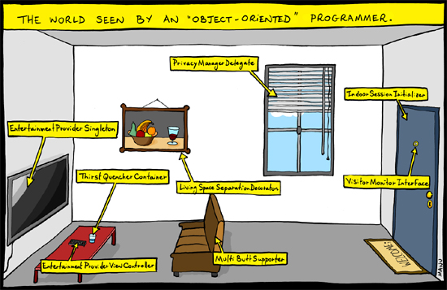
CS 142, Spring 2024
Lecture 2: Review and introduction to Lists
Thanks to Marty Stepp and Stuart Reges for parts of these slides!

Slide 2
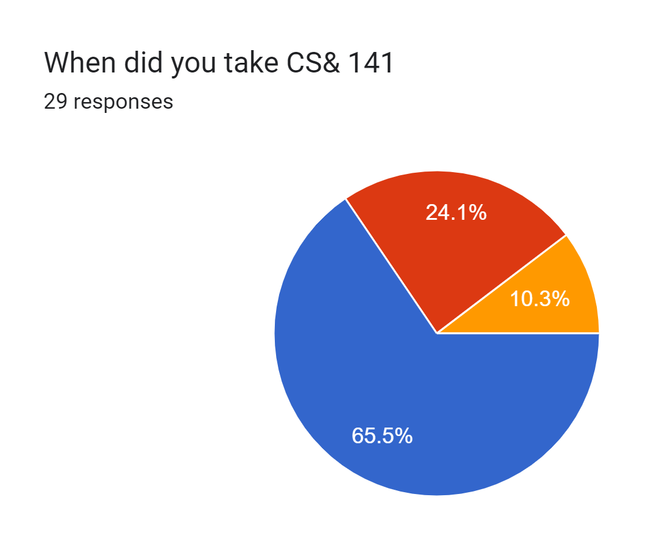
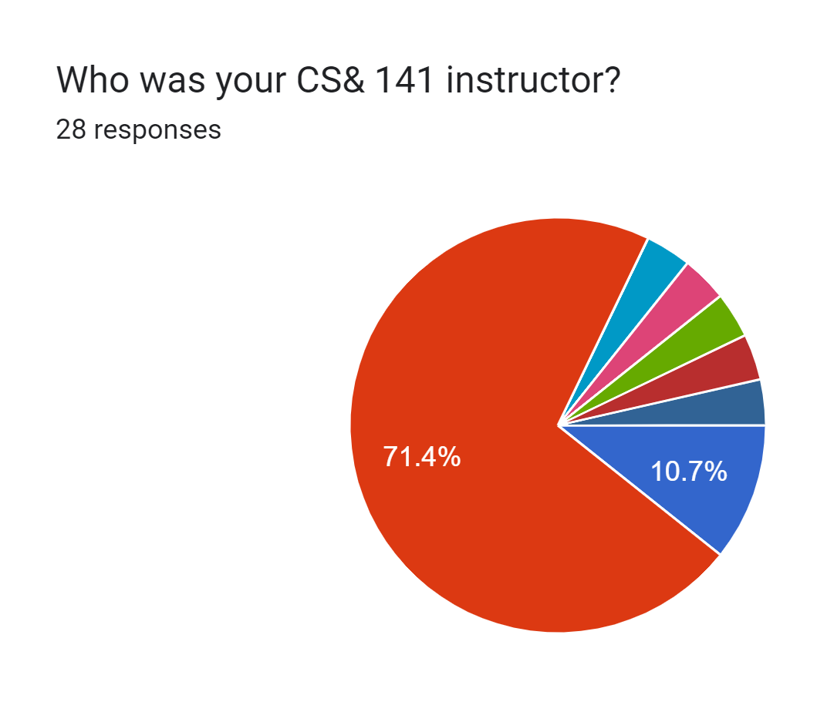


Survey Results

Slide 3
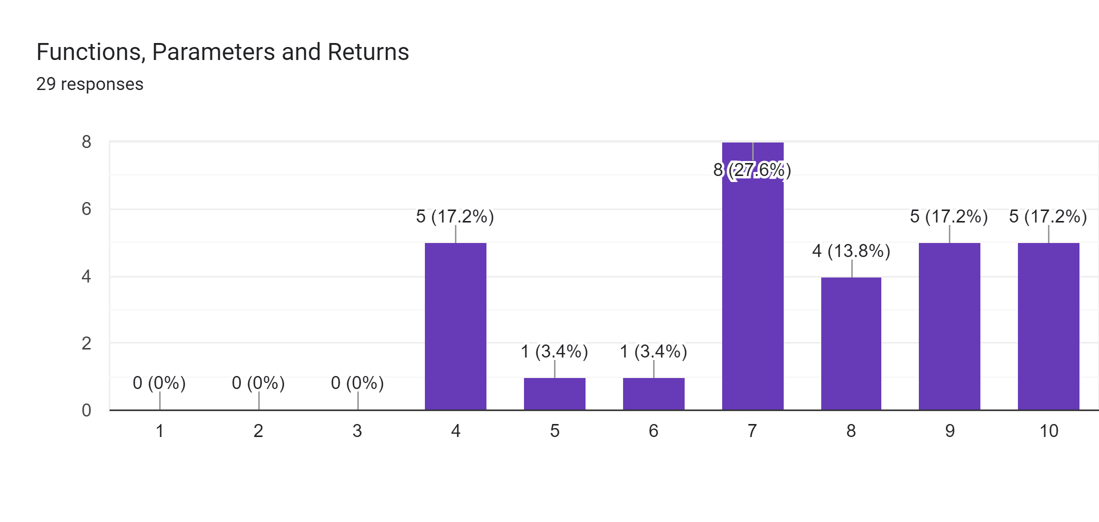
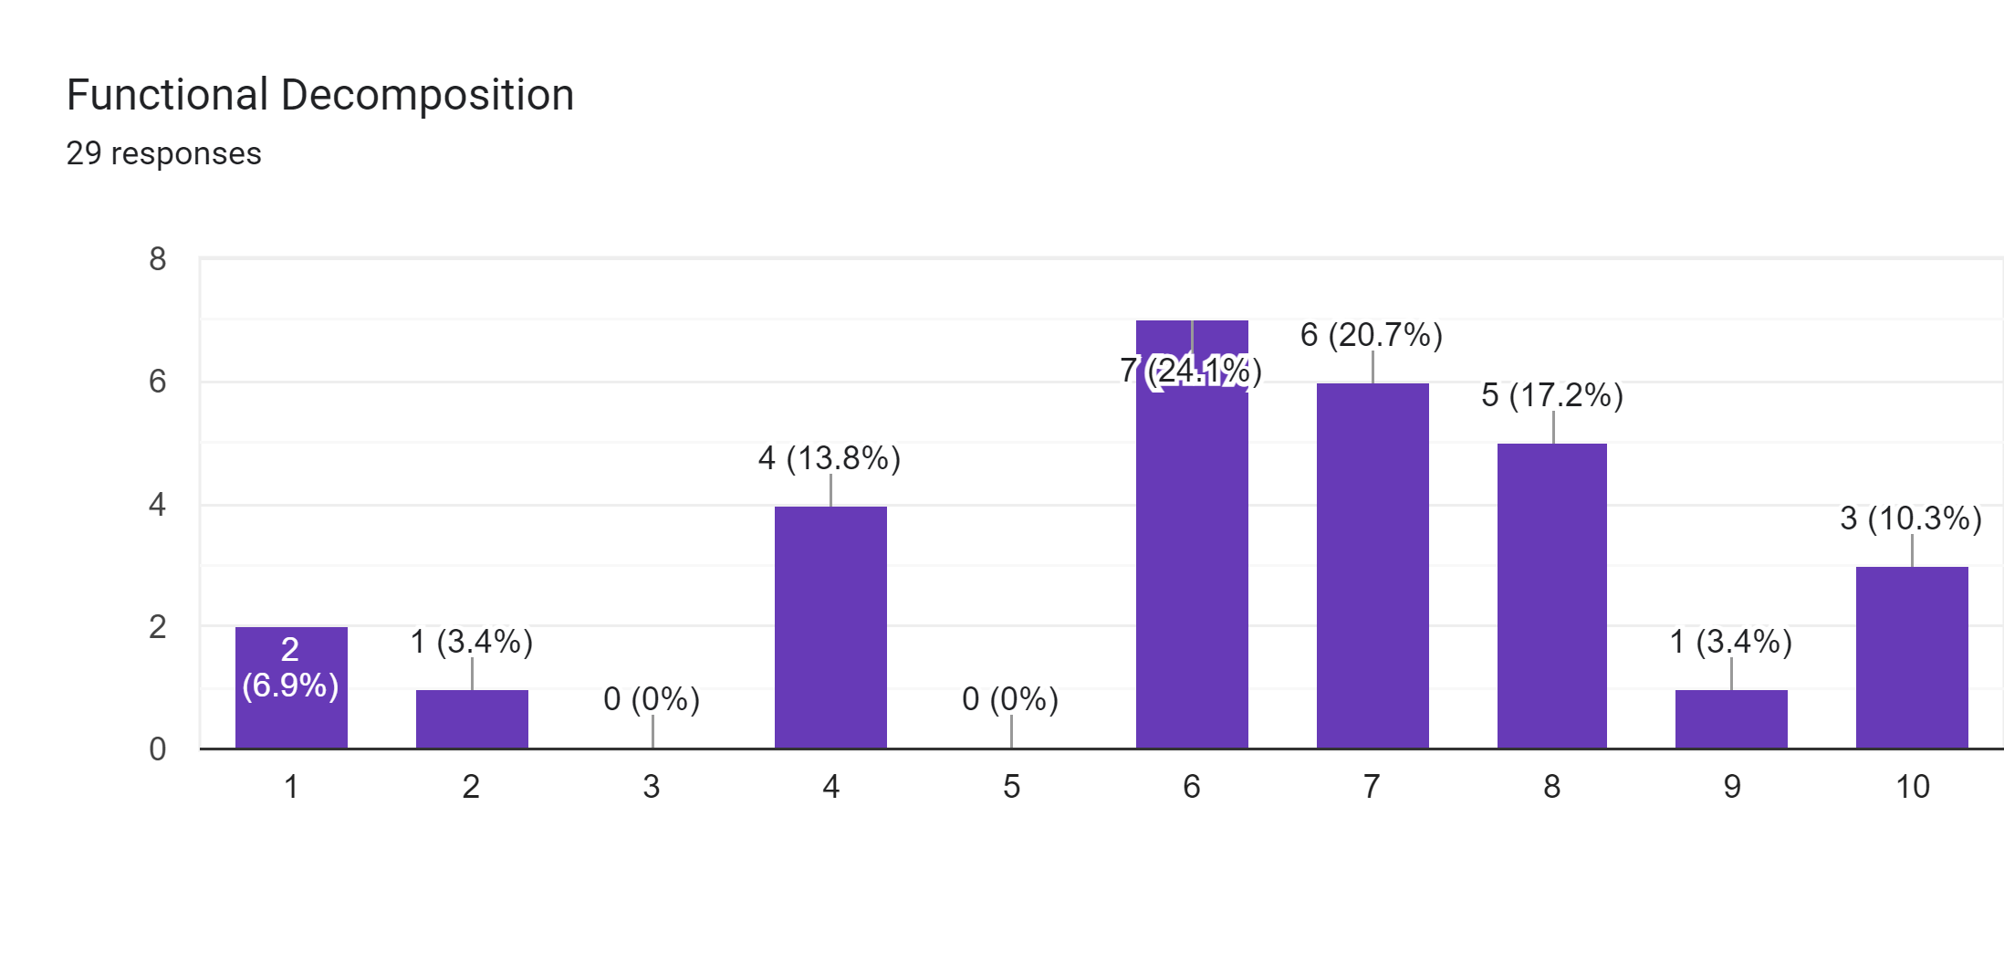
Topic Survey Results
Most students indicated they were pretty comfortable with:
variables
expressions
for loops
while loops
if/else statements
Boolean logic

Slide 4
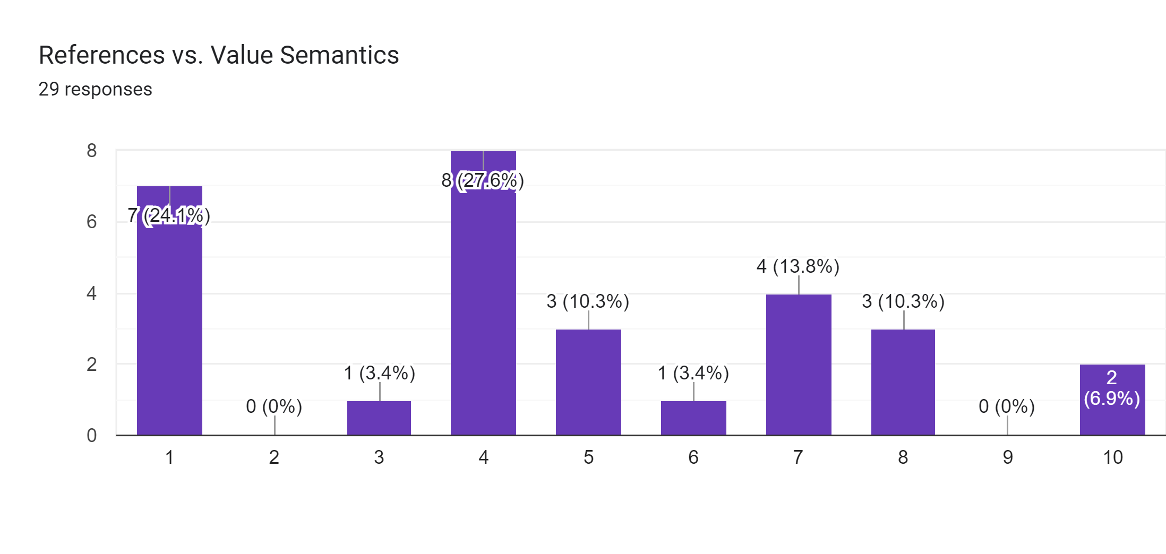
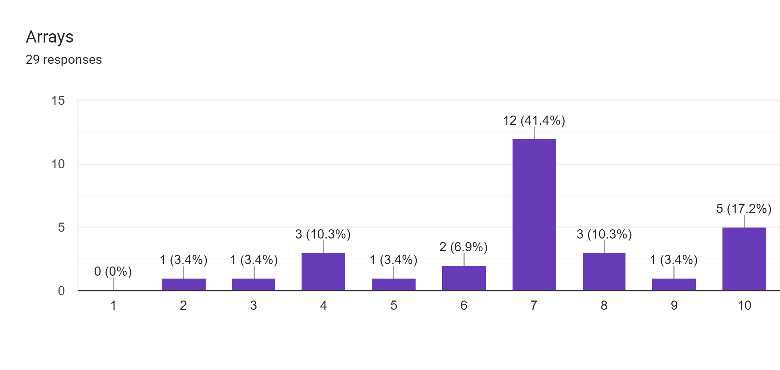
Topic Survey Results
Methods, how parameters are passed to them and how and when to create them appears to be an area many students are unsure about

Slide 5
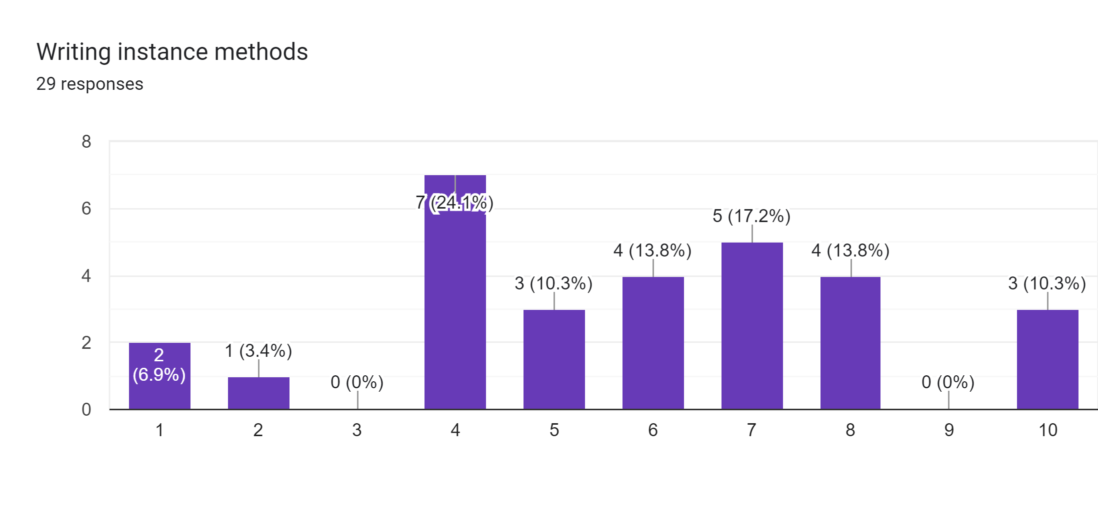

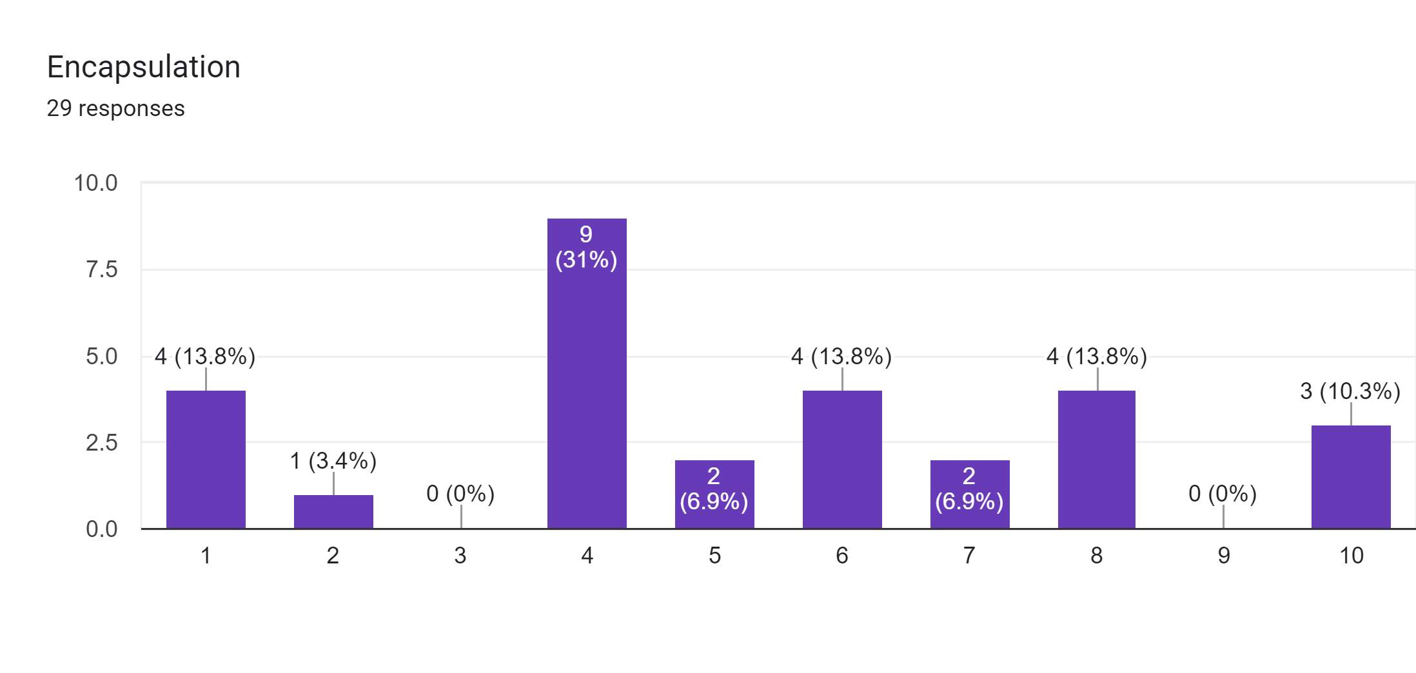
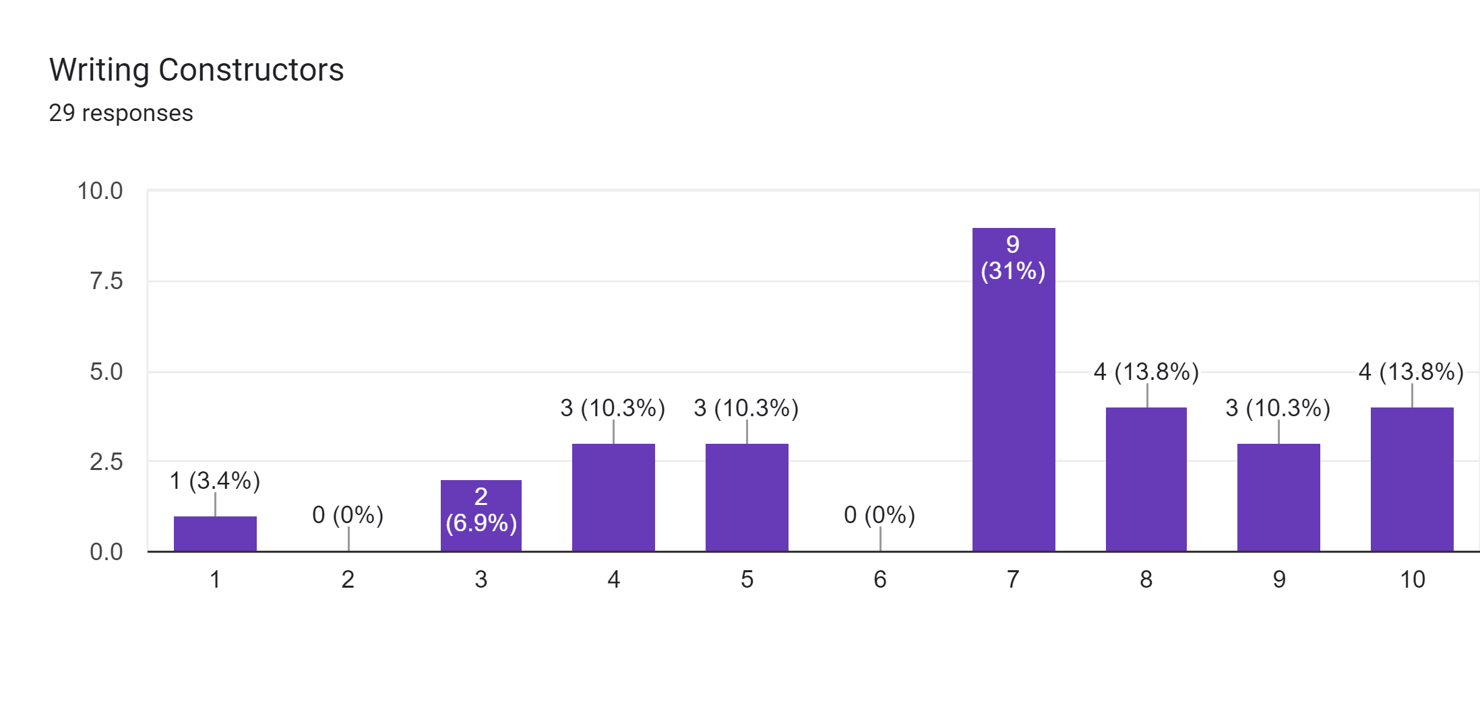
Topic Survey: Objects

Slide 6
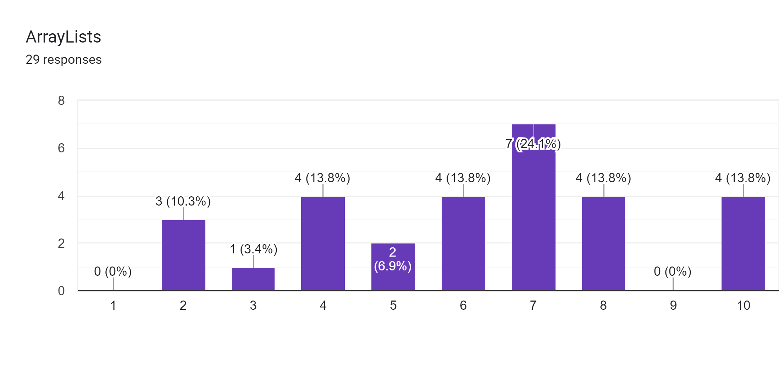
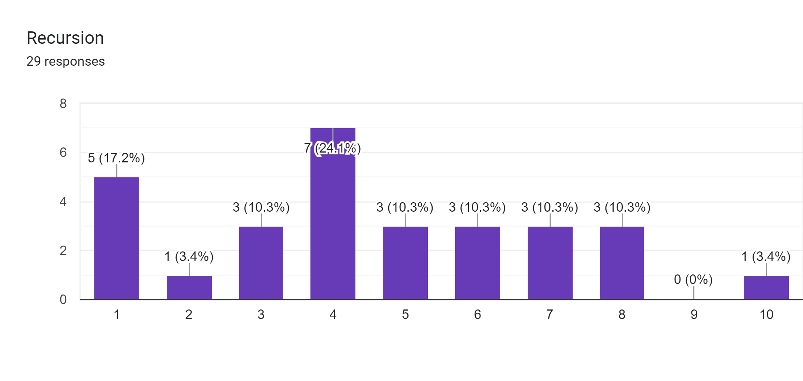
Topic Survey: Advanced
I do not expect you to know either of these topics!
I only asked as I know a few instructors like to discuss them very briefly in CS& 141.

Slide 7
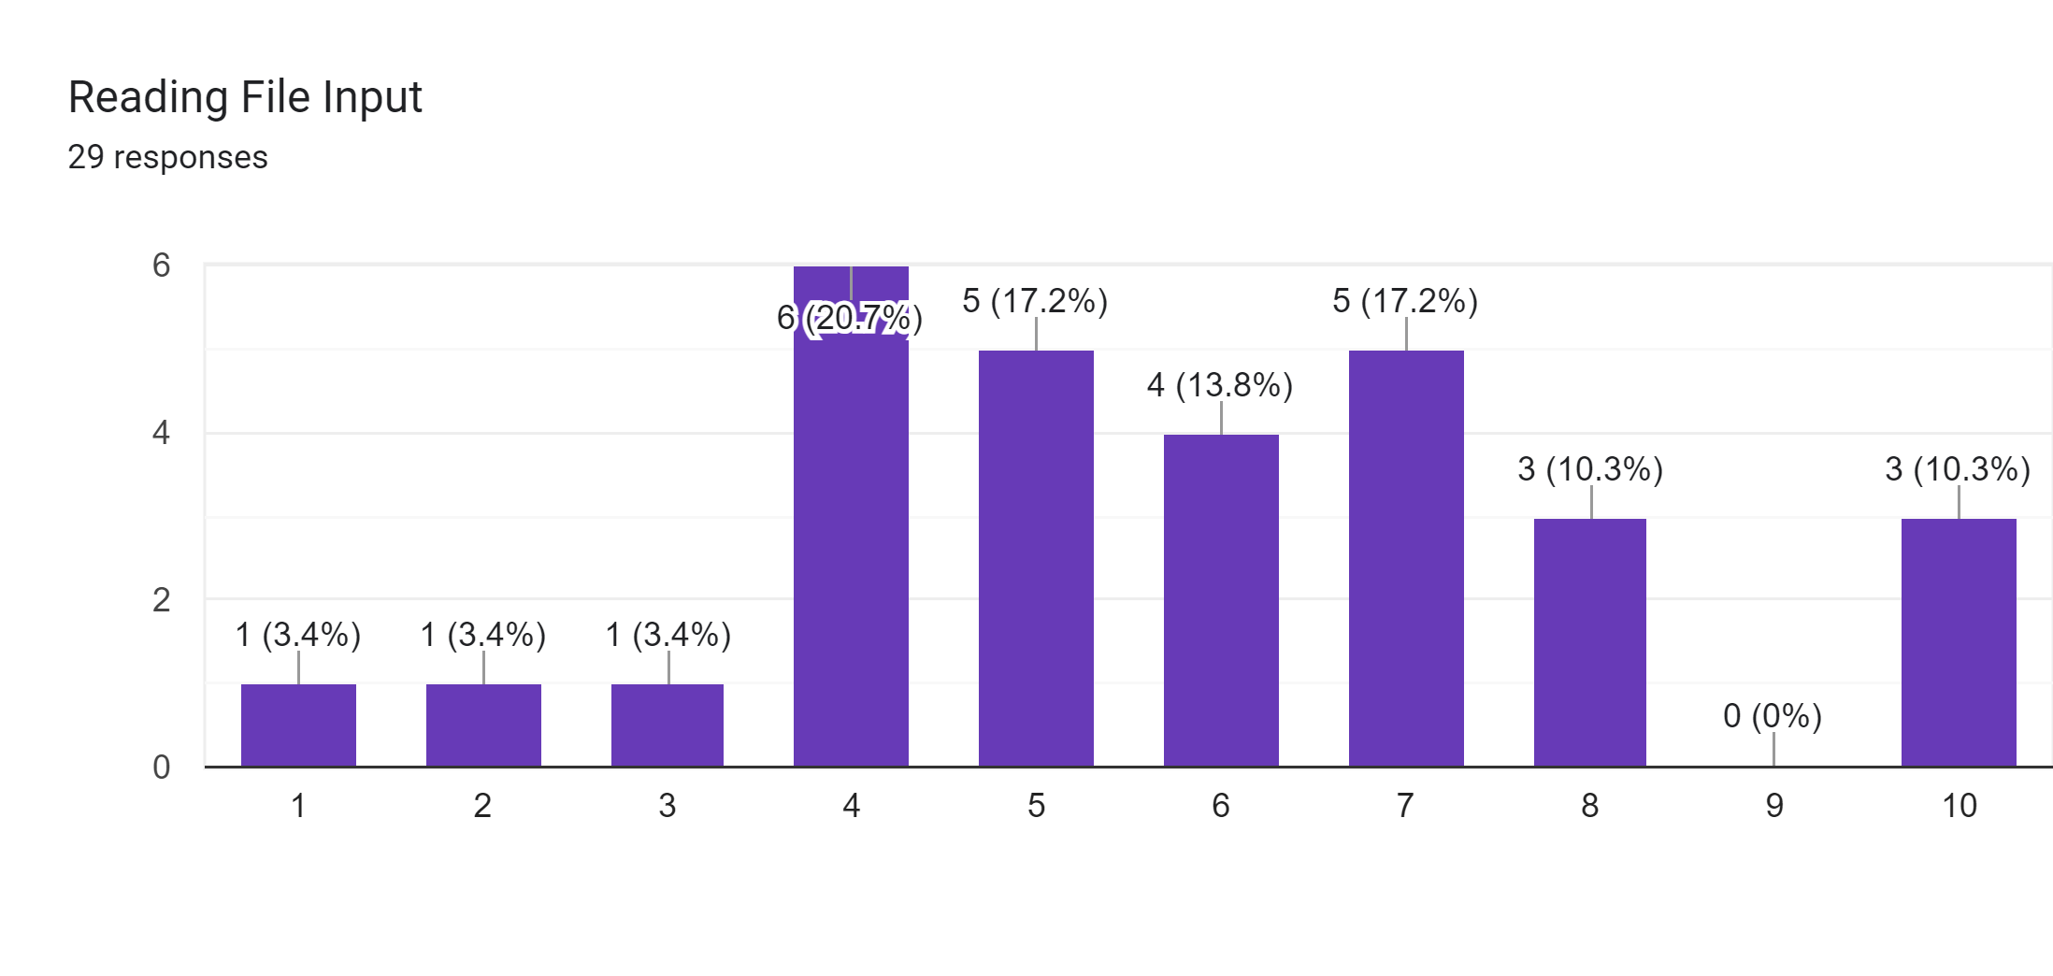

Topic Survey: Needing Review
We will review how to work with files and what is and isn’t good style.

Slide 8
What does this code do?
public static void main(String[] args) {
int a = 7;
int b = 35;
int[] list = {2, 14};
change(a, b, list);
System.out.println(a + " " + b + list[0] + list[1]);
}
public static void change(int a, int b, int[] list) {
a = b;
list[0] = list[1];
System.out.println(a + " " + b + list[0] + list[1]);
}
What does this code do?

Slide 9
Value semantics
value semantics: Behavior where values are copied when assigned, passed as parameters, or returned.
All primitive types in Java use value semantics.
When one variable is assigned to another, its value is copied.
Modifying the value of one variable does not affect others.
int x = 5;
int y = x; // x = 5, y = 5
y = 17; // x = 5, y = 17
x = 8; // x = 8, y = 17

Slide 10
Reference semantics (objects)
reference semantics: Behavior where variables actually store the address of an object in memory.
When one variable is assigned to another, the object is not copied; both variables refer to the same object.
Modifying the value of one variable will affect others.
int[] a1 = {4, 15, 8};
int[] a2 = a1; // refer to same array as a1
a2[0] = 7;
System.out.println(Arrays.toString(a1)); // [7, 15, 8]
index | 0 | 1 | 2
value | 4 | 15 | 8
index | 0 | 1 | 2
value | 7 | 15 | 8
a1
a2

Slide 11
Arrays pass by reference
iq
index | 0 | 1 | 2
value | 126 | 167 | 95
index | 0 | 1 | 2
value | 252 | 334 | 190
a
Arrays are passed as parameters by reference.
Changes made in the method are also seen by the caller.
public static void main(String[] args) {
int[] iq = {126, 167, 95};
increase(iq);
System.out.println(Arrays.toString(iq));
}
public static void increase(int[] a) {
for (int i = 0; i < a.length; i++) {
a[i] = a[i] * 2;
}
}
Output:
[252, 334, 190]

Slide 12

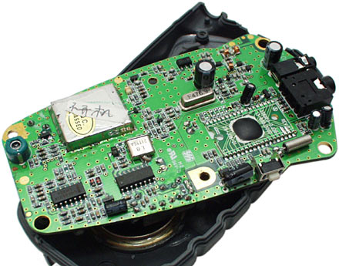
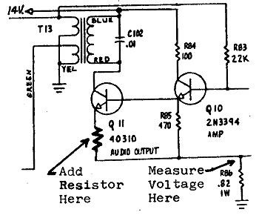
Abstraction
abstraction: A distancing between ideas and details.
We can use objects without knowing how they work.
abstraction in a cell phone:
You understand its external behavior (buttons, screen).
You don't understand its inner details, and you don't need to.

Slide 13

Blueprint analogy
iPhone blueprint
state: current song volume battery life
behavior: power on/off change station/song change volume choose random song
creates
iPhone #1
state: song = "1,000,000 Miles" volume = 17 battery life = 2.5 hrs
behavior: power on/off change station/song change volume choose random song
iPhone #2
state: song = "Letting You" volume = 9 battery life = 3.41 hrs
behavior: power on/off change station/song change volume choose random song
iPhone #3
state: song = "Discipline" volume = 24 battery life = 1.8 hrs
behavior: power on/off change station/song change volume choose random song

Slide 14
Point objects (desired)
Point p1 = new Point(5, -2);
Point p2 = new Point(); // origin, (0, 0)
Data in each Point object:
Methods in each Point object:
Field name | Description
x | the point's x-coordinate
y | the point's y-coordinate
Method name | Description
setLocation(x, y) | sets the point's x and y to the given values
translate(dx, dy) | adjusts the point's x and y by the given amounts
distance(p) | how far away the point is from point p
draw(g) | displays the point on a drawing panel

Slide 15
Fields
field: A variable inside an object that is part of its state.
Each object has its own copy of each field.
Declaration syntax:
type name;
Example:
public class Student {
String name; // each Student object has a
double gpa; // name and gpa field
}

Slide 16
Instance methods
instance method (or object method): Exists inside each object of a class and gives behavior to each object.
public type name(parameters) {
statements;
}
same syntax as static methods, but without static keyword
Example:
public void shout() {
System.out.println("HELLO THERE!");
}

Slide 17
Point objects w/ method
Each Point object has its own copy of the draw method, which operates on that object's state:
Point p1 = new Point();
p1.x = 7;
p1.y = 2;
Point p2 = new Point();
p2.x = 4;
p2.y = 3;
p1.draw(g);
p2.draw(g);
p1
public void draw(Graphics g) {
// this code can see p1's x and y
}
x | 7 | y | 2
public void draw(Graphics g) {
// this code can see p2's x and y
}
x | 4 | y | 3
p2

Slide 18
Class example with methods
public class Point {
int x;
int y;
public void translate(int dx, int dy) {
x = x + dx;
y = y + dy;
}
public double distanceFromOrigin() {
return Math.sqrt(x * x + y * y);
}
}

Slide 19
Constructors
constructor: Initializes the state of new objects.
public type(parameters) {
statements;
}
runs when the client uses the new keyword
no return type is specified; it implicitly "returns" the new object being created
If a class has no constructor, Java gives it a default constructor with no parameters that sets all fields to 0.

Slide 20
Multiple constructors
A class can have multiple constructors.
Each one must accept a unique set of parameters.
Exercise: Write a Point constructor with no parameters that initializes the point to (0, 0).
// Constructs a new point at (0, 0).
public Point() {
x = 0;
y = 0;
}

Slide 21
Printing objects
By default, Java doesn't know how to print objects:
Point p = new Point();
p.x = 10;
p.y = 7;
System.out.println("p is " + p); // p is Point@9e8c34
// better, but cumbersome; p is (10, 7)
System.out.println("p is (" + p.x + ", " + p.y + ")");
// desired behavior
System.out.println("p is " + p); // p is (10, 7)

Slide 22
The toString method
tells Java how to convert an object into a String
Point p1 = new Point(7, 2);
System.out.println("p1: " + p1);
// the above code is really calling the following:
System.out.println("p1: " + p1.toString());
Every class has a toString, even if it isn't in your code.
Default: class's name @ object's memory address (base 16)
Point@9e8c34

Slide 23
toString syntax
public String toString() {
code that returns a String representing this object;
}
Method name, return, and parameters must match exactly.
Example:
// Returns a String representing this Point.
public String toString() {
return "(" + x + ", " + y + ")";
}

Slide 24
Private fields
A field can be declared private.
No code outside the class can access or change it.
private type name;
Examples:
private int id;
private String name;
Client code sees an error when accessing private fields:
PointMain.java:11: x has private access in Point
System.out.println("p1 is (" + p1.x + ", " + p1.y + ")");
^

Slide 25
Accessing private state
We can provide methods to get and/or set a field's value:
// A "read-only" access to the x field ("accessor")
public int getX() {
return x;
}
// Allows clients to change the x field ("mutator")
public void setX(int newX) {
x = newX;
}
Client code will look more like this:
System.out.println("p1: (" + p1.getX() + ", " + p1.getY() + ")");
p1.setX(14);

Slide 26
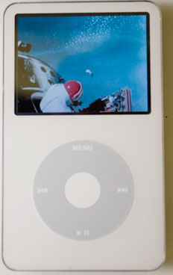
Encapsulation
encapsulation: Hiding implementation details of an object from its clients.
Encapsulation provides abstraction.
separates external view (behavior) from internal view (state)
Encapsulation protects the integrity of an object's data.

