Slide 1
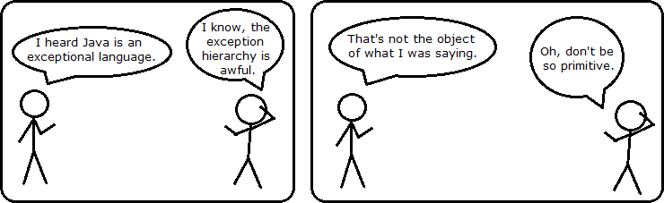
CS 142
Lecture 3: Class and object review; ArrayLists
http://www.alexsweet.co.uk/comics.php?comic=2
Thanks to Marty Stepp and Stuart Reges for parts of these slides

Slide 2
Recall: Point Class
public class Point {
int x;
int y;
public void translate(int dx, int dy) {
x = x + dx;
y = y + dy;
}
public double distanceFromOrigin() {
return Math.sqrt(x * x + y * y);
}
}
public class PointMain {
public static void main(String[] args) {
Point p = new Point();
p.x = 4;
p.x = 5;
System.out.println("(" + p.x + ", " + p.y + ")");
}
}
Wouldn’t it be nice if we could create a Point with x and y set from the beginning?

Slide 3
Constructors
constructor: Initializes the state of new objects.
public type(parameters) {
statements;
}
runs when the client uses the new keyword
no return type is specified; it implicitly "returns" the new object being created
If a class has no constructor, Java gives it a default constructor with no parameters that sets all fields to 0.

Slide 4
Multiple constructors
A class can have multiple constructors.
Each one must accept a unique set of parameters.
Exercise: Write a Point constructor with no parameters that initializes the point to (0, 0).
// Constructs a new point at (0, 0).
public Point() {
x = 0;
y = 0;
}

Slide 5
Private fields
A field can be declared private.
No code outside the class can access or change it.
private type name;
Examples:
private int id;
private String name;
Client code sees an error when accessing private fields:
PointMain.java:11: x has private access in Point
System.out.println("p1 is (" + p1.x + ", " + p1.y + ")");
^

Slide 6
Accessing private state
We can provide methods to get and/or set a field's value:
// A "read-only" access to the x field ("accessor")
public int getX() {
return x;
}
// Allows clients to change the x field ("mutator")
public void setX(int newX) {
x = newX;
}
Client code will look more like this:
System.out.println("p1: (" + p1.getX() + ", " + p1.getY() + ")");
p1.setX(14);

Slide 7


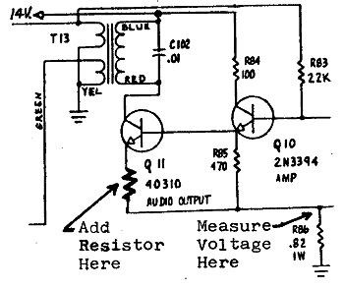
Encapsulation
encapsulation: Hiding implementation details of an object from its clients.
Encapsulation provides abstraction.
separates external view (behavior) from internal view (state)
Encapsulation protects the integrity of an object's data.

Slide 8
From Last Time: Array Limitations
Fixed-size
Adding or removing from middle is hard
Not much built-in functionality (need Arrays class)

Slide 9
Java's fix: List Abstraction
Like an array that resizes to fit its contents.
When a list is created, it is initially empty.
[]
Use add methods to add to different locations in list
[hello, ABC, goodbye, okay]
The list object keeps track of the element values that have been added to it, their order, indexes, and its total size.
You can add, remove, get, set, ... any index at any time.

Slide 10
ArrayList implementation
What is an ArrayList's behavior?
add, remove, indexOf, etc
What is an ArrayList's state?
Many elements of the same type
For example, unfilled array
index | 0 | 1 | 2 | 3 | 4 | 5 | 6 | ... | 98 | 99
value | 17 | 932085 | -32053278 | 100 | 3 | 0 | 0 | ... | 0 | 0
size | 5

Slide 11
ArrayIntList implementation
Starting out simpler than Java's built-in ArrayList
Only stores ints
Fewer methods: add(value), add(index, value), get(index), set(index, value), size(), isEmpty(), remove(index), indexOf(value), contains(value), toString(),
Fields?
int[]
int to keep track of the number of elements added
The default capacity (array length) will be 10

Slide 12
Implementing add
How do we add to the end of a list?
public void add(int value) { // just put the element
list[size] = value; // in the last slot,
size++; // and increase the size
}
list.add(42);
index | 0 | 1 | 2 | 3 | 4 | 5 | 6 | 7 | 8 | 9
value | 3 | 8 | 9 | 7 | 5 | 12 | 0 | 0 | 0 | 0
size | 6
index | 0 | 1 | 2 | 3 | 4 | 5 | 6 | 7 | 8 | 9
value | 3 | 8 | 9 | 7 | 5 | 12 | 42 | 0 | 0 | 0
size | 7

Slide 13
Printing an ArrayIntList
How can we make our ArrayIntList print out nicely?
We can write a toString method!
Tells Java how to convert an object into a String
ArrayIntList list = new ArrayIntList();
System.out.println("list is " + list);
// ("list is " + list.toString());
Syntax:
public String toString() {
code that returns a suitable String;
}

Slide 14
Preconditions
precondition: Something your method assumes is true at the start of its execution.
Often documented as a comment on the method's header:
// Returns the element at the given index.
// Precondition: 0 <= index < size
public int get(int index) {
return elementData[index];
}
Stating a precondition doesn't really "solve" the problem, but it at least documents our decision and warns the client what not to do.
What if we want to actually enforce the precondition?

Slide 15
Bad precondition test
What is wrong with the following way to handle violations?
// Returns the element at the given index.
// Precondition: 0 <= index < size
public int get(int index) {
if (index < 0 || index >= size) {
System.out.println("Bad index! " + index);
return -1;
}
return elementData[index];
}
returning -1 no better than returning 0 (could be legal value)
println is not a very strong deterrent to the client (esp. GUI)

Slide 16
Throwing exceptions
throw new ExceptionType();
throw new ExceptionType("message");
Generates an exception that will crash the program, unless it has code to handle ("catch") the exception.
Common exception types:
ArithmeticException, ArrayIndexOutOfBoundsException, FileNotFoundException, IllegalArgumentException, IllegalStateException, IOException, NoSuchElementException, NullPointerException, RuntimeException, UnsupportedOperationException
Why would anyone ever want a program to crash?

Slide 17
Exception example
public int get(int index) {
if (index < 0 || index >= size) {
throw new ArrayIndexOutOfBoundsException(index);
}
return elementData[index];
}

