Slide 1
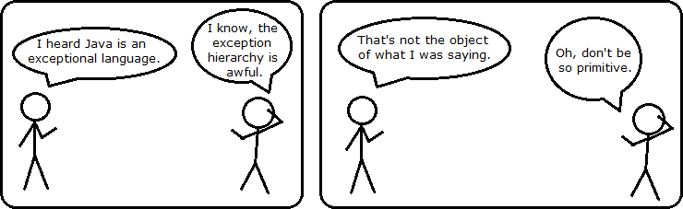
CS 142
Lecture 6: searching; using ArrayLists
Thanks to Marty Stepp and Stuart Reges for parts of these slides

Slide 2
Sequential search
sequential search: Locates a target value in an array / list by examining each element from start to finish. Use to write indexOf.
How many elements will it need to examine?
Example: Searching the array below for the value 42:
The array is sorted. How can we take advantage of this?
index | 0 | 1 | 2 | 3 | 4 | 5 | 6 | 7 | 8 | 9 | 10 | 11 | 12 | 13 | 14 | 15 | 16
value | -4 | 2 | 7 | 10 | 15 | 20 | 22 | 25 | 30 | 36 | 42 | 50 | 56 | 68 | 85 | 92 | 103
i

Slide 3
Binary search
binary search: Locates a target value in a sorted array or list by successively eliminating half of the array from consideration.
How many elements will it need to examine?
Example: Searching the array below for the value 42:
index | 0 | 1 | 2 | 3 | 4 | 5 | 6 | 7 | 8 | 9 | 10 | 11 | 12 | 13 | 14 | 15 | 16
value | -4 | 2 | 7 | 10 | 15 | 20 | 22 | 25 | 30 | 36 | 42 | 50 | 56 | 68 | 85 | 92 | 103
min
mid
max

Slide 4
Arrays.binarySearch
// searches an entire sorted array for a given value
// returns its index if found; a negative number if not found
// Precondition: array is sorted
Arrays.binarySearch(array, value)
// searches given portion of a sorted array for a given value
// examines minIndex (inclusive) through maxIndex (exclusive)
// returns its index if found; a negative number if not found
// Precondition: array is sorted
Arrays.binarySearch(array, minIndex, maxIndex, value)
The binarySearch method in the Arrays class searches an array very efficiently if the array is sorted.
You can search the entire array, or just a range of indexes (useful for "unfilled" arrays such as the one in ArrayIntList)

Slide 5
Using binarySearch
// index 0 1 2 3 4 5 6 7 8 9 10 11 12 13 14 15
int[] a = {-4, 2, 7, 9, 15, 19, 25, 28, 30, 36, 42, 50, 56, 68, 85, 92};
int index = Arrays.binarySearch(a, 0, 16, 42); // index1 is 10
int index2 = Arrays.binarySearch(a, 0, 16, 21); // index2 is -7
binarySearch returns the index where the value is found
if the value is not found, binarySearch returns:
-(insertionPoint + 1)
where insertionPoint is the index where the element would have been, if it had been in the array in sorted order.
To insert the value into the array, negate insertionPoint + 1
int indexToInsert21 = -(index2 + 1); // 6

Slide 6
Binary search
Write a binarySearch method.
If the target value is not found, return its negative insertion point.
int index = binarySearch(data, 42); // 10
int index2 = binarySearch(data, 66); // -14
index | 0 | 1 | 2 | 3 | 4 | 5 | 6 | 7 | 8 | 9 | 10 | 11 | 12 | 13 | 14 | 15 | 16
value | -4 | 2 | 7 | 10 | 15 | 20 | 22 | 25 | 30 | 36 | 42 | 50 | 56 | 68 | 85 | 92 | 103

Slide 7
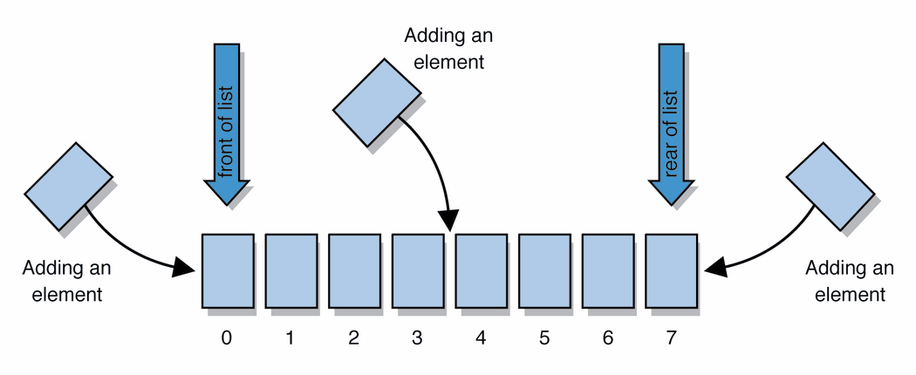
Java's ArrayList
collection: an object that stores data ("elements")
import java.util.*; // to use Java's collections
list: a collection of elements with 0-based indexes
elements can be added to the front, back, or elsewhere
a list has a size (number of elements that have been added)
in Java, a list can be represented as an ArrayList object

Slide 8
Type parameters (generics)
ArrayList<Type> name = new ArrayList<>();
When constructing an ArrayList, you must specify the type of its elements in < >
This is called a type parameter ; ArrayList is a generic class.
Allows the ArrayList class to store lists of different types.
Arrays use a similar idea with Type[]
ArrayList<String> names = new ArrayList<>();
names.add("Merlin");
names.add("Percy");

Slide 9
Wrapper classes
Primitive Type | Wrapper Type
int | Integer
double | Double
char | Character
boolean | Boolean
A wrapper is an object whose sole purpose is to hold a primitive value.
Once you construct the list, use it with primitives as normal:
ArrayList<Double> grades = new ArrayList<>();
grades.add(3.2);
grades.add(2.7);
...
double myGrade = grades.get(0);

Slide 10
ArrayList methods
add(value) | appends value at end of list
add(index, value) | inserts given value just before the given index, shifting subsequent values to the right
clear() | removes all elements of the list
indexOf(value) | returns first index where given value is found in list (-1 if not found)
get(index) | returns the value at given index
remove(index) | removes/returns value at given index, shifting subsequent values to the left
set(index, value) | replaces value at given index with given value
size() | returns the number of elements in list
toString() | returns a string representation of the list such as "[3, 42, -7, 15]"
* (a partial list; see the Java API for other methods)

Slide 11
ArrayList vs. array
String[] names = new String[5]; // construct
names[0] = "Jessica"; // store
String s = names[0]; // retrieve
for (int i = 0; i < names.length; i++) {
if (names[i].startsWith("B")) { ... }
} // iterate
ArrayList<String> list = new ArrayList<>();
list.add("Jessica"); // store
String s = list.get(0); // retrieve
for (int i = 0; i < list.size(); i++) {
if (list.get(i).startsWith("B")) { ... }
} // iterate

Slide 12
Words exercise
Write a program that reads a file and displays the words of that file as a list.
Then display the words in reverse order.
Then display them with all plural words (ending in "s") removed.

Slide 13
Exercise solution (partial)
ArrayList<String> allWords = new ArrayList<>();
Scanner input = new Scanner(new File("words.txt"));
while (input.hasNext()) {
String word = input.next();
allWords.add(word);
}
// display in reverse order
for (int i = allWords.size() - 1; i >= 0; i--) {
System.out.println(allWords.get(i));
}
// remove all plural words
for (int i = 0; i < allWords.size(); i++) {
String word = allWords.get(i);
if (word.endsWith("s")) {
allWords.remove(i);
i--;
}
}

Slide 14
ArrayList as param/return
public static void name(ArrayList<Type> name) {// param
public static ArrayList<Type> name(params) // return
Example:
// Returns count of plural words in the given list.
public static int countPlural(ArrayList<String> list) {
int count = 0;
for (int i = 0; i < list.size(); i++) {
String str = list.get(i);
if (str.endsWith("s")) {
count++;
}
}
return count;
}

Slide 15
Preconditions
precondition: Something your method assumes is true at the start of its execution.
Often documented as a comment on the method's header:
// Returns the element at the given index.
// Precondition: 0 <= index < size
public int get(int index) {
return elementData[index];
}
Stating a precondition doesn't really "solve" the problem, but it at least documents our decision and warns the client what not to do.
What if we want to actually enforce the precondition?

Slide 16
Bad precondition test
What is wrong with the following way to handle violations?
// Returns the element at the given index.
// Precondition: 0 <= index < size
public int get(int index) {
if (index < 0 || index >= size) {
System.out.println("Bad index! " + index);
return -1;
}
return elementData[index];
}
returning -1 no better than returning 0 (could be legal value)
println is not a very strong deterrent to the client (esp. GUI)

Slide 17
Throwing exceptions
throw new ExceptionType();
throw new ExceptionType("message");
Generates an exception that will crash the program, unless it has code to handle ("catch") the exception.
Common exception types:
ArithmeticException, ArrayIndexOutOfBoundsException, FileNotFoundException, IllegalArgumentException, IllegalStateException, IOException, NoSuchElementException, NullPointerException, RuntimeException, UnsupportedOperationException
Why would anyone ever want a program to crash?

Slide 18
Exception example
public int get(int index) {
if (index < 0 || index >= size) {
throw new ArrayIndexOutOfBoundsException(index);
}
return elementData[index];
}

Slide 19
Postconditions
postcondition: Something your method promises will be true at the end of its execution.
Often documented as a comment on the method's header:
// Makes sure that this list's internal array is large
// enough to store the given number of elements.
// Postcondition: elementData.length >= capacity
public void ensureCapacity(int capacity) {
// double in size until large enough
while (capacity > elementData.length) {
elementData = Arrays.copyOf(elementData,
2 * elementData.length);
}
}
If your method states a postcondition, clients should be able to rely on that statement being true after they call the method.

