Slide 1

CS 142
Lecture 7: Complexity
Thanks to Marty Stepp and Stuart Reges for parts of these slides

Slide 2
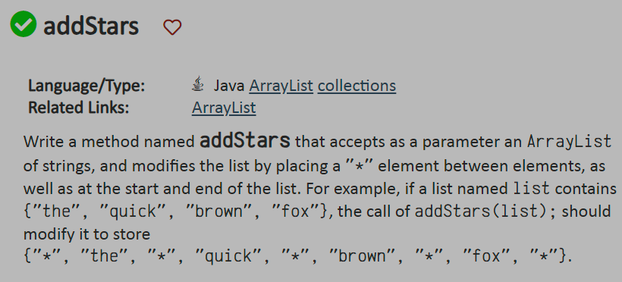
Recall: addStars
Yesterday we looked at addStars in lab
What was hard about this problem?
Is there any similarity between this problem and RemovePlurals code could help us?

Slide 3
Evaluating our Algorithms
Over the last few lectures, we have discussed sequential search and binary search
  We found we need to check way less indexes when using binary search – so it is faster
  How can we communicate this to others without walking through the whole algorithm?
    Generally, how can we compare the efficiency of different code solutions?

Slide 4
Runtime Efficiency
efficiency: measure of computing resources used by code.
  can be relative to speed (time), memory (space), etc.
  most commonly refers to run time
Assume the following:
  Any single Java statement takes same amount of time to run.
  A method call's runtime is measured by the total of the statements inside the method's body.
  A loop's runtime, if the loop repeats N times, is N times the runtime of the statements in its body.

Slide 5
Efficiency examples
statement1;
statement2;
statement3;
for (int i = 1; i <= N; i++) {
statement4;
}
for (int i = 1; i <= N; i++) {
statement5;
statement6;
statement7;
}
3
N
4N + 3
3N

Slide 6
Efficiency examples 2
for (int i = 1; i <= N; i++) {
for (int j = 1; j <= N; j++) {
statement1;
}
}
for (int i = 1; i <= N; i++) {
statement2;
statement3;
statement4;
statement5;
}
How many statements will execute if N = 10? If N = 1000?
N²
N² + 4N
4N

Slide 7
Algorithm growth rates
We measure runtime in proportion to the input data size, N.
  growth rate: Change in runtime as N changes.
Say an algorithm runs 0.4N³ + 25N² + 8N + 17 statements.
  Consider the runtime when N is extremely large .
  We ignore constants like 25 because they are tiny next to N.
  The highest-order term (N³) dominates the overall runtime.
  We say that this algorithm runs "on the order of" N³.
  or O(N³) for short ("Big-Oh of N cubed")

Slide 8
Complexity classes
complexity class: A category of algorithm efficiency based on the algorithm's relationship to the input size N.
Class | Big-Oh | If you double N, ... | Example
constant | O(1) | unchanged | 10ms
logarithmic | O(log₂ N) | increases slightly | 175ms
linear | O(N) | doubles | 3.2 sec
log-linear | O(N log₂ N) | slightly more than doubles | 6 sec
quadratic | O(N²) | quadruples | 1 min 42 sec
cubic | O(N³) | multiplies by 8 | 55 min
... | ... | ... | ...
exponential | O(2^{N}) | multiplies drastically | 5 * 10⁶¹ years

Slide 9
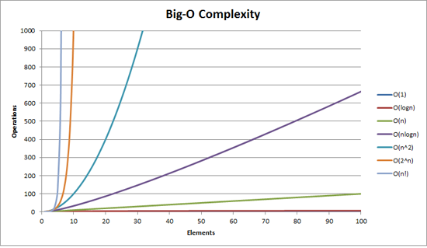
Complexity classes
http://recursive-design.com/blog/2010/12/07/comp-sci-101-big-o-notation/ - post about a Google interview

Slide 10
Collection efficiency
Efficiency of our ArrayIntList or Java's ArrayList:
Method | ArrayList
add
add(index, value)
get
remove
set
size
Method | ArrayList
add | O(1)
add(index, value) | O(N)
get | O(1)
remove | O(N)
set | O(1)
size | O(1)

Slide 11
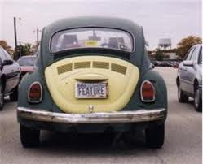
The software crisis
software engineering: The practice of developing, designing, documenting, testing large computer programs.
Large-scale projects face many issues:
  programmers working together
  getting code finished on time
  avoiding redundant code
  finding and fixing bugs
  maintaining, reusing existing code
code reuse: The practice of writing program code once and using it in many contexts.

