Slide 1
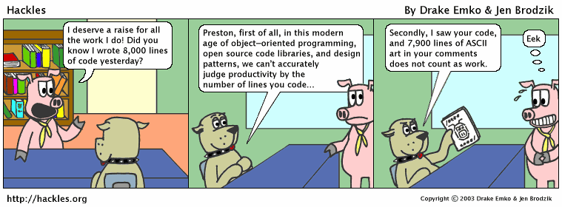
CS 142
Lecture 8: Inheritance and Polymorphism
Thanks to Marty Stepp and Stuart Reges for parts of these slides

Slide 2
Algorithm growth rates
We measure runtime in proportion to the input data size, N.
  growth rate: Change in runtime as N changes.
Say an algorithm runs 0.4N³ + 25N² + 8N + 17 statements.
  Consider the runtime when N is extremely large .
  We ignore constants like 25 because they are tiny next to N.
  The highest-order term (N³) dominates the overall runtime.
  We say that this algorithm runs "on the order of" N³.
  or O(N³) for short ("Big-Oh of N cubed")

Slide 3
Complexity classes
complexity class: A category of algorithm efficiency based on the algorithm's relationship to the input size N.
Class | Big-Oh | If you double N, ... | Example
constant | O(1) | unchanged | 10ms
logarithmic | O(log₂ N) | increases slightly | 175ms
linear | O(N) | doubles | 3.2 sec
log-linear | O(N log₂ N) | slightly more than doubles | 6 sec
quadratic | O(N²) | quadruples | 1 min 42 sec
cubic | O(N³) | multiplies by 8 | 55 min
... | ... | ... | ...
exponential | O(2^{N}) | multiplies drastically | 5 * 10⁶¹ years

Slide 4
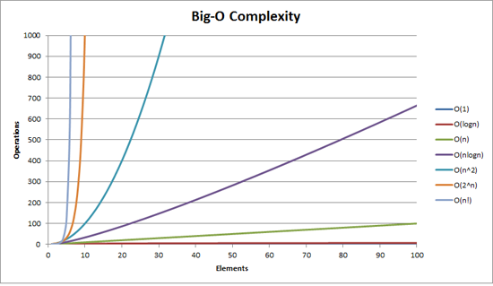
Complexity classes
http://recursive-design.com/blog/2010/12/07/comp-sci-101-big-o-notation/ - post about a Google interview

Slide 5
Collection efficiency
Efficiency of our ArrayIntList or Java's ArrayList:
Method | ArrayList
add
add(index, value)
get
remove
set
size
Method | ArrayList
add | O(1)
add(index, value) | O(N)
get | O(1)
remove | O(N)
set | O(1)
size | O(1)

Slide 6
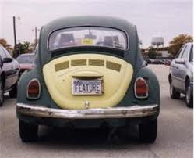
The software crisis
software engineering: The practice of developing, designing, documenting, testing large computer programs.
Large-scale projects face many issues:
  programmers working together
  getting code finished on time
  avoiding redundant code
  finding and fixing bugs
  maintaining, reusing existing code
code reuse: The practice of writing program code once and using it in many contexts.

Slide 7
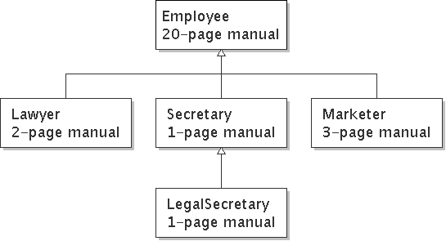

Law firm employee analogy
common rules: hours, vacation, benefits, regulations ...
  all employees attend a common orientation to learn general company rules
  each employee receives a 20-page manual of common rules
each subdivision also has specific rules:
  employee receives a smaller (1-3 page) manual of these rules
  smaller manual adds some new rules and also changes some rules from the large manual

Slide 8
Separating behavior
Why not just have a 22 page Lawyer manual, a 21-page Secretary manual, a 23-page Marketer manual, etc.?
Some advantages of the separate manuals:
  maintenance: Only one update if a common rule changes.
  locality: Quick discovery of all rules specific to lawyers.
Some key ideas from this example:
  General rules are useful (the 20-page manual).
  Specific rules that may override general ones are also useful.

Slide 9
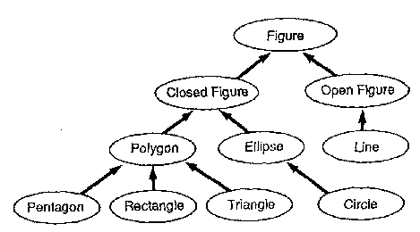
Is-a relationships, hierarchies
is-a relationship: A hierarchical connection where one category can be treated as a specialized version of another.
  every marketer is an employee
  every legal secretary is a secretary
inheritance hierarchy: A set of classes connected by is-a relationships that can share common code.

Slide 10
Employee regulations
Consider the following employee regulations:
  Employees work 40 hours / week.
  Employees make $40,000 per year, except legal secretaries who make $5,000 extra per year ($45,000 total), and marketers who make $10,000 extra per year ($50,000 total).
  Employees have 2 weeks of paid vacation leave per year, except lawyers who get an extra week (a total of 3).
  Employees should use a yellow form to apply for leave, except for lawyers who use a pink form.
Each type of employee has some unique behavior:
  Lawyers know how to sue.
  Marketers know how to advertise.
  Secretaries know how to take dictation.
  Legal secretaries know how to prepare legal documents.

Slide 11
An Employee class
// A class to represent employees in general (20-page manual).
public class Employee {
public int getHours() {
return 40; // works 40 hours / week
}
public double getSalary() {
return 40000.0; // $40,000.00 / year
}
public int getVacationDays() {
return 10; // 2 weeks' paid vacation
}
public String getVacationForm() {
return "yellow"; // use the yellow form
}
}
  Exercise: Implement class Secretary, based on the previous employee regulations. (Secretaries can take dictation.)

Slide 12
Redundant Secretary class
// A redundant class to represent secretaries.
public class Secretary {
public int getHours() {
return 40; // works 40 hours / week
}
public double getSalary() {
return 40000.0; // $40,000.00 / year
}
public int getVacationDays() {
return 10; // 2 weeks' paid vacation
}
public String getVacationForm() {
return "yellow"; // use the yellow form
}
public void takeDictation(String text) {
System.out.println("Taking dictation of text: " + text);
}
}

Slide 13
Desire for code-sharing
takeDictation is the only unique behavior in Secretary.
We'd like to be able to say:
// A class to represent secretaries.
public class Secretary {
copy all the contents from the Employee class;
public void takeDictation(String text) {
System.out.println("Taking dictation of text: " + text);
}
}

Slide 14
Inheritance
inheritance: A way to form new classes based on existing classes, taking on their attributes/behavior.
  a way to group related classes
  a way to share code between two or more classes
One class can extend another, absorbing its data/behavior.
  superclass: The parent class that is being extended.
  subclass: The child class that extends the superclass and inherits its behavior.
    Subclass gets a copy of every field and method from superclass

Slide 15
Inheritance syntax
  public class name extends superclass {
  Example:
  public class Secretary extends Employee {
  ...
  }
By extending Employee, each Secretary object now:
  receives a getHours, getSalary, getVacationDays, and getVacationForm method automatically
  can be treated as an Employee by client code (seen later)

Slide 16
Improved Secretary code
// A class to represent secretaries.
public class Secretary extends Employee {
public void takeDictation(String text) {
System.out.println("Taking dictation of text: " + text);
}
}
Now we only write the parts unique to each type.
  Secretary inherits getHours, getSalary, getVacationDays, and getVacationForm methods from Employee.
  Secretary adds the takeDictation method.

Slide 17
Implementing Lawyer
Consider the following lawyer regulations:
  Lawyers who get an extra week of paid vacation (a total of 3).
  Lawyers use a pink form when applying for vacation leave.
  Lawyers have some unique behavior: they know how to sue.
Problem: We want lawyers to inherit most behavior from employee, but we want to replace parts with new behavior.

Slide 18
Overriding methods
override: To write a new version of a method in a subclass that replaces the superclass's version.
  No special syntax required to override a superclass method.
  Just write a new version of it in the subclass.
  public class Lawyer extends Employee {
  // overrides getVacationForm method in Employee class
  public String getVacationForm() {
  return "pink";
  }
  ...
  }
  Exercise: Complete the Lawyer class.
    (3 weeks vacation, pink vacation form, can sue)

Slide 19
Lawyer class
// A class to represent lawyers.
public class Lawyer extends Employee {
// overrides getVacationForm from Employee class
public String getVacationForm() {
return "pink";
}
// overrides getVacationDays from Employee class
public int getVacationDays() {
return 15; // 3 weeks vacation
}
public void sue() {
System.out.println("I'll see you in court!");
}
}
  Exercise: Complete the Marketer class. Marketers make $10,000 extra ($50,000 total) and know how to advertise.

Slide 20
Marketer class
// A class to represent marketers.
public class Marketer extends Employee {
public void advertise() {
System.out.println("Act now while supplies last!");
}
public double getSalary() {
return 50000.0; // $50,000.00 / year
}
}

Slide 21
Levels of inheritance
Multiple levels of inheritance in a hierarchy are allowed.
  Example: A legal secretary is the same as a regular secretary but makes more money ($45,000) and can file legal briefs.
  public class LegalSecretary extends Secretary {
  ...
  }
  Exercise: Complete the LegalSecretary class.

Slide 22
LegalSecretary class
// A class to represent legal secretaries.
public class LegalSecretary extends Secretary {
public void fileLegalBriefs() {
System.out.println("I could file all day!");
}
public double getSalary() {
return 45000.0; // $45,000.00 / year
}
}

Slide 23
Calling overridden methods
Subclasses can call overridden methods with super
  super.method(parameters)
  Example:
  public class LegalSecretary extends Secretary {
  public double getSalary() {
  double baseSalary = super.getSalary();
  return baseSalary + 5000.0;
  }
  ...
  }

Slide 24
Inheritance and constructors
Imagine that we want to give employees more vacation days the longer they've been with the company.
  For each year worked, we'll award 2 additional vacation days.
  When an Employee object is constructed, we'll pass in the number of years the person has been with the company.
  This will require us to modify our Employee class and add some new state and behavior.
  Exercise: Make necessary modifications to the Employee class.

Slide 25
Modified Employee class
public class Employee {
private int years;
public Employee(int initialYears) {
years = initialYears;
}
public int getHours() {
return 40;
}
public double getSalary() {
return 50000.0;
}
public int getVacationDays() {
return 10 + 2 * years;
}
public String getVacationForm() {
return "yellow";
}
}

Slide 26
Problem with constructors
Now that we've added the constructor to the Employee class, our subclasses do not compile. The error:
  Lawyer.java:2: cannot find symbol
  symbol : constructor Employee()
  location: class Employee
  public class Lawyer extends Employee {
  ^
  The short explanation: Once we write a constructor (that requires parameters) in the superclass, we must now write constructors for our employee subclasses as well.
  The long explanation: (next slide)

Slide 27
The detailed explanation
Constructors are not inherited.
  Subclasses don't inherit the Employee(int) constructor.
  Subclasses receive a default constructor that contains:
    public Lawyer() {
    super(); // calls Employee() constructor
    }
But our Employee(int) replaces the default Employee().
  The subclasses' default constructors are now trying to call a non-existent default Employee constructor.

Slide 28
Calling superclass constructor
  super(parameters);
  Example:
  public class Lawyer extends Employee {
  public Lawyer(int years) {
  super(years); // calls Employee constructor
  }
  ...
  }
  The super call must be the first statement in the constructor.
  Exercise: Make a similar modification to the Marketer class.

Slide 29
Modified Marketer class
// A class to represent marketers.
public class Marketer extends Employee {
public Marketer(int years) {
super(years);
}
public void advertise() {
System.out.println("Act now while supplies last!");
}
public double getSalary() {
return super.getSalary() + 10000.0;
}
}
  Exercise: Modify the Secretary subclass.
    Secretaries' years of employment are not tracked.
    They do not earn extra vacation for years worked.

Slide 30
Modified Secretary class
// A class to represent secretaries.
public class Secretary extends Employee {
public Secretary() {
super(0);
}
public void takeDictation(String text) {
System.out.println("Taking dictation of text: " + text);
}
}
  Since Secretary doesn't require any parameters to its constructor, LegalSecretary compiles without a constructor.
    Its default constructor calls the Secretary() constructor.

Slide 31
Inheritance and fields
Try to give lawyers $5000 for each year at the company:
  public class Lawyer extends Employee {
  ...
  public double getSalary() {
  return super.getSalary() + 5000 * years;
  }
  ...
  }
Does not work; the error is the following:
  Lawyer.java:7: years has private access in Employee
  return super.getSalary() + 5000 * years;
  ^
Private fields cannot be directly accessed from subclasses.
  One reason: So that subclassing can't break encapsulation.
  How can we get around this limitation?

Slide 32
Improved Employee code
Add an accessor for any field needed by the subclass.
public class Employee {
private int years;
public Employee(int initialYears) {
years = initialYears;
}
public int getYears() {
return years;
}
...
}
public class Lawyer extends Employee {
public Lawyer(int years) {
super(years);
}
public double getSalary() {
return super.getSalary() + 5000 * getYears();
}
...
}

Slide 33
Revisiting Secretary
The Secretary class currently has a poor solution.
  We set all Secretaries to 0 years because they do not get a vacation bonus for their service.
  If we call getYears on a Secretary object, we'll always get 0.
  This isn't a good solution; what if we wanted to give some other reward to all employees based on years of service?
Redesign our Employee class to allow for a better solution.

Slide 34
Improved Employee code
Let's separate the standard 10 vacation days from those that are awarded based on seniority.
  public class Employee {
  private int years;
  public Employee(int initialYears) {
  years = initialYears;
  }
  public int getVacationDays() {
  return 10 + getSeniorityBonus();
  }
  // vacation days given for each year in the company
  public int getSeniorityBonus() {
  return 2 * years;
  }
  ...
  }
  How does this help us improve the Secretary?

Slide 35
Improved Secretary code
Secretary can selectively override getSeniorityBonus; when getVacationDays runs, it will use the new version.
  Choosing a method at runtime is called dynamic binding.
  public class Secretary extends Employee {
  public Secretary(int years) {
  super(years);
  }
  // Secretaries don't get a bonus for their years of service.
  public int getSeniorityBonus() {
  return 0;
  }
  public void takeDictation(String text) {
  System.out.println("Taking dictation of text: " + text);
  }
  }

Slide 36
Polymorphism
polymorphism: Ability for the same code to be used with different types of objects and behave differently with each.
  System.out.println can print any type of object.
    Each one displays in its own way on the console.
  CritterMain can interact with any type of critter.
    Each one moves, fights, etc. in its own way.

Slide 37
Coding with polymorphism
A variable of type T can hold an object of any subclass of T.
  Employee ed = new Lawyer();
  You can call any methods from the Employee class on ed.
When a method is called on ed, it behaves as a Lawyer.
  System.out.println(ed.getSalary()); // 50000.0
  System.out.println(ed.getVacationForm()); // pink

