Slide 1
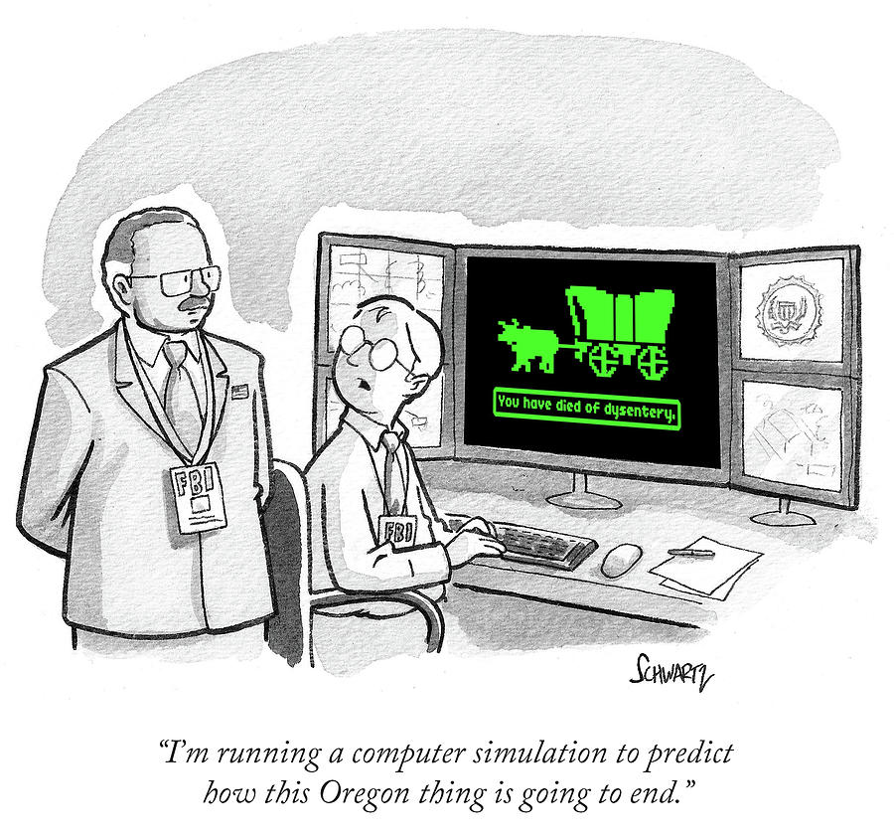
CS 142
Lecture 14: 2D arrays and Introduction to Recursion
Thanks to Marty Stepp and Stuart Reges for parts of these slides.

Slide 2
How are Critters Stored?
We want the critters to be able to move sideways and up and down
We could use a list or array but that would be tough to reason about

Slide 3
Creating an array of arrays
int[10][8] data creates an array of length 10 that stores
arrays of length 8
int[10][8] data;
for(int i = 0; i < data.length; i++) {
for(int j = 0; j < data[i].length; j++) {
data[i][j] = i * 10 + j;
}
}
for(int i = 0; i < data.length; i++) {
for(int j = 0; j < data[i].length; j++) {
System.out.print(data[i][j] + " ");
}
System.out.println();
}
Output:
0 1 2 3 4 5 6 7
10 11 12 13 14 15 16 17
20 21 22 23 24 25 26 27
30 31 32 33 34 35 36 37
40 41 42 43 44 45 46 47
50 51 52 53 54 55 56 57
60 61 62 63 64 65 66 67
70 71 72 73 74 75 76 77
80 81 82 83 84 85 86 87
90 91 92 93 94 95 96 97

Slide 4
Array of arrays mystery
void mystery(int[][] data, int[] result, int pos, int n) {
for(int i = 0; i < n; i++) {
for(int j = 0; j < n; j++) {
result[j] = data[i + pos][j + pos];
}
}
}
Suppose that a variable called grid has been declared as follows:
int[6][6] grid = {{8, 2, 7, 8, 2, 1}, {1, 5, 1, 7, 4, 7},
{5, 9, 6, 7, 3, 2}, {7, 8, 7, 7, 7, 9},
{4, 2, 6, 9, 2, 3}, {2, 2, 8, 1, 1, 3}}
which means it will store the following 6-by-6 grid of values:
8 2 7 8 2 1
1 5 1 7 4 7
5 9 6 7 3 2
7 8 7 7 7 9
4 2 6 9 2 3
2 2 8 1 1 3
For each call at right, indicate what value
is returned. If the function call results in an
error, write error instead.
Function Call Contents of Array Returned
mystery(grid, 2, 2) _____________________
mystery(grid, 0, 2) _____________________
mystery(grid, 3, 3) _____________________

Slide 5
Exercise
Write a function called max_row that takes a list of lists as a parameter and returns the index of the row that contains the maximum value.
To test this create an array as follows:
int[][] arr = {0, 1, 2, 3},
{6, 4, 5, 7},
{1, 7, 6, 8},
{5, 2, 6, 7}
};

Slide 6
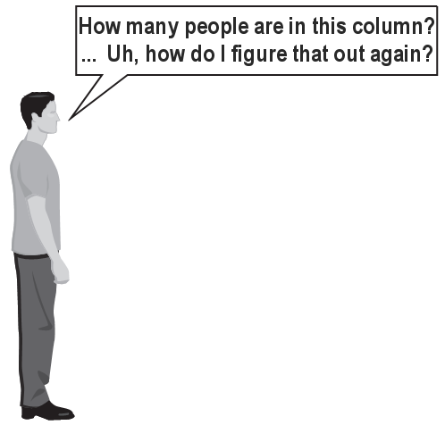

Exercise
(To a student in the front row)
How many students total are directly behind you in your "column" of the classroom?
  You have poor vision, so you can
  see only the people right next to you.
  So you can't just look back and count.
  But you are allowed to ask
  questions of the person next to you.
  How can we solve this problem?
  (recursively )

Slide 7
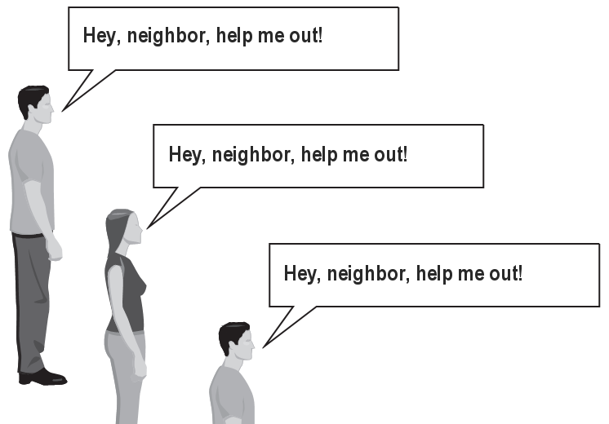
The idea
Recursion is all about breaking a big problem into smaller occurrences of that same problem.
  Each person can solve a small part of the problem.
    What is a small version of the problem that would be easy to answer?
    What information from a neighbor might help me?

Slide 8
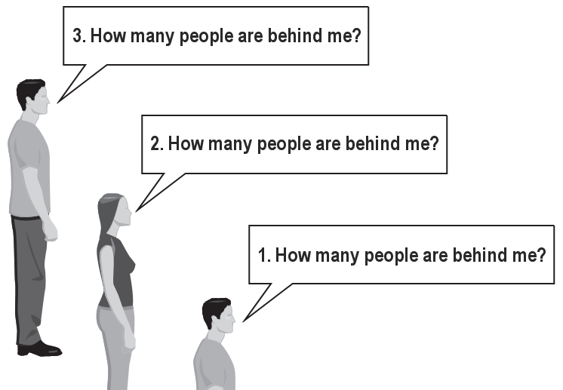
Recursive algorithm
Number of people behind me:
  If there is someone behind me,
  ask him/her how many people are behind him/her.
    When they respond with a value N, then I will answer N + 1.
  If there is nobody behind me, I will answer 0.

Slide 9
Recursion
recursion: The definition of an operation in terms of itself.
  Solving a problem using recursion depends on solving
  smaller occurrences of the same problem.
recursive programming: Writing methods that call themselves to solve problems recursively.
  An equally powerful substitute for iteration (loops)
  Particularly well-suited to solving certain types of problems

Slide 10
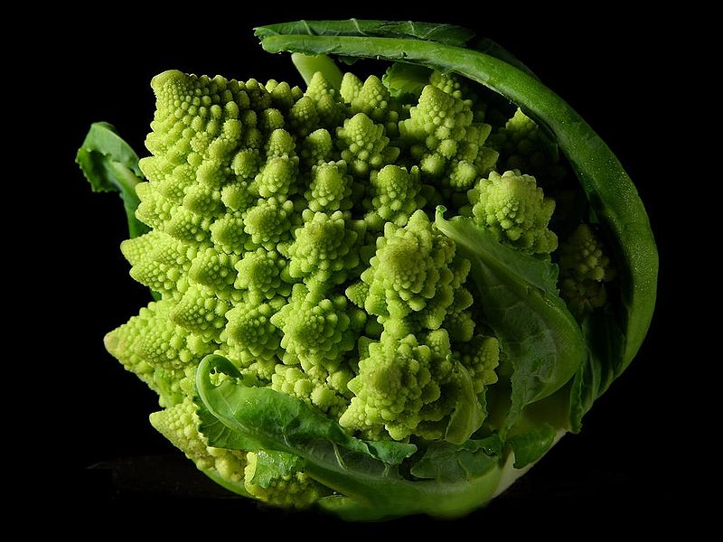

Slide 11
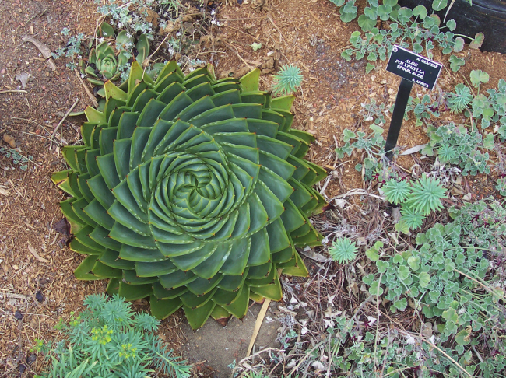

Slide 12
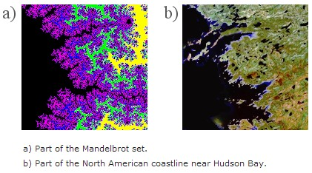

Slide 13


Slide 14
Why learn recursion?
"Cultural experience" – think differently about problems
Solves some problems more naturally than iteration
Can lead to elegant, simplistic, short code (when used well)
Many programming languages ("functional" languages such as Scheme, ML, and Haskell) use recursion exclusively (no loops)
A key component of many of our assignments in CSE 143

Slide 15
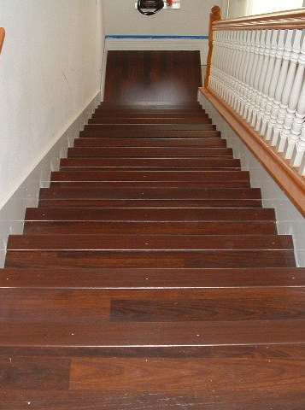
Getting down stairs
Need to know two things:
  Getting down one stair
  Recognizing the bottom
Most code will look like:
if (simplest case) {
compute and return solution
} else {
divide into similar subproblem(s)
solve each subproblem recursively
assemble the overall solution
}

Slide 16
Recursion and cases
Every recursive algorithm involves at least 2 cases:
  base case: A simple occurrence that can be answered directly.
  recursive case: A more complex occurrence of the problem that cannot be directly answered, but can instead be described in terms of smaller occurrences of the same problem.
  Some recursive algorithms have more than one base or recursive case, but all have at least one of each.
  A crucial part of recursive programming is identifying these cases.

Slide 17
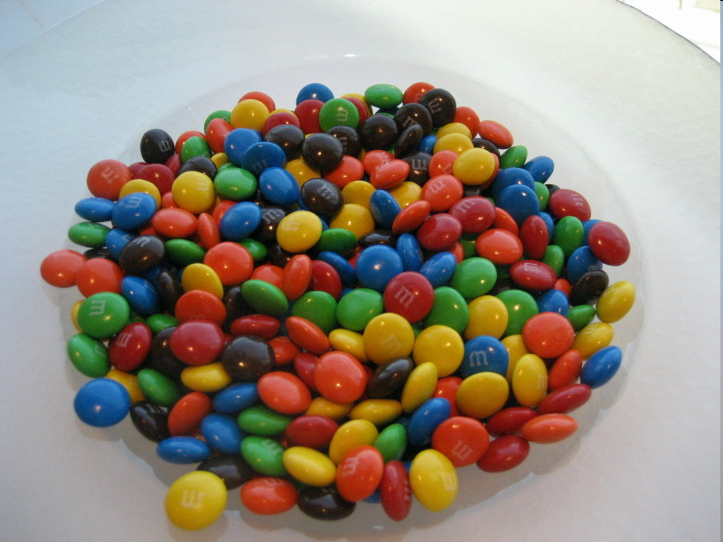
Another recursive task
How can we remove exactly half of the M&M's in a large bowl, without dumping them all out or being able to count them?
  What if multiple people help out with solving the problem?
  Can each person do a small part of the work?
  What is a number of M&M's
  that it is easy to double,
  even if you can't count?
    (What is a "base case"?)

Slide 18
Recursion in Java
Consider the following method to print a line of * characters:
  // Prints a line containing the given number of stars.
  // Precondition: n >= 0
  public static void printStars(int n) {
  for (int i = 0; i < n; i++) {
  System.out.print("*");
  }
  System.out.println(); // end the line of output
  }
Write a recursive version of this method (that calls itself).
  Solve the problem without using any loops.
  Hint: Your solution should print just one star at a time.

Slide 19
A basic case
What are the cases to consider?
  What is a very easy number of stars to print without a loop?
  public static void printStars(int n) {
  if (n == 1) {
  // base case; just print one star
  System.out.println("*");
  } else {
  ...
  }
  }

Slide 20
Handling more cases
Handling additional cases, with no loops (in a bad way):
  public static void printStars(int n) {
  if (n == 1) {
  // base case; just print one star
  System.out.println("*");
  } else if (n == 2) {
  System.out.print("*");
  System.out.println("*");
  } else if (n == 3) {
  System.out.print("*");
  System.out.print("*");
  System.out.println("*");
  } else if (n == 4) {
  System.out.print("*");
  System.out.print("*");
  System.out.print("*");
  System.out.println("*");
  } else ...
  }

Slide 21
Handling more cases 2
Taking advantage of the repeated pattern (somewhat better):
  public static void printStars(int n) {
  if (n == 1) {
  // base case; just print one star
  System.out.println("*");
  } else if (n == 2) {
  System.out.print("*");
  printStars(1); // prints "*"
  } else if (n == 3) {
  System.out.print("*");
  printStars(2); // prints "**"
  } else if (n == 4) {
  System.out.print("*");
  printStars(3); // prints "***"
  } else ...
  }

Slide 22
Using recursion properly
Condensing the recursive cases into a single case:
  public static void printStars(int n) {
  if (n == 1) {
  // base case; just print one star
  System.out.println("*");
  } else {
  // recursive case; print one more star
  System.out.print("*");
  printStars(n - 1);
  }
  }

Slide 23
"Recursion Zen"
The real, even simpler, base case is an n of 0, not 1:
  public static void printStars(int n) {
  if (n == 0) {
  // base case; just end the line of output
  System.out.println();
  } else {
  // recursive case; print one more star
  System.out.print("*");
  printStars(n - 1);
  }
  }
  Recursion Zen: The art of properly identifying the best set of cases for a recursive algorithm and expressing them elegantly.
  (A CSE 143 informal term)

Slide 24
Exercise
Write a recursive method reverseLines that accepts a file Scanner and prints the lines of the file in reverse order.
  Example input file: Expected console output:
  I have eaten the icebox
  the plums that were in
  that were in the plums
  the icebox I have eaten
  What are the cases to consider?
    How can we solve a small part of the problem at a time?
    What is a file that is very easy to reverse?

Slide 25
Reversal pseudocode
Reversing the lines of a file:
  Read a line L from the file.
  Print the rest of the lines in reverse order.
  Print the line L.
If only we had a way to reverse the rest of the lines of the file....

Slide 26
Reversal solution
public static void reverseLines(Scanner input) {
if (input.hasNextLine()) {
// recursive case
String line = input.nextLine();
reverseLines(input);
System.out.println(line);
}
}
  Where is the base case?

Slide 27
Tracing our algorithm
call stack: The method invocations currently running
  reverseLines(new Scanner("poem.txt"));
public static void reverseLines(Scanner input) {
if (input.hasNextLine()) {
String line = input.nextLine(); // "I have eaten"
reverseLines(input);
System.out.println(line);
}
}
public static void reverseLines(Scanner input) {
if (input.hasNextLine()) {
String line = input.nextLine(); // "the plums"
reverseLines(input);
System.out.println(line);
}
}
public static void reverseLines(Scanner input) {
if (input.hasNextLine()) {
String line = input.nextLine(); // "that were in"
reverseLines(input);
System.out.println(line);
}
}
public static void reverseLines(Scanner input) {
if (input.hasNextLine()) {
String line = input.nextLine(); // "the icebox"
reverseLines(input);
System.out.println(line);
}
}
public static void reverseLines(Scanner input) {
if (input.hasNextLine()) { // false
...
}
}
input file:
output:
I have eaten
the plums
that were in
the icebox
the icebox
that were in
the plums
I have eaten

Slide 28
Recursive tracing
Consider the following recursive method:
  public static int mystery(int n) {
  if (n < 10) {
  return n;
  } else {
  int a = n / 10;
  int b = n % 10;
  return mystery(a + b);
  }
  }
  What is the result of the following call?
    mystery(648)

Slide 29
A recursive trace
mystery(648):
  int a = 648 / 10; // 64
  int b = 648 % 10; // 8
  return mystery(a + b); // mystery(72)
    mystery(72):
    int a = 72 / 10; // 7
    int b = 72 % 10; // 2
    return mystery(a + b); // mystery(9)
      mystery(9):
      return 9;

Slide 30
Recursive tracing 2
Consider the following recursive method:
  public static int mystery(int n) {
  if (n < 10) {
  return (10 * n) + n;
  } else {
  int a = mystery(n / 10);
  int b = mystery(n % 10);
  return (100 * a) + b;
  }
  }
  What is the result of the following call?
    mystery(348)

Slide 31
A recursive trace 2
mystery(348)
  int a = mystery(34);
    int a = mystery(3);
      return (10 * 3) + 3; // 33
    int b = mystery(4);
      return (10 * 4) + 4; // 44
    return (100 * 33) + 44; // 3344
  int b = mystery(8);
    return (10 * 8) + 8; // 88
  return (100 * 3344) + 88; // 334488
  What is this method really doing?

