Slide 1
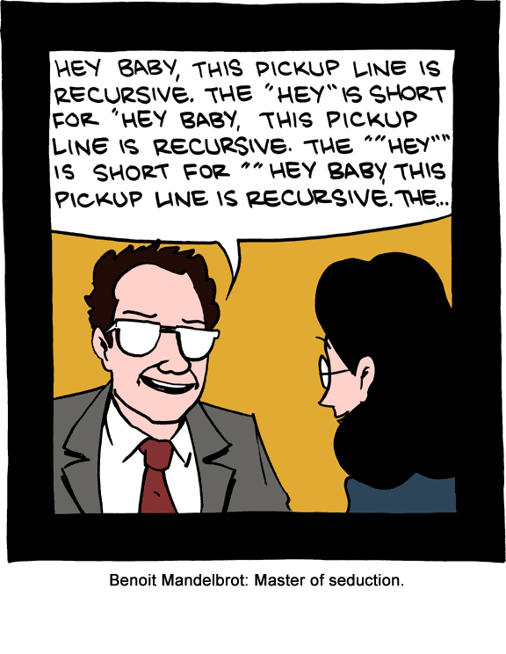
CS 142
Lecture 16: recursion
Thanks to Marty Stepp and Stuart Reges for parts of these slides.

Slide 2
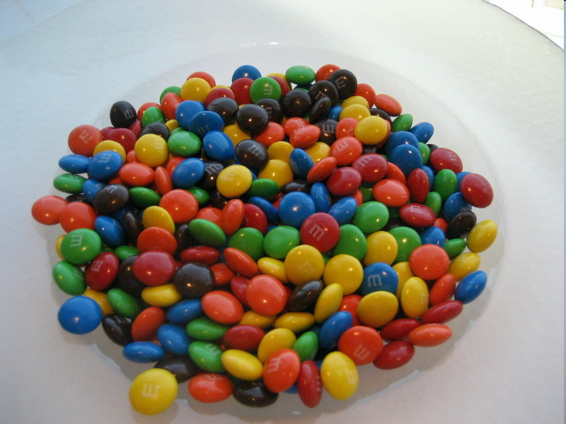
Another recursive task
How can we remove exactly half of the M&M's in a large bowl, without dumping them all out or being able to count them?
  What if multiple people help out with solving the problem?
  Can each person do a small part of the work?
  What is a number of M&M's
  that it is easy to double,
  even if you can't count?

Slide 3
Recursion and cases
Every recursive algorithm involves at least 2 cases:
  base case: A simple occurrence that can be answered directly.
  recursive case: A more complex occurrence of the problem that cannot be directly answered, but can instead be described in terms of smaller occurrences of the same problem.
  Some recursive algorithms have more than one base or recursive case, but all have at least one of each.
  A crucial part of recursive programming is identifying these cases.

Slide 4
Using recursion properly
Condensing the recursive cases into a single case:
  public static void printStars(int n) {
  if (n == 1) {
  // base case; just print one star
  System.out.println("*");
  } else {
  // recursive case; print one more star
  System.out.print("*");
  printStars(n - 1);
  }
  }

Slide 5
"Recursion Zen"
The real, even simpler, base case is an n of 0, not 1:
  public static void printStars(int n) {
  if (n == 0) {
  // base case; just end the line of output
  System.out.println();
  } else {
  // recursive case; print one more star
  System.out.print("*");
  printStars(n - 1);
  }
  }
  Recursion Zen: The art of properly identifying the best set of cases for a recursive algorithm and expressing them elegantly.
  (A CS 142 informal term)

Slide 6
Exercise
Write a recursive method reverseLines that accepts a file Scanner and prints the lines of the file in reverse order.
  Example input file: Expected console output:
  I have eaten the icebox
  the plums that were in
  that were in the plums
  the icebox I have eaten
  What are the cases to consider?
    How can we solve a small part of the problem at a time?
    What is a file that is very easy to reverse?

Slide 7
Reversal pseudocode
Reversing the lines of a file:
  Read a line L from the file.
  Print the rest of the lines in reverse order.
  Print the line L.
If only we had a way to reverse the rest of the lines of the file....

Slide 8
Reversal solution
public static void reverseLines(Scanner input) {
if (input.hasNextLine()) {
// recursive case
String line = input.nextLine();
reverseLines(input);
System.out.println(line);
}
}
  Where is the base case?

Slide 9
Tracing our algorithm
call stack: The method invocations currently running
  reverseLines(new Scanner("poem.txt"));
public static void reverseLines(Scanner input) {
if (input.hasNextLine()) {
String line = input.nextLine(); // "I have eaten"
reverseLines(input);
System.out.println(line);
}
}
public static void reverseLines(Scanner input) {
if (input.hasNextLine()) {
String line = input.nextLine(); // "the plums"
reverseLines(input);
System.out.println(line);
}
}
public static void reverseLines(Scanner input) {
if (input.hasNextLine()) {
String line = input.nextLine(); // "that were in"
reverseLines(input);
System.out.println(line);
}
}
public static void reverseLines(Scanner input) {
if (input.hasNextLine()) {
String line = input.nextLine(); // "the icebox"
reverseLines(input);
System.out.println(line);
}
}
public static void reverseLines(Scanner input) {
if (input.hasNextLine()) { // false
...
}
}
input file:
output:
I have eaten
the plums
that were in
the icebox
the icebox
that were in
the plums
I have eaten

Slide 10
Recursive tracing
Consider the following recursive method:
  public static int mystery(int n) {
  if (n < 10) {
  return n;
  } else {
  int a = n / 10;
  int b = n % 10;
  return mystery(a + b);
  }
  }
  What is the result of the following call?
    mystery(648)

Slide 11
A recursive trace
mystery(648):
  int a = 648 / 10; // 64
  int b = 648 % 10; // 8
  return mystery(a + b); // mystery(72)
    mystery(72):
    int a = 72 / 10; // 7
    int b = 72 % 10; // 2
    return mystery(a + b); // mystery(9)
      mystery(9):
      return 9;

Slide 12
Recursive tracing 2
Consider the following recursive method:
  public static int mystery(int n) {
  if (n < 10) {
  return (10 * n) + n;
  } else {
  int a = mystery(n / 10);
  int b = mystery(n % 10);
  return (100 * a) + b;
  }
  }
  What is the result of the following call?
    mystery(348)

Slide 13
A recursive trace 2
mystery(348)
  int a = mystery(34);
    int a = mystery(3);
      return (10 * 3) + 3; // 33
    int b = mystery(4);
      return (10 * 4) + 4; // 44
    return (100 * 33) + 44; // 3344
  int b = mystery(8);
    return (10 * 8) + 8; // 88
  return (100 * 3344) + 88; // 334488
  What is this method really doing?

Slide 14
Exercise
Write a recursive method pow accepts an integer base and exponent and returns the base raised to that exponent.
  Example: pow(3, 4) returns 81
  Solve the problem recursively and without using loops.

Slide 15
An optimization
Notice the following mathematical property:
  3¹² = 531441 = 9⁶
  = (3²)⁶
  531441 = (9²)³
  = ((3²)²)³
  When does this "trick" work?
  How can we incorporate this optimization into our pow method?
  What is the benefit of this trick if the method already works?

Slide 16
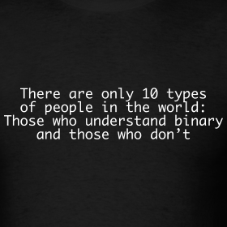

Slide 17
Exercise
Write a recursive method printBinary that accepts an integer and prints that number's representation in binary (base 2).
  Example: printBinary(7) prints 111
  Example: printBinary(12) prints 1100
  Example: printBinary(42) prints 101010
  Write the method recursively and without using any loops.
place | 10 | 1 |  | 32 | 16 | 8 | 4 | 2 | 1
value | 4 | 2 |  | 1 | 0 | 1 | 0 | 1 | 0

Slide 18
Stutter
How did we break the number apart?
  public static int stutter(int n) {
  if (n < 10) {
  return (10 * n) + n;
  } else {
  int a = mystery(n / 10);
  int b = mystery(n % 10);
  return (100 * a) + b;
  }
  }

Slide 19
Case analysis
Recursion is about solving a small piece of a large problem.
  What is 69743 in binary?
    Do we know anything about its representation in binary?
  Case analysis:
    What is/are easy numbers to print in binary?
    Can we express a larger number in terms of a smaller number(s)?

Slide 20
printBinary solution
  // Prints the given integer's binary representation.
  // Precondition: n >= 0
  public static void printBinary(int n) {
  if (n < 2) {
  // base case; same as base 10
  System.out.println(n);
  } else {
  // recursive case; break number apart
  printBinary(n / 2);
  printBinary(n % 2);
  }
  }
  Can we eliminate the precondition and deal with negatives?

