Slide 1
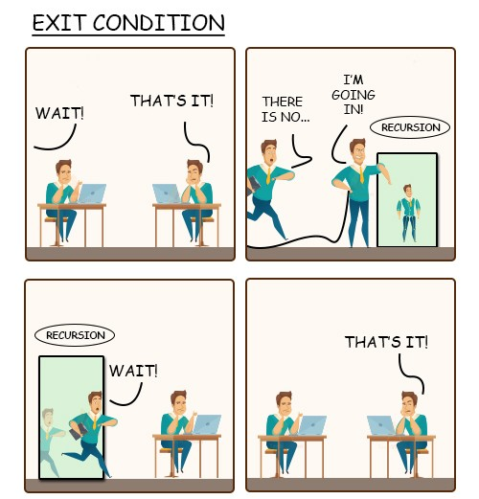
CS 142
Lecture 20: Recursion; structures
Thanks to Marty Stepp and Stuart Reges for parts of these slides

Slide 2
Exercise
Write a method crawl accepts a File parameter and prints information about that file.
If the File object represents a normal file, just print its name.
If the File object represents a directory, print its name and information about every file/directory inside it, indented.
cse143
handouts
syllabus.doc
lecture_schedule.xls
homework
1-tiles
TileMain.java
TileManager.java
index.html
style.css
recursive data: A directory can contain other directories.

Slide 3
File objects
A File object (from the java.io package) represents a file or directory on the disk.
Constructor/method | Description
File(String) | creates File object representing file with given name
canRead() | returns whether file is able to be read
delete() | removes file from disk
exists() | whether this file exists on disk
getName() | returns file's name
isDirectory() | returns whether this object represents a directory
length() | returns number of bytes in file
listFiles() | returns a File[] representing files in this directory
renameTo(File) | changes name of file

Slide 4
Public/private pairs
We cannot vary the indentation without an extra parameter:
public static void crawl(File f, String indent) {
Often the parameters we need for our recursion do not match those the client will want to pass.
In these cases, we instead write a pair of methods:
1) a public, non-recursive one with parameters the client wants
2) a private, recursive one with the parameters we really need

Slide 5
Exercise solution
// Prints information about this file,
// and (if it is a directory) any files inside it.
public static void crawl(File f) {
crawl(f, ""); // call private recursive helper
}
// Recursive helper to implement crawl/indent behavior.
private static void crawl(File f, String indent) {
System.out.println(indent + f.getName());
if (f.isDirectory()) {
// recursive case; print contained files/dirs
File[] contents = f.listFiles();
for (int i = 0; i < contents.length; i++) {
crawl(subFile, indent + " ");
}
}
}

Slide 6
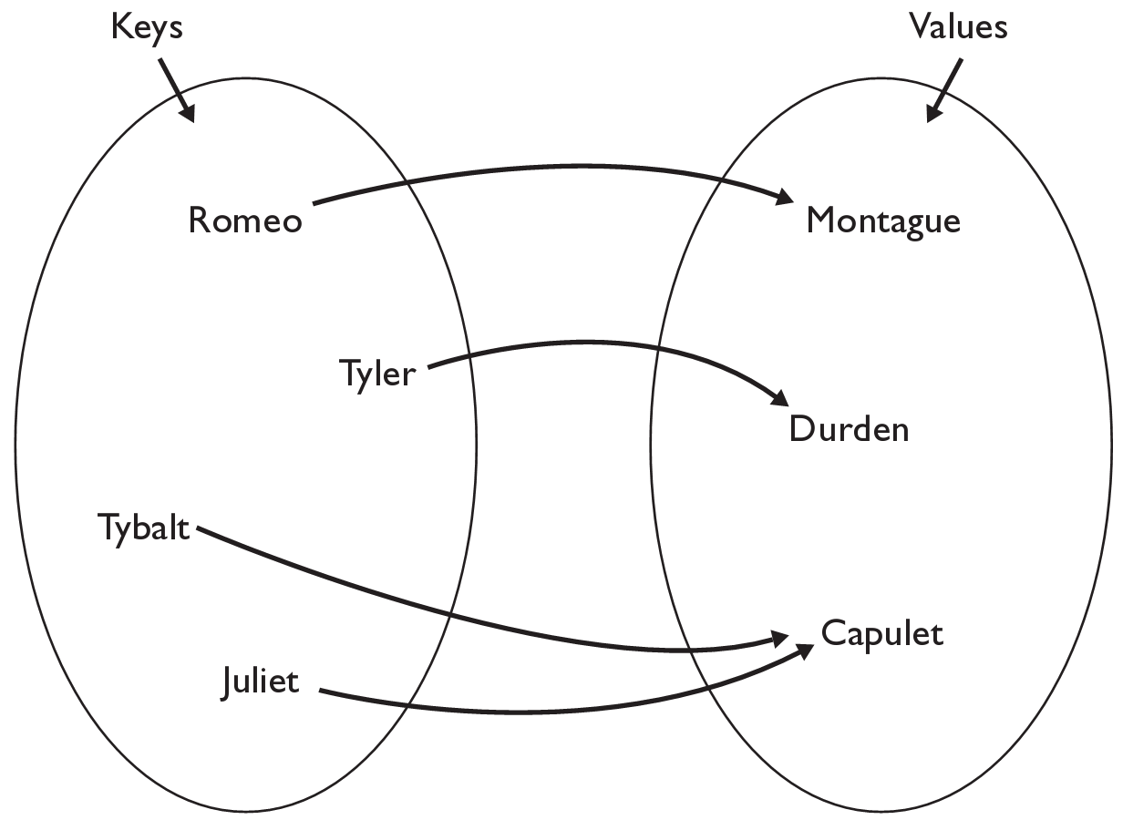
Maps
map: Holds a set of unique keys and a collection of values, where each key is associated with one value.
a.k.a. "dictionary", "associative array", "hash"
basic map operations:
put(key, value ): Adds a mapping from a key to a value.
get(key ): Retrieves the value mapped to the key.
remove(key ): Removes the given key and its mapped value.
myMap.get("Juliet") returns "Capulet"

Slide 7
Map methods
put(key, value) | adds a mapping from the given key to the given value; if the key already exists, replaces its value with the given one
get(key) | returns the value mapped to the given key (null if not found)
containsKey(key) | returns true if the map contains a mapping for the given key
remove(key) | removes any existing mapping for the given key
clear() | removes all key/value pairs from the map
size() | returns the number of key/value pairs in the map
isEmpty() | returns true if the map's size is 0
toString() | returns a string such as "{a=90, d=60, c=70}"
keySet() | returns a set of all keys in the map
values() | returns a collection of all values in the map
putAll(map) | adds all key/value pairs from the given map to this map
equals(map) | returns true if given map has the same mappings as this one

Slide 8
Using maps
A map allows you to get from one half of a pair to the other.
Remembers one piece of information about every index (key).
Later, we can supply only the key and get back the related value:
Allows us to ask: What is Suzy's phone number?
// key value
put("Suzy", "206-685-2181")
Map
get("Suzy")
Map
"206-685-2181"

Slide 9
keySet and values
keySet method returns a Set of all keys in the map
can loop over the keys in a foreach loop
can get each key's associated value by calling get on the map
Map<String, Integer> ages = new TreeMap<String, Integer>();
ages.put("Marty", 19);
ages.put("Geneva", 2); // ages.keySet() returns Set<String>
ages.put("Vicki", 57);
for (String name : ages.keySet()) { // Geneva -> 2
int age = ages.get(name); // Marty -> 19
System.out.println(name + " -> " + age); // Vicki -> 57
}
values method returns a collection of all values in the map
can loop over the values in a foreach loop
no easy way to get from a value to its associated key(s)

Slide 10
The "for each" loop
for (type name : collection) {
statements;
}
Provides a clean syntax for looping over the elements of a Set, List, array, or other collection
Set<Double> grades = new HashSet<Double>();
...
for (double grade : grades) {
System.out.println("Student's grade: " + grade);
}
needed because sets have no indexes; can't get element i

Slide 11
Languages and Grammars

Slide 12
Languages and grammars
(formal) language: A set of words or symbols.
grammar: A description of a language that describes which sequences of symbols are allowed in that language.
describes language syntax (rules) but not semantics (meaning)
can be used to generate strings from a language, or to determine whether a given string belongs to a given language

Slide 13
Sentence generation
<s>
<np>
<vp>
<pn>
<tv>
<np>
<dp>
<adjp>
<n>
<adj>
<adjp>
<adj>
Fred
honored
the
green
wonderful
child

Slide 14
Backus-Naur (BNF)
Backus-Naur Form (BNF): A syntax for describing language grammars in terms of transformation rules, of the form:
<symbol> ::= <expression> | <expression> ... | <expression>
terminal: A fundamental symbol of the language.
non-terminal: A high-level symbol describing language syntax, which can be transformed into other non-terminal or terminal symbol(s) based on the rules of the grammar.
developed by two Turing-award-winning computer scientists in 1960 to describe their new ALGOL programming language

Slide 15
An example BNF grammar
<s>::=<n> <v>
<n>::=Marty | Allison | Stuart | Jessica
<v>::=cried | slept | belched
Some sentences that could be generated from this grammar:
Marty slept
Jessica belched
Stuart cried

Slide 16
BNF grammar version 2
<s>::=<np> <v>
<np>::=<pn> | <dp> <n>
<pn>::=Marty | Allison | Stuart | Jessica
<dp>::=a | the
<n>::=ball | hamster | carrot | computer
<v>::=cried | slept | belched
Some sentences that could be generated from this grammar:
the carrot cried
Jessica belched
a computer slept

Slide 17
BNF grammar version 3
<s>::=<np> <v>
<np>::=<pn> | <dp> <adj> <n>
<pn>::=Marty | Victoria | Stuart | Jessica
<dp>::=a | the
<adj>::=silly | invisible | loud | romantic
<n>::=ball | hamster | carrot | computer
<v>::=cried | slept | belched
Some sentences that could be generated from this grammar:
the invisible carrot cried
Jessica belched
a computer slept
a romantic ball belched

Slide 18
Grammars and recursion
<s>::=<np> <v>
<np>::=<pn> | <dp> <adjp> <n>
<pn>::=Marty | Victoria | Stuart | Jessica
<dp>::=a | the
<adjp>::=<adj> <adjp> | <adj>
<adj>::=silly | invisible | loud | romantic
<n>::=ball | hamster | carrot | computer
<v>::=cried | slept | belched
Grammar rules can be defined recursively, so that the expansion of a symbol can contain that same symbol.
There must also be expressions that expand the symbol into something non-recursive, so that the recursion eventually ends.

Slide 19
Grammar, final version
<s>::=<np> <vp>
<np>::=<dp> <adjp> <n>|<pn>
<dp>::=the|a
<adjp>::=<adj>|<adj> <adjp>
<adj>::=big|fat|green|wonderful|faulty|subliminal
<n>::=dog|cat|man|university|father|mother|child
<pn>::=John|Jane|Sally|Spot|Fred|Elmo
<vp>::=<tv> <np>|<iv>
<tv>::=hit|honored|kissed|helped
<iv>::=died|collapsed|laughed|wept
Could this grammar generate the following sentences?
Fred honored the green wonderful child
big Jane wept the fat man fat
Generate a random sentence using this grammar.

