Slide 1
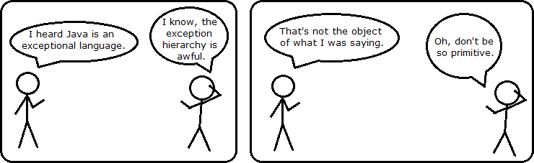
CS 142
Lecture 23: Interfaces; Abstract Classes
Thanks to Marty Stepp and Stuart Reges for parts of these slides

Slide 2
Related classes
Consider classes for shapes with common features:
Circle (defined by radius r ):
  area = π r ², perimeter = 2 π r
Rectangle (defined by width w and height h ):
  area = w h, perimeter = 2w + 2h
Triangle (defined by side lengths a, b, and c)
  area = √(s (s - a) (s - b) (s - c))
  where s = ½ (a + b + c),
  perimeter = a + b + c
  Every shape has these, but each computes them differently.
r
w
h
b
a
c

Slide 3
Storing Multiple Types
It would be nice if we could store shapes of different types in a list. What do we need in order to do this?
Are there any downsides?

Slide 4
Solution: Interfaces
interface: A list of methods that a class can promise to implement.
  Inheritance gives you an is-a relationship and code sharing.
    A Lawyer can be treated as an Employee and inherits its code.
  Interfaces give you an is-a relationship without code sharing.
    A Rectangle object can be treated as a Shape but inherits no code.
  Analogous to non-programming idea of roles or certifications:
    "I'm certified as a CPA accountant.
    This assures you I know how to do taxes, audits, and consulting."
    "I'm 'certified' as a Shape, because I implement the Shape interface.
    This assures you I know how to compute my area and perimeter."

Slide 5
Interface syntax
  public interface name {
  public type name(type name, ..., type name);
  public type name(type name, ..., type name);
  ...
  public type name(type name, ..., type name);
  }
  Example:
  public interface Vehicle {
  public int getSpeed();
  public void setDirection(int direction);
  }

Slide 6
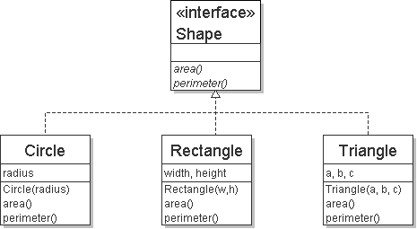
Shape interface
  // Describes features common to all shapes.
  public interface Shape {
  public double area();
  public double perimeter();
  }
  Saved as Shape.java
abstract method: A header without an implementation.
  The actual bodies are not specified, because we want to allow each class to implement the behavior in its own way.

Slide 7
Implementing an interface
  public class name implements interface {
  ...
  }
A class can declare that it "implements" an interface.
  The class must contain each method in that interface.
  public class Bicycle implements Vehicle {
  ...
  }
  (Otherwise it will fail to compile.)
  Banana.java:1: Banana is not abstract and does not override abstract method area() in Shape
  public class Banana implements Shape {
  ^

Slide 8
Interfaces + polymorphism
Interfaces benefit the client code author the most.
  They allow polymorphism.
  (the same code can work with different types of objects)
  public static void printInfo(Shape s) {
  System.out.println("The shape: " + s);
  System.out.println("area : " + s.area());
  System.out.println("perim: " + s.perimeter());
  System.out.println();
  }
  ...
  Circle circ = new Circle(12.0);
  Triangle tri = new Triangle(5, 12, 13);
  printInfo(circ);
  printInfo(tri);

Slide 9
Maps – again!
We did an example in lecture with a HashMap.
In lab we did an exercise with a TreeMap.
They had the same methods and seemed to be used for the same tasks.
Why do we need both?
index | 0 | 1 | 2 | 3
value | 42 | -3 | 17 | 9

Slide 10
Lists
We implemented an ArrayIntList class so we could create a list that changed size as data was added
Is there any other way we could have created a list structure?
index | 0 | 1 | 2 | 3
value | 42 | -3 | 17 | 9

Slide 11
Abstract data types (ADTs)
abstract data type (ADT): A specification of a collection of data and the operations that can be performed on it.
  Describes what a collection does, not how it does it
We don't know exactly how other types of lists are implemented, and we don't need to.
  We just need to understand the idea of the list and what operations it can perform.

Slide 12
An IntList interface
  // Represents a list of integers.
  public interface IntList {
  public void add(int value);
  public void add(int index, int value);
  public int get(int index);
  public int indexOf(int value);
  public boolean isEmpty();
  public void remove(int index);
  public void set(int index, int value);
  public int size();
  }
  public class ArrayIntList implements IntList { ...
  public class LinkedIntList implements IntList { ...

Slide 13
Client code w/ interface
  public class ListClient {
  public static void main(String[] args) {
  IntList list1 = new ArrayIntList();
  process(list1);
  IntList list2 = new LinkedIntList();
  process(list2);
  }
  public static void process(IntList list) {
  list.add(18);
  list.add(27);
  list.add(93);
  System.out.println(list);
  list.remove(1);
  System.out.println(list);
  }
  }

Slide 14
Using ADT interfaces
When using Java's built-in collection classes:
It is considered good practice to always declare collection variables using the corresponding ADT interface type:
  List<String> list = new ArrayList<>();
Methods that accept a collection as a parameter should also declare the parameter using the ADT interface type:
  public void stutter(List<String> list) {
  ...
  }

Slide 15
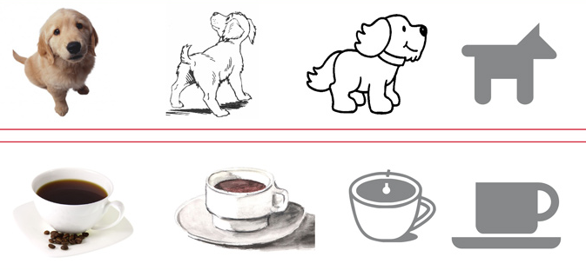
Abstract Classes
A mix between a class and an interface
  Contains some abstract methods (unimplemented)
  Contains some fully implemented methods
  Other classes can inherit from it not extend it
  All abstract methods must be overridden

Slide 16
Languages and Grammars

Slide 17
Languages and grammars
(formal) language: A set of words or symbols.
grammar: A description of a language that describes which sequences of symbols are allowed in that language.
  describes language syntax (rules) but not semantics (meaning)
  can be used to generate strings from a language, or to determine whether a given string belongs to a given language

Slide 18
Sentence generation
<s>
<np>
<vp>
<pn>
<tv>
<np>
<dp>
<adjp>
<n>
<adj>
<adjp>
<adj>
Fred
honored
the
green
wonderful
child

Slide 19
Backus-Naur (BNF)
Backus-Naur Form (BNF): A syntax for describing language grammars in terms of transformation rules, of the form:
  <symbol> ::= <expression> | <expression> ... | <expression>
  terminal: A fundamental symbol of the language.
  non-terminal: A high-level symbol describing language syntax, which can be transformed into other non-terminal or terminal symbol(s) based on the rules of the grammar.
  developed by two Turing-award-winning computer scientists in 1960 to describe their new ALGOL programming language

Slide 20
An example BNF grammar
  <s>::=<n> <v>
  <n>::=Marty | Allison | Stuart | Jessica
  <v>::=cried | slept | belched
Some sentences that could be generated from this grammar:
  Marty slept
  Jessica belched
  Stuart cried

Slide 21
BNF grammar version 2
  <s>::=<np> <v>
  <np>::=<pn> | <dp> <n>
  <pn>::=Marty | Allison | Stuart | Jessica
  <dp>::=a | the
  <n>::=ball | hamster | carrot | computer
  <v>::=cried | slept | belched
Some sentences that could be generated from this grammar:
  the carrot cried
  Jessica belched
  a computer slept

Slide 22
BNF grammar version 3
  <s>::=<np> <v>
  <np>::=<pn> | <dp> <adj> <n>
  <pn>::=Marty | Victoria | Stuart | Jessica
  <dp>::=a | the
  <adj>::=silly | invisible | loud | romantic
  <n>::=ball | hamster | carrot | computer
  <v>::=cried | slept | belched
Some sentences that could be generated from this grammar:
  the invisible carrot cried
  Jessica belched
  a computer slept
  a romantic ball belched

Slide 23
Grammars and recursion
  <s>::=<np> <v>
  <np>::=<pn> | <dp> <adjp> <n>
  <pn>::=Marty | Victoria | Stuart | Jessica
  <dp>::=a | the
  <adjp>::=<adj> <adjp> | <adj>
  <adj>::=silly | invisible | loud | romantic
  <n>::=ball | hamster | carrot | computer
  <v>::=cried | slept | belched
Grammar rules can be defined recursively, so that the expansion of a symbol can contain that same symbol.
  There must also be expressions that expand the symbol into something non-recursive, so that the recursion eventually ends.

Slide 24
Grammar, final version
  <s>::=<np> <vp>
  <np>::=<dp> <adjp> <n>|<pn>
  <dp>::=the|a
  <adjp>::=<adj>|<adj> <adjp>
  <adj>::=big|fat|green|wonderful|faulty|subliminal
  <n>::=dog|cat|man|university|father|mother|child
  <pn>::=John|Jane|Sally|Spot|Fred|Elmo
  <vp>::=<tv> <np>|<iv>
  <tv>::=hit|honored|kissed|helped
  <iv>::=died|collapsed|laughed|wept
Could this grammar generate the following sentences?
  Fred honored the green wonderful child
  big Jane wept the fat man fat
Generate a random sentence using this grammar.

