Slide 1
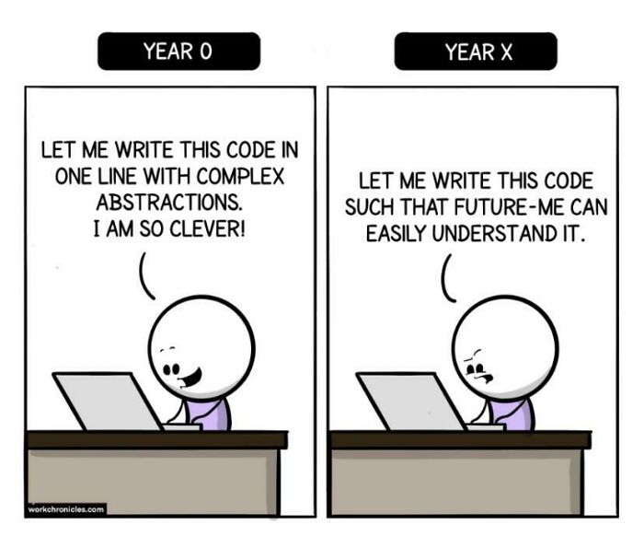
CS 142
Lecture 24: interfaces; Comparable
Thanks to Marty Stepp and Stuart Reges for parts of these slides

Slide 2
Recall: Searching
What do we need to know about a type in order to search a list or array that contains instances of that type?
index | 0 | 1 | 2 | 3 | 4 | 5 | 6 | 7 | 8
value | 42 | -3 | 17 | 9 | 12 | 22 | 6 | 4 | 72

Slide 3
Collections class
(all Lists are a type of Collection)
Method name | Description
binarySearch(list, value) | returns the index of the given value in a sorted list (< 0 if not found)
copy(listTo, listFrom) | copies listFrom's elements to listTo
emptyList(), emptyMap(), emptySet() | returns a read-only collection of the given type that has no elements
fill(list, value) | sets every element in the list to have the given value
max(collection), min(collection) | returns largest/smallest element
replaceAll(list, old, new) | replaces an element value with another
reverse(list) | reverses the order of a list's elements
shuffle(list) | arranges elements into a random order
sort(list) | arranges elements into ascending order

Slide 4
Ordering and objects
Can we sort an array of Strings?
  Operators like < and > do not work with String objects.
  But we do think of strings as having an alphabetical ordering.
natural ordering: Rules governing the relative placement of all values of a given type.
comparison function: Code that, when given two values A and B of a given type, decides their relative ordering:
  A < B, A == B, A > B

Slide 5
The compareTo method
The standard way for a Java class to define a comparison function for its objects is to define a compareTo method.
  Example: in the String class, there is a method:
  public int compareTo(String other)
A call of A.compareTo(B) will return:
  a value < 0 if A comes "before" B in the ordering,
  a value > 0 if A comes "after" B in the ordering,
  or 0 if A and B are considered "equal" in the ordering.

Slide 6
Using compareTo
compareTo can be used as a test in an if statement.
  String a = "alice";
  String b = "bob";
  if (a.compareTo(b) < 0) { // true
  ...
  }
Primitives | Objects
if (a < b) { ... | if (a.compareTo(b) < 0) { ...
if (a <= b) { ... | if (a.compareTo(b) <= 0) { ...
if (a == b) { ... | if (a.compareTo(b) == 0) { ...
if (a != b) { ... | if (a.compareTo(b) != 0) { ...
if (a >= b) { ... | if (a.compareTo(b) >= 0) { ...
if (a > b) { ... | if (a.compareTo(b) > 0) { ...

Slide 7
compareTo and collections
You can use an array or list of strings with Java's included binarySearch method because it calls compareTo internally.
  String[] a = {"al", "bob", "cari", "dan", "mike"};
  int index = Arrays.binarySearch(a, "dan"); // 3
Java's TreeMap uses compareTo internally for ordering.
A call to your compareTo method should return:
  a value < 0 if this object is "before" the other object,
  a value > 0 if this object is "after" the other object,
  or 0 if this object is "equal" to the other.

Slide 8
Comparable
public interface Comparable<E> {
public int compareTo(E other);
}
A class can implement the Comparable interface to define a natural ordering function for its objects.
A call to your compareTo method should return:
  a value < 0 if this object is "before" the other object,
  a value > 0 if this object is "after" the other object,
  or 0 if this object is "equal" to the other.
If you want multiple orderings, use a Comparator instead

Slide 9
Comparable template
public class name implements Comparable<name> {
...
public int compareTo(name other) {
...
}
}

Slide 10
compareTo tricks
delegation trick - If your object's fields are comparable (such as strings), use their compareTo results to help you:
  // sort by employee name, e.g. "Jim" < "Susan"
  public int compareTo(Employee other) {
  return name.compareTo(other.getName());
  }
toString trick - If your object's toString representation is related to the ordering, use that to help you:
  // sort by date, e.g. "09/19" > "04/01"
  public int compareTo(Date other) {
  return toString().compareTo(other.toString());
  }

Slide 11
compareTo tricks
subtraction trick - Subtracting related values produces the right result for what you want compareTo to return:
  // sort by x and break ties by y
  public int compareTo(Point other) {
  if (x != other.x) {
  return x - other.x; // different x
  } else {
  return y - other.y; // same x; compare y
  }
  }
  The idea:
    if x > other.x, then x - other.x > 0
    if x < other.x, then x - other.x < 0
    if x == other.x, then x - other.x == 0
      NOTE: This trick doesn't work for doubles (but see Math.signum)

Slide 12
Graphical User Interfaces

Slide 13
Why GUIs
GUI: Graphical User Interface
write programs where the user doesn't have to interact with the console
more practice using built in objects
Try event-driven programming in Java

Slide 14
History of GUIs in Java
Abstract Windowing Toolkit (AWT): (JDK 1.0 - 1.1)
  Maps general Java code to each operating system's real GUI system.
  Problems: Limited to lowest common denominator; clunky to use.
Swing: (JDK 1.2+)
  Paints GUI controls itself pixel-by-pixel rather than handing off to OS.
  Benefits: Features; compatibility; OO design.
Java FX: (JDK 7.6+)
  Adds many features for more sophisticated interfaces including CSS.

Slide 15

GUI Parts
window: A first-class citizen of the graphical desktop.
  Also called a top-level container.
  examples: frame, dialog box, applet
component: A GUI widget that resides in a window.
  Also called controls in many other languages.
  examples: button, text box, label
container: A logical grouping for storing components.
  examples: panel, box

