Slide 1
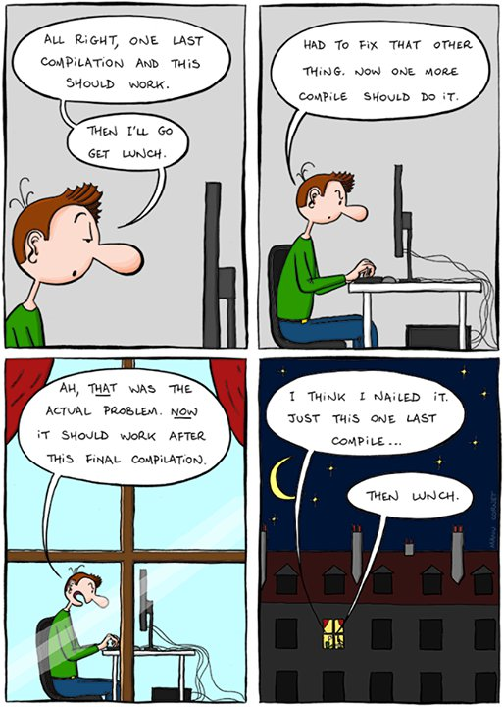
CS 142
Lecture 25: GUIs
Thanks to Marty Stepp and Stuart Reges for parts of these slides

Slide 2
Why GUIs
GUI: Graphical User Interface
write programs where the user doesn't have to interact with the console
more practice using built in objects
Try event-driven programming in Java

Slide 3
History of GUIs in Java
Abstract Windowing Toolkit (AWT): (JDK 1.0 - 1.1)
  Maps general Java code to each operating system's real GUI system.
  Problems: Limited to lowest common denominator; clunky to use.
Swing: (JDK 1.2+)
  Paints GUI controls itself pixel-by-pixel rather than handing off to OS.
  Benefits: Features; compatibility; OO design.
Java FX: (JDK 7.6+)
  Adds many features for more sophisticated interfaces including CSS.

Slide 4

GUI Parts
window: A first-class citizen of the graphical desktop.
  Also called a top-level container.
  examples: frame, dialog box, applet
component: A GUI widget that resides in a window.
  Also called controls in many other languages.
  examples: button, text box, label
container: A logical grouping for storing components.
  examples: panel, box

Slide 5
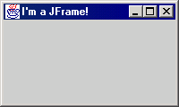
JFrame
import javax.swing.*;
A frame is a graphical window that can
be used to hold other components
public JFrame()
public JFrame(String title)
Creates a frame with an optional title.
public void setTitle(String text)
Puts the given text in the frame’s title bar.
public void setDefaultCloseOperation(int op)
Makes the frame perform the given action when it closes. Common value: JFrame.EXIT_ON_CLOSE
public void add(Component comp)
Places the given component or container inside the frame.
  How would we add more than one component to the frame?
NOTE: Call setVisible(true) to make a frame appear on screen after creating it.

Slide 6

JFrame Example
A simple program that creates and shows a JFrame:
  import javax.swing.*;
  public class SimpleFrame {
  public static void main(String[] args) {
  JFrame frame = new JFrame();
  frame.setVisible(true);
  }
  }
Graphical output:

Slide 7
JFrame Properties
JFrames have the following unique properties that you can get or set in your graphical programs:
name | type | description | methods
default close operation | int | what should happen when frame is closed | getDefaultCloseOperation, setDefaultCloseOperation
icon image | Image | icon in the window's title bar | getIconImage, setIconImage
layout | LayoutManager | how the frame should position its components | getLayout, setLayout
resizable | boolean | whether the window can be resized | isResizable, setResizable
title | String | window's title bar text | getTitle, setTitle

Slide 8
Component Properties
All components also have the following properties:
name | type | description | methods
background | Color | background color | getBackground, setBackground
enabled | boolean | whether the component can be interacted with | isEnabled, setEnabled
font | Font | font used to display any text on the component | getFont, setFont
foreground | Color | foreground color | getForeground, setForeground
location | Point | (x, y) position of component on screen | getLocation, setLocation
size | Dimension | width, height of component | getSize, setSize
preferred size | Dimension | width, height that the component wants to be | getPreferredSize, setPreferredSize
visible | boolean | whether the component can be seen on screen | isVisible, setVisible

Slide 9
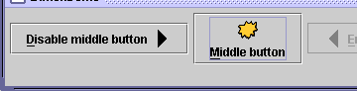
JButton and JLabel
The most common component—
a button is a clickable onscreen
region that the user interacts with
to perform a single command
A text label is simply a string of text
displayed on screen in a graphical
program. Labels often give infor-
mation or describe other components
public JButton(String text)
public JLabel(String text)
Creates a new button / label with the given string as its text.
public String getText()
Returns the text showing on the button / label.
public void setText(String text)
Sets button / label's text to be the given string.

Slide 10
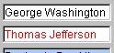

JTextField and JTextArea
A text field is like a label, except that the text
in it can be edited and modified by the user.
Text fields are commonly used for user input,
where the user types information in the field
and the program reads it
A text area is a multi-line text field
public JTextField(int columns)
public JTextArea(int lines, int columns)
Creates a new text field that is the given number of columns (letters) wide.
public String getText()
Returns the text currently in the field.
public void setText(String text)
Sets field's text to be the given string.

Slide 11
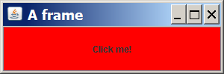
Components Example
The following program attempts to show two buttons:
  import java.awt.*;
  import javax.swing.*;
  public class ComponentsExample1 {
  public static void main(String[] args) {
  JFrame frame = new JFrame();
  frame.setDefaultCloseOperation(JFrame.EXIT_ON_CLOSE);
  frame.setSize(new Dimension(300, 100));
  frame.setTitle("A frame");
  JButton button1 = new JButton();
  button1.setText("I'm a button.");
  button1.setBackground(Color.BLUE);
  frame.add(button1);
  JButton button2 = new JButton();
  button2.setText("Click me!");
  button2.setBackground(Color.RED);
  frame.add(button2);
  frame.setVisible(true);
  }
  }

Slide 12
Layout Problems
The preceding program added two buttons to the frame, but only one appeared on the screen.
layout manager: An object contained inside frames and other graphical containers that decides the position and size of the components inside the container.
The default layout manager sizes each component added to occupy the full window space.

Slide 13
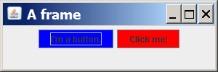
Changing Layouts
We can correct the program's appearance by changing the frame's layout manager.
Change the layout by calling the setLayout method on the frame and passing a layout manager object.
  We will see several layout managers later.
  We'll use one called a FlowLayout, which sizes each component to its preferred size and positions them in left-to-right rows.
  If the following line is added to the preceding program just before calling setVisible(true), its appearance will be:
  frame.setLayout(new FlowLayout());

Slide 14
Event-driven Programming

Slide 15
Event-driven Programming
program's execution is indeterminate
on-screen components cause events to occur when they are clicked / interacted with
events can be handled, causing the program to respond, driving the execution thru events (an "event-driven" program)

Slide 16
Action events: ActionEvent
most common / simple event type in Swing
represent an action occurring on a GUI component
created by:
  button clicks
  check box checking / unchecking
  menu clicks
  pressing Enter in a text field
  etc.

Slide 17

Listening for Events
attach listener to component
listener’s appropriate method will be called when event occurs (e.g. when the button is clicked)
for Action events, use ActionListener

Slide 18
Writing an ActionListener
// part of Java; you don't write this
public interface ActionListener {
public void actionPerformed(ActionEvent event);
}
// Prints a message when the button is clicked.
public class MyActionListener
implements ActionListener {
public void actionPerformed(ActionEvent event){
JOptionPane.showMessageDialog(null,
"An event occurred!");
}
}

Slide 19
Attaching an ActionListener
JButton button = new JButton("button 1");
ActionListener listener = new MyActionListener();
button.addActionListener(listener);
now button will print "Event occurred!" when clicked
  addActionListener method exists in many Swing components

