Slide 1
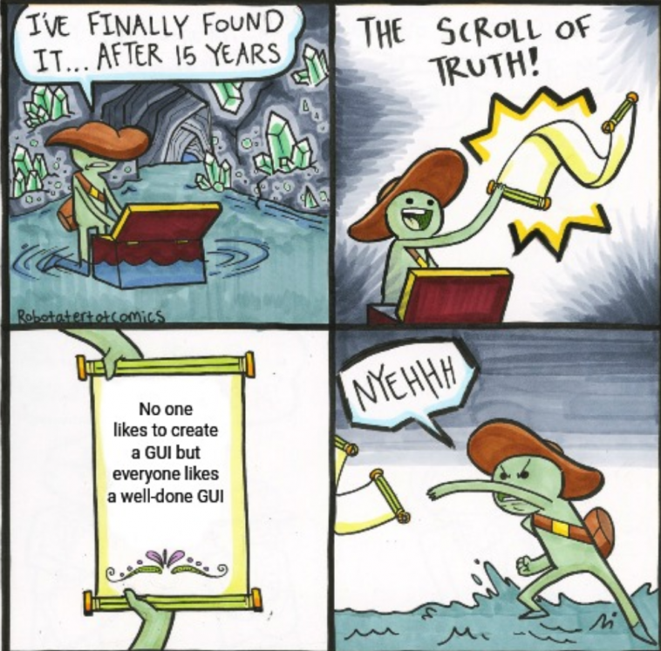
CS 142
Lecture 26: event driven programming; layout
Thanks to Marty Stepp and Stuart Reges for parts of these slides

Slide 2
Event-driven Programming
program's execution is indeterminate
on-screen components cause events to occur when they are clicked / interacted with
events can be handled, causing the program to respond, driving the execution thru events (an "event-driven" program)

Slide 3
Action events: ActionEvent
most common / simple event type in Swing
represent an action occurring on a GUI component
created by:
button clicks
check box checking / unchecking
menu clicks
pressing Enter in a text field
etc.

Slide 4

Listening for Events
attach listener to component
listener’s appropriate method will be called when event occurs (e.g. when the button is clicked)
for Action events, use ActionListener

Slide 5
Writing an ActionListener
// part of Java; you don't write this
public interface ActionListener {
public void actionPerformed(ActionEvent event);
}
// Prints a message when the button is clicked.
public class MyActionListener
implements ActionListener {
public void actionPerformed(ActionEvent event){
JOptionPane.showMessageDialog(null,
"An event occurred!");
}
}

Slide 6
Attaching an ActionListener
JButton button = new JButton("button 1");
ActionListener listener = new MyActionListener();
button.addActionListener(listener);
now button will print "Event occurred!" when clicked
addActionListener method exists in many Swing components

Slide 7
Layout

Slide 8
Sizing and positioning
How does the programmer specify where each component appears, how big each component should be, and what the component should do if the window is resized / moved / maximized / etc.?
Absolute positioning (C++, C#, VB, others): Programmer specifies exact pixel coordinates of every component.
"Put this button at (x=15, y=75) and make it 70x31 px in size."
Layout managers (Java): Objects that decide where to position each component based on some general rules or criteria.
"Put these four buttons into a 2x2 grid and put these text boxes in a horizontal flow in the south part of the frame."

Slide 9
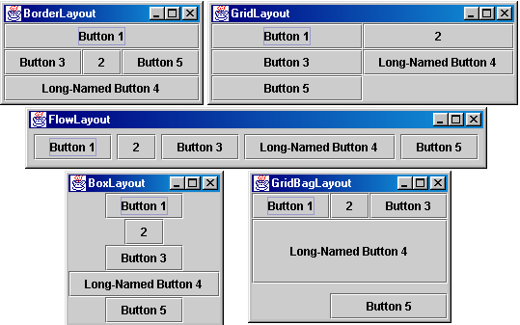
Containers and layout
Place components in a container; add the container to a frame.
container: An object that stores components and governs their positions, sizes, and resizing behavior.

Slide 10
JFrame as container
A JFrame is a container. Containers have these methods:
public void add(Component comp) public void add(Component comp, Object info) Adds a component to the container, possibly giving extra information about where to place it.
public void remove(Component comp)
public void setLayout(LayoutManager mgr) Uses the given layout manager to position components.
public void validate() Refreshes the layout (if it changes after the container is onscreen).

Slide 11
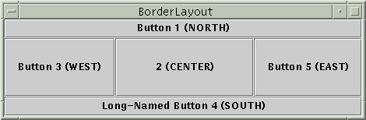

Preferred sizes
Swing component objects each have a certain size they would "like" to be: Just large enough to fit their contents (text, icons, etc.).
This is called the preferred size of the component.
Some types of layout managers (e.g. FlowLayout) choose to size the components inside them to the preferred size.
Others (e.g. BorderLayout, GridLayout) disregard the preferred size and use some other scheme to size the components.
Buttons at preferred size: Not preferred size:

Slide 12
FlowLayout
public FlowLayout()
treats container as a left-to-right, top-to-bottom "paragraph".
Components are given preferred size, horizontally and vertically.
Components are positioned in the order added.
If too long, components wrap around to the next line.
myFrame.setLayout(new FlowLayout());
myFrame.add(new JButton("Button 1"));
The default layout for containers other than JFrame (seen later).

Slide 13
BorderLayout
public BorderLayout()
Divides container into five regions:
NORTH and SOUTH regions expand to fill region horizontally, and use the component's preferred size vertically.
WEST and EAST regions expand to fill region vertically, and use the component's preferred size horizontally.
CENTER uses all space not occupied by others.
myFrame.setLayout(new BorderLayout());
myFrame.add(new JButton("Button 1"), BorderLayout.NORTH);
This is the default layout for a JFrame.

Slide 14
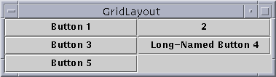
GridLayout
public GridLayout(int rows, int columns)
Treats container as a grid of equally-sized rows and columns.
Components are given equal horizontal / vertical size, disregarding preferred size.
Can specify 0 rows or columns to indicate expansion in that direction as needed.

Slide 15
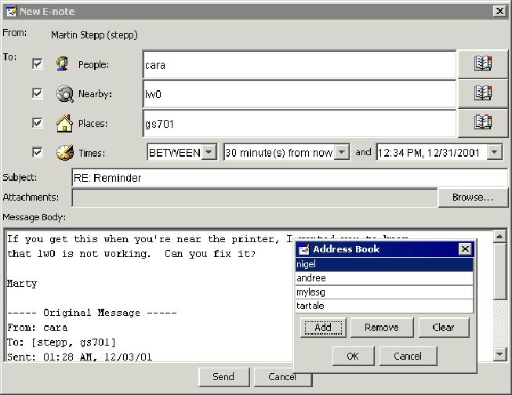
Complex layouts
How would you create a complex window like this, using the layout managers shown?

Slide 16
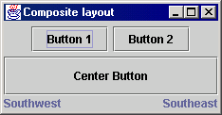
Solution: composite layout
create panels within panels
each panel has a different layout, and by combining the layouts, more complex / powerful layout can be achieved
example:
how many panels?
what layout in each?

Slide 17
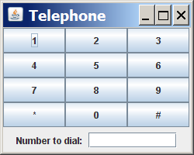
Composite layout example
import java.awt.*;
import javax.swing.*;
public class Telephone {
public static void main(String[] args) {
JFrame frame = new JFrame();
frame.setDefaultCloseOperation(JFrame.EXIT_ON_CLOSE);
frame.setSize(new Dimension(250, 200));
frame.setTitle("Telephone");
frame.setLayout(new BorderLayout());
JPanel centerPanel = new JPanel(new GridLayout(4, 3));
for (int i = 1; i <= 9; i++) {
centerPanel.add(new JButton("" + i));
}
centerPanel.add(new JButton("*"));
centerPanel.add(new JButton("0"));
centerPanel.add(new JButton("#"));
frame.add(centerPanel, BorderLayout.CENTER);
JPanel southPanel = new JPanel(new FlowLayout());
southPanel.add(new JLabel("Number to dial: "));
southPanel.add(new JTextField(10));
frame.add(southPanel, BorderLayout.SOUTH);
frame.setVisible(true);
}
}

Slide 18
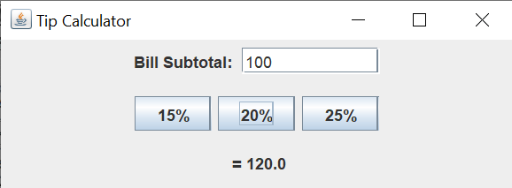
Exercise: Tip Calculator
Write a program that allows the user to calculate a 15%, 20% or 25% tip by pressing a button.
Make the window 400 by 150
Program should exit when the window is closed
Tip calculation only happens when a button is pressed

Slide 19
JFrame Properties
JFrames have the following unique properties that you can get or set in your graphical programs:
name | type | description | methods
default close operation | int | what should happen when frame is closed | getDefaultCloseOperation, setDefaultCloseOperation
icon image | Image | icon in the window's title bar | getIconImage, setIconImage
layout | LayoutManager | how the frame should position its components | getLayout, setLayout
resizable | boolean | whether the window can be resized | isResizable, setResizable
title | String | window's title bar text | getTitle, setTitle

Slide 20
Component Properties
All components also have the following properties:
name | type | description | methods
background | Color | background color | getBackground, setBackground
enabled | boolean | whether the component can be interacted with | isEnabled, setEnabled
font | Font | font used to display any text on the component | getFont, setFont
foreground | Color | foreground color | getForeground, setForeground
location | Point | (x, y) position of component on screen | getLocation, setLocation
size | Dimension | width, height of component | getSize, setSize
preferred size | Dimension | width, height that the component wants to be | getPreferredSize, setPreferredSize
visible | boolean | whether the component can be seen on screen | isVisible, setVisible

Slide 21
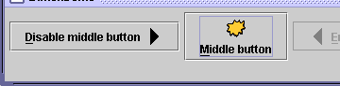
JButton and JLabel
The most common component— a button is a clickable onscreen region that the user interacts with to perform a single command
A text label is simply a string of text displayed on screen in a graphical program. Labels often give infor- mation or describe other components
public JButton(String text) public JLabel(String text) Creates a new button / label with the given string as its text.
public String getText() Returns the text showing on the button / label.
public void setText(String text) Sets button / label's text to be the given string.

Slide 22
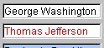

JTextField and JTextArea
A text field is like a label, except that the text in it can be edited and modified by the user. Text fields are commonly used for user input, where the user types information in the field and the program reads it
A text area is a multi-line text field
public JTextField(int columns)
public JTextArea(int lines, int columns) Creates a new text field that is the given number of columns (letters) wide.
public String getText() Returns the text currently in the field.
public void setText(String text) Sets field's text to be the given string.

