Slide 1
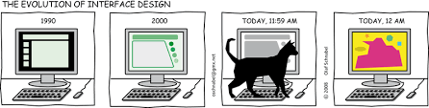
CS 142
Lecture 28: GUIs
Thanks to Marty Stepp and Stuart Reges for parts of these slides

Slide 2
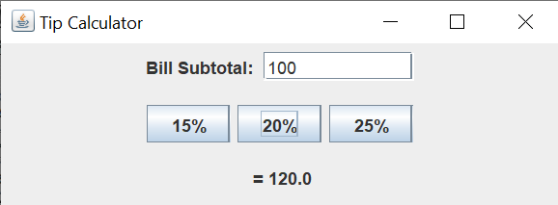
Exercise: Tip Calculator
Write a program that allows the user to calculate a 15%, 20% or 25% tip by pressing a button.
  Make the window 400 by 150
  Program should exit when the window is closed
  Tip calculation only happens when a button is pressed

Slide 3
Making our GUI an Object
Usually we do not create a GUI in main, instead we make it in an object. Then in main we can write:
public static void main(String[] args) {
new MyGui();
}

Slide 4
Accessing ActionEvent
public Object getSource()
Returns the object on which the Event initially occurred.
public String getActionCommand()
Returns the command string associated with this action.
  this will be the button text if a button triggered the event

Slide 5
How can we access our TextField?
We can't get it from the ActionEvent as no event has occurred on it
We can't change the method header of actionPerformed
It only exists in the constructor of our TipCalculator class
Solution: make it a field?

Slide 6

Nested classes
nested class: A class defined inside of another class.
Usefulness:
  Nested classes are hidden from other classes (encapsulated).
  Nested objects can access/modify the fields of their outer object.
Event listeners are often defined as nested classes inside a GUI.

Slide 7
Nested class syntax
// enclosing outer class
public class name {
...
// nested inner class
private class name {
...
}
}
  Only the outer class can see the nested class or make objects of it.
  Each nested object is associated with the outer object that created it, so it can access/modify that outer object's methods/fields.
    If necessary, can refer to outer object as OuterClassName.this

Slide 8
Static inner classes
// enclosing outer class
public class name {
...
// non-nested static inner class
public static class name {
...
}
}
  Static inner classes are not associated with a particular outer object.
  They cannot see the fields of the enclosing class.
  Usefulness: Clients can refer to and instantiate static inner classes:
    Outer.Inner name = new Outer.Inner(params);

Slide 9
GUI event example
public class MyGUI {
private JFrame frame;
private JButton stutter;
private JTextField textfield;
public MyGUI() {
...
stutter.addActionListener(new StutterListener());
}
...
// When button is clicked, doubles the field's text.
private class StutterListener implements ActionListener {
public void actionPerformed(ActionEvent event) {
String text = textfield.getText();
textfield.setText(text + text);
}
}
}

Slide 10
Making your own DrawingPanel
To draw shapes on a window we need to add an image
  BufferedImage name = new BufferedImage(width, height, colorType)
  We will be using color type BufferedImage.TYPE_INT_RGB
An image can’t go directly in the frame. It must go inside an ImageIcon and the ImageIcon must go in a Label and then finally we can put the Label on the Frame
Jframe frame = new JFrame();
BufferedImage img =
new BufferedImage(400, 500, BufferedImage.TYPE_INT_RGB);
JLabel surround = new JLabel(new ImageIcon(img));
frame.add(surround);

Slide 11
Drawing
Just like with the DrawingPanel, we need a pen to draw shapes.
  You can get a pen from the image the same way you did from the DrawingPanel:
  Graphics name = yourBufferedImage.getGraphics()
  Now you can call all the same methods you called on the Graphics object you got from DrawingPanel.

Slide 12
Animation
We need to make some code to run every n amount of seconds
  Use the Timer class
  Create a class that extends TimerTask and give it a run()method
    Think of the timer as an alarm clock that only has a snooze button
  Timer timer = new Timer(); // from java.util
  TimerTask task = new MyTimer();
  timer.schedule(task, 200, 100); // starts timer to run task
  // after 200ms and then every 100ms
  public class MyTimer extends TimerTask {
  private int count;
  public void run() {
  count++;
  pen.drawRect(10 * count, 20 * count, 40, 30);
  frame.repaint(); // redraws the picture on the screen
  } // so we can see the update
  }

Slide 13
JFrame Properties
JFrames have the following unique properties that you can get or set in your graphical programs:
name | type | description | methods
default close operation | int | what should happen when frame is closed | getDefaultCloseOperation, setDefaultCloseOperation
icon image | Image | icon in the window's title bar | getIconImage, setIconImage
layout | LayoutManager | how the frame should position its components | getLayout, setLayout
resizable | boolean | whether the window can be resized | isResizable, setResizable
title | String | window's title bar text | getTitle, setTitle

Slide 14
Component Properties
All components also have the following properties:
name | type | description | methods
background | Color | background color | getBackground, setBackground
enabled | boolean | whether the component can be interacted with | isEnabled, setEnabled
font | Font | font used to display any text on the component | getFont, setFont
foreground | Color | foreground color | getForeground, setForeground
location | Point | (x, y) position of component on screen | getLocation, setLocation
size | Dimension | width, height of component | getSize, setSize
preferred size | Dimension | width, height that the component wants to be | getPreferredSize, setPreferredSize
visible | boolean | whether the component can be seen on screen | isVisible, setVisible

Slide 15
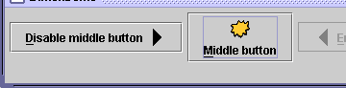
JButton and JLabel
The most common component—
a button is a clickable onscreen
region that the user interacts with
to perform a single command
A text label is simply a string of text
displayed on screen in a graphical
program. Labels often give infor-
mation or describe other components
public JButton(String text)
public JLabel(String text)
Creates a new button / label with the given string as its text.
public String getText()
Returns the text showing on the button / label.
public void setText(String text)
Sets button / label's text to be the given string.

Slide 16
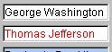

JTextField and JTextArea
A text field is like a label, except that the text
in it can be edited and modified by the user.
Text fields are commonly used for user input,
where the user types information in the field
and the program reads it
A text area is a multi-line text field
public JTextField(int columns)
public JTextArea(int lines, int columns)
Creates a new text field that is the given number of columns (letters) wide.
public String getText()
Returns the text currently in the field.
public void setText(String text)
Sets field's text to be the given string.

