Slide 1

CS 142
Lecture 31: sorting
Thanks to Marty Stepp and Stuart Reges for parts of these slides

Slide 2
Selection sort example
Initial array:
After 1st, 2nd, and 3rd passes:
index | 0 | 1 | 2 | 3 | 4 | 5 | 6 | 7 | 8 | 9 | 10 | 11 | 12 | 13 | 14 | 15 | 16
value | 22 | 18 | 12 | -4 | 27 | 30 | 36 | 50 | 7 | 68 | 91 | 56 | 2 | 85 | 42 | 98 | 25
index | 0 | 1 | 2 | 3 | 4 | 5 | 6 | 7 | 8 | 9 | 10 | 11 | 12 | 13 | 14 | 15 | 16
value | -4 | 18 | 12 | 22 | 27 | 30 | 36 | 50 | 7 | 68 | 91 | 56 | 2 | 85 | 42 | 98 | 25
index | 0 | 1 | 2 | 3 | 4 | 5 | 6 | 7 | 8 | 9 | 10 | 11 | 12 | 13 | 14 | 15 | 16
value | -4 | 2 | 12 | 22 | 27 | 30 | 36 | 50 | 7 | 68 | 91 | 56 | 18 | 85 | 42 | 98 | 25
index | 0 | 1 | 2 | 3 | 4 | 5 | 6 | 7 | 8 | 9 | 10 | 11 | 12 | 13 | 14 | 15 | 16
value | -4 | 2 | 7 | 22 | 27 | 30 | 36 | 50 | 12 | 68 | 91 | 56 | 18 | 85 | 42 | 98 | 25

Slide 3
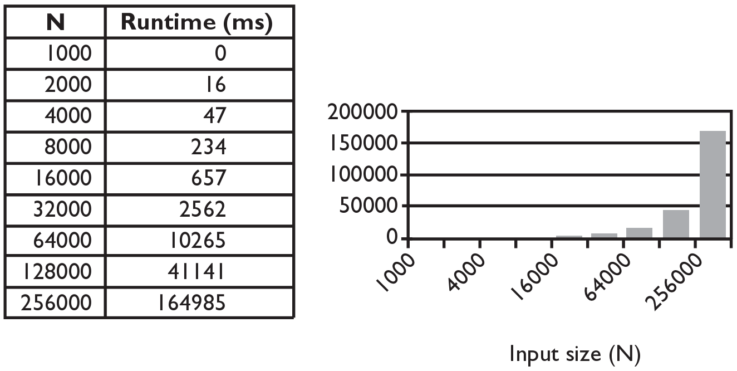
Selection sort runtime (Fig. 13.6)
What is the complexity class (Big-Oh) of selection sort?

Slide 4
Similar algorithms
index | 0 | 1 | 2 | 3 | 4 | 5 | 6 | 7 | 8 | 9 | 10 | 11 | 12 | 13 | 14 | 15 | 16
value | 22 | 18 | 12 | -4 | 27 | 30 | 36 | 50 | 7 | 68 | 91 | 56 | 2 | 85 | 42 | 98 | 25
bubble sort: Make repeated passes, swapping adjacent values
slower than selection sort (has to do more swaps)
insertion sort: Shift each element into a sorted sub-array
faster than selection sort (examines fewer values)
index | 0 | 1 | 2 | 3 | 4 | 5 | 6 | 7 | 8 | 9 | 10 | 11 | 12 | 13 | 14 | 15 | 16
value | 18 | 12 | -4 | 22 | 27 | 30 | 36 | 7 | 50 | 68 | 56 | 2 | 85 | 42 | 91 | 25 | 98
22
50
91
98
index | 0 | 1 | 2 | 3 | 4 | 5 | 6 | 7 | 8 | 9 | 10 | 11 | 12 | 13 | 14 | 15 | 16
value | -4 | 12 | 18 | 22 | 27 | 30 | 36 | 50 | 7 | 68 | 91 | 56 | 2 | 85 | 42 | 98 | 25
sorted sub-array (indexes 0-7)
7

Slide 5
Merge sort
merge sort: Repeatedly divides the data in half, sorts each half, and combines the sorted halves into a sorted whole.
The algorithm:
Divide the list into two roughly equal halves.
Sort the left half.
Sort the right half.
Merge the two sorted halves into one sorted list.
Often implemented recursively.
An example of a "divide and conquer" algorithm.
Invented by John von Neumann in 1945

Slide 6
Merge sort example
index | 0 | 1 | 2 | 3 | 4 | 5 | 6 | 7
value | 22 | 18 | 12 | -4 | 58 | 7 | 31 | 42
split
22 | 18 | 12 | -4
58 | 7 | 31 | 42
split
split
22 | 18
12 | -4
58 | 7
31 | 42
split
split
split
split
22
18
12
-4
58
7
31
42
merge
merge
merge
merge
18 | 22
-4 | 12
7 | 58
31 | 42
merge
merge
-4 | 12 | 18 | 22
7 | 31 | 42 | 58
merge
-4 | 7 | 12 | 18 | 22 | 31 | 42 | 58

Slide 7
More runtime intuition
Merge sort performs O(N) operations on each level. (width)
Each level splits the data in 2, so there are log₂ N levels. (height)
Product of these = N * log₂ N = O(N log N). (area)
Example: N = 32. Performs ~ log₂ 32 = 5 levels of N operations each:
32
16
8
height = log₂ N
4
2
1
width = N
Notes:
Merge sort parallelizes well! You can have different computers process the split arrays in parallel
Big companies can sort trillions of numbers pretty quickly but sending it to different computers

Slide 8
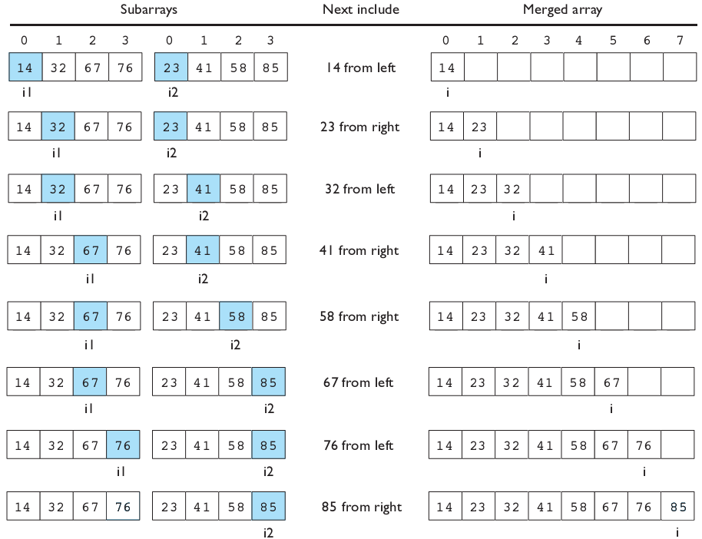
Merging sorted halves
Notes:
Point out what happens when you’ve used up one side
CODE IS ON NEXT SLIDE – ONLY MOVE ON IF NOT LIVE CODING

Slide 9
Solution: merge halves code
// Merges the left/right elements into a sorted result.
// Precondition: left/right are sorted
public static void merge(int[] result, int[] left,
int[] right) {
int i1 = 0; // index into left array
int i2 = 0; // index into right array
for (int i = 0; i < result.length; i++) {
if (i2 >= right.length ||
(i1 < left.length && left[i1] <= right[i2])) {
result[i] = left[i1]; // take from left
i1++;
} else {
result[i] = right[i2]; // take from right
i2++;
}
}
}

Slide 10
Solution: merge sort code 2
// Rearranges the elements of a into sorted order using
// the merge sort algorithm (recursive).
public static void mergeSort(int[] a) {
if (a.length >= 2) {
// split array into two halves
int[] left = Arrays.copyOfRange(a, 0, a.length/2);
int[] right = Arrays.copyOfRange(a, a.length/2, a.length);
// sort the two halves
mergeSort(left);
mergeSort(right);
// merge the sorted halves into a sorted whole
merge(a, left, right);
}
}

Slide 11
Quick sort
quick sort: Orders a list of values by partitioning the list around one element called a pivot, then sorting each partition.
invented by British computer scientist C.A.R. Hoare in 1960
Quick sort is another divide and conquer algorithm:
Choose one element in the list to be the pivot.
Divide the elements so that all elements less than the pivot are to its left and all greater (or equal) are to its right.
Conquer by applying quick sort (recursively) to both partitions.
Runtime: O(N log N) average, O(N²) worst case.
Generally somewhat faster than merge sort.

Slide 12
Quick sort example
index | 0 | 1 | 2 | 3 | 4 | 5 | 6 | 7 | 8 | 9
value | 65 | 23 | 81 | 43 | 92 | 39 | 57 | 16 | 75 | 32 | choose pivot=65
32 | 23 | 81 | 43 | 92 | 39 | 57 | 16 | 75 | 65 | swap pivot (65) to end
32 | 23 | 16 | 43 | 92 | 39 | 57 | 81 | 75 | 65 | swap 81, 16
32 | 23 | 16 | 43 | 57 | 39 | 92 | 81 | 75 | 65 | swap 57, 92
32 | 23 | 16 | 43 | 57 | 39 | 92 | 81 | 75 | 65
32 | 23 | 16 | 43 | 57 | 39 | 65 | 81 | 75 | 92 | swap pivot back in
recursively quicksort each half
32 | 23 | 16 | 43 | 57 | 39 | pivot=32
39 | 23 | 16 | 43 | 57 | 32 | swap to end
16 | 23 | 39 | 43 | 57 | 32 | swap 39, 16
16 | 23 | 32 | 43 | 57 | 39 | swap 32 back in
81 | 75 | 92 | pivot=81
92 | 75 | 81 | swap to end
75 | 92 | 81 | swap 92, 75
75 | 81 | 92 | swap 81 back in
...
...

Slide 13
Choosing a "pivot"
The algorithm will work correctly no matter which element you choose as the pivot.
A simple implementation can just use the first element.
But for efficiency, it is better if the pivot divides up the array into roughly equal partitions.
What kind of value would be a good pivot? A bad one?
index | 0 | 1 | 2 | 3 | 4 | 5 | 6 | 7 | 8 | 9 | 10 | 11 | 12 | 13 | 14 | 15 | 16
value | 8 | 18 | 12 | -4 | 27 | 30 | 36 | 50 | 7 | 68 | 91 | 56 | 2 | 85 | 42 | 98 | 25

Slide 14
Partitioning an array
Swap the pivot to the last array slot, temporarily.
Repeat until done partitioning (until i,j meet):
Starting from i = 0, find an element a[i] ≥ pivot.
Starting from j = N-1, find an element a[j] ≤ pivot.
These elements are out of order, so swap a[i] and a[j].
Swap the pivot back to index i to place it between the partitions.
index | 0 | 1 | 2 | 3 | 4 | 5 | 6 | 7 | 8 | 9
value | 6 | 1 | 4 | 9 | 0 | 3 | 5 | 2 | 7 | 8
 | 8 i |  |  |  |  |  |  | ← | j | 6
 | 2 | i | → | → |  |  | j | 8
 |  |  |  | 5 | i | → | 9
 |  |  |  |  |  |  | 6 |  |  | 9
 | 2 | 1 | 4 | 5 | 0 | 3 | 6 | 8 | 7 | 9

Slide 15
Quick sort code
public static void quickSort(int[] a) {
quickSort(a, 0, a.length - 1);
}
private static void quickSort(int[] a, int min, int max) {
if (min >= max) { // base case; no need to sort
return;
}
// choose pivot; we'll use the first element (might be bad!)
int pivot = a[min];
swap(a, min, max); // move pivot to end
// partition the two sides of the array
int middle = partition(a, min, max - 1, pivot);
swap(a, middle, max); // restore pivot to proper location
// recursively sort the left and right partitions
quickSort(a, min, middle - 1);
quickSort(a, middle + 1, max);
}

Slide 16
Partition code
// partitions a with elements < pivot on left and
// elements > pivot on right;
// returns index of element that should be swapped with pivot
private static int partition(int[] a, int i, int j, int pivot) {
while (i <= j) {
// move index markers i,j toward center
// until we find a pair of out-of-order elements
while (i <= j && a[i] < pivot) { i++; }
while (i <= j && a[j] > pivot) { j--; }
if (i <= j) {
swap(a, i, j);
i++;
j--;
}
}
return i;
}

Slide 17
Quick sort runtime
Best-case analysis: If partition divides the array fairly evenly.
Let T(N) = Runtime for quick sort to process an array of size N.
quickSort(a, length=N):
swap pivot to end. // O(1)
mid = partition(a, pivot). // approx. N time
swap pivot to mid. // O(1)
quickSort(min, mid-1). // T(N/2) if left size ≈ N/2
quickSort(mid+1, max). // T(N/2) if right size ≈ N/2
T(N) = 2T(N/2) + k₁N + k₂(1) for some constants k₁, k₂
T(N) = O(N log N)
Worst-case: What if the pivot is chosen poorly? What is the runtime?
T(N) = T(N-1) + T(1) + k₁N + k₂(1) = O(N²)

Slide 18
Choosing a better pivot
Choosing the first element as the pivot leads to very poor performance on certain inputs (ascending, descending)
does not partition the array into roughly-equal size chunks
Alternative methods of picking a pivot:
random: Pick a random index from [min .. max]
median-of-3: look at left/middle/right elements and pick the one with the medium value of the three:
a[min], a[(max+min)/2], and a[max]
better performance than picking random numbers every time
provides near-optimal runtime for almost all input orderings
index | 0 | 1 | 2 | 3 | 4 | 5 | 6 | 7 | 8 | 9 | 10 | 11 | 12 | 13 | 14 | 15 | 16
value | 8 | 18 | 91 | -4 | 27 | 30 | 86 | 50 | 65 | 78 | 5 | 56 | 2 | 25 | 42 | 98 | 31

Slide 19
Stable sorting
stable sort: One that maintains relative order of "equal" elements.
important for secondary sorting, e.g.
sort by name, then sort again by age, then by salary, ...
All of the N² sorts shown are stable.
bubble, selection, insertion, shell
Merge sort is stable.
Quick sort is not stable.
The partitioning algorithm can reverse the order of "equal" elements.
For this reason, Java's Arrays/Collections.sort() use merge sort.

Slide 20
Unstable sort example
Suppose you want to sort these points by Y first, then by X:
[(4, 2), (5, 7), (3, 7), (3, 1)]
A stable sort like merge sort would do it this way:
[(3, 1), (4, 2), (5, 7), (3, 7)] sort by y
[(3, 1), (3, 7), (4, 2), (5, 7)] sort by x
Note that the relative order of (3, 1) and (3, 7) is maintained.
Quick sort might leave them in the following state:
[(3, 1), (4, 2), (5, 7), (3, 7)] sort by y
[(3, 7), (3, 1), (4, 2), (5, 7)] sort by x
Note that the relative order of (3, 1) and (3, 7) has reversed.

Slide 21
In-place sorting
In-place: not needing to copy the array/list, just needing space for constant sized variables
Which of the sorts that we have seen so far can we do in-place?
selection sort
insertion sort
bubble sort
quick sort (usually considered in-place even though variable space is needed for stack pointers to recursive calls)

Slide 22
Sorting in the real world
What sort does Java’s built-in sort use?
a hybrid of multiple sorts
Insertion sort
Quick sort
Merge sort
Most real-world sorts are hybrids as the setup cost for the more efficient sorts is really high when the amount of data is small.
If you are asked to implement a sort in an interview, I would generally recommend going for merge sort
efficient, good sort that is commonly used
stable
much easier to get right in an interview than quick sort

Slide 23
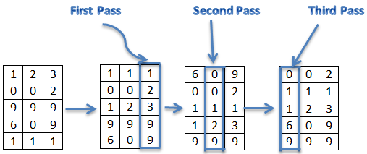
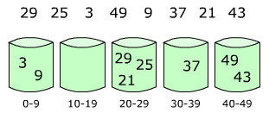
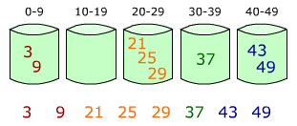
Bucket/radix sort
bucket sort: arrange items into buckets or bins repeatedly
radix sort: sort integers by 1s, then 10s, then 100s, ...
O(N) when used with data in a known fixed range (!)

Slide 24
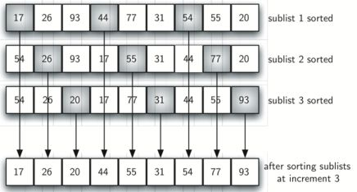
Shell sort
shell sort: Sort every k th element, repeatedly, then reduce k
not as fast as merge/quick sort, but better than selection/insertion
O(N ^{3/2}) or O(N ^{4/3}) depending on gaps used

Slide 25
Parallel sorts
parallel sorting algorithms: modify existing algorithms to work with multiple CPUs/cores
common example: parallel merge sort.
general algorithm idea:
Split array into two halves.
One core/CPU sorts each half.
Once both halves are done, a single core merges them.

