Slide 1
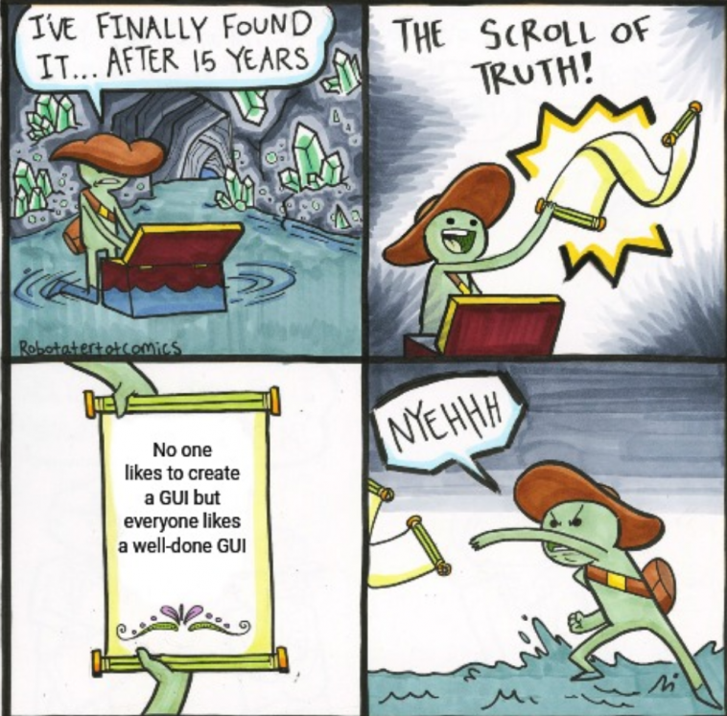
CS 142
Lecture 32: Object; equals; generics
Thanks to Marty Stepp and Stuart Reges for parts of these slides

Slide 2
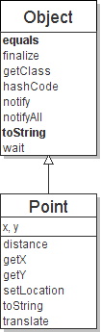
The class Object
The class Object forms the root of the overall inheritance tree of all Java classes.
Every class is implicitly a subclass of Object
The Object class defines several methods that become part of every class you write. For example:
public String toString() Returns a text representation of the object, usually so that it can be printed.

Slide 3
Object methods
What does this list of methods tell you about Java's design?
method | description
protected Object clone() | creates a copy of the object
public boolean equals(Object o) | returns whether two objects have the same state
protected void finalize() | called during garbage collection
public Class<?> getClass() | info about the object's type
public int hashCode() | a code suitable for putting this object into a hash collection
public String toString() | text representation of the object
public void notify() public void notifyAll() public void wait() public void wait(...) | methods related to concurrency and locking (seen later)

Slide 4
Common properties of objects
When Sun designed Java, they felt that every object (including arrays) should be able to:
be compared to other objects (equals)
be printed on the console or converted into a string (toString)
ask questions at runtime about what type/class it is (getClass)
be created (constructors), copied (clone), and destroyed (finalize)
be used in hash-based collections (hashCode)
perform multi-threaded synchronization and locking (notify/wait)
This powerful and broad set of capabilities helped Java's adoption as an object-oriented language.

Slide 5
Using the Object class
You can store any object in a variable of type Object.
Object o1 = new Point(5, -3);
Object o2 = "hello there";
You can write methods that accept an Object parameter.
public void example(Object o) {
if (o != null) {
System.out.println("o is " + o.toString());
}
You can make arrays or collections of Objects.
Object[] a = new Object[5];
a[0] = "hello";
a[1] = new Random();
List<Object> list = new ArrayList<Object>();

Slide 6
Recall: comparing objects
The == operator does not work well with objects.
== tests for referential equality, not state-based equality.
It produces true only when you compare an object to itself.
Point p1 = new Point(5, 3);
Point p2 = new Point(5, 3);
Point p3 = p2;
// p1 == p2 is false;
// p1 == p3 is false;
// p2 == p3 is true
// p1.equals(p2)?
// p2.equals(p3)?
...
p1
x | 5 | y | 3
p2
...
x | 5 | y | 3
p3

Slide 7
Default equals method
The Object class's equals implementation is very simple:
public class Object {
...
public boolean equals(Object o) {
return this == o;
}
}
However:
When we have used equals with various kinds of objects, it didn't behave like == . Why not?
The Java API documentation for equals is elaborate. Why?

Slide 8
Overriding equals
The Object class is designed for inheritance.
Its description and specification will apply to all other Java classes.
So, its specification must be flexible enough to apply to all classes.
Subclasses will override equals to test for equality in their own way.
The Object equals spec enumerates basic properties that clients can rely on that method to have in all subtypes of Object.
(this == o) is compatible with these properties, but so are other tests.

Slide 9
Flawed equals method 1
public boolean equals(Point other) { // bad
if (x == other.x && y == other.y) {
return true;
} else {
return false;
}
}
Let's write an equals method for a Point class.
The method should compare the state of the two objects and return true if they have the same x/y position.
What's wrong with the above implementation?

Slide 10
Flaws in the method
The body can be shortened to the following (boolean zen):
return x == other.x && y == other.y;
The parameter to equals must be of type Object, not Point.
It should be legal to compare a Point to any other object:
// this should be allowed
Point p = new Point(7, 2);
if (p.equals("hello")) { // false
...
equals should always return false if a non-Point is passed.
By writing ours to accept a Point, we have overloaded equals.
Point has two equals methods: One takes an Object, one takes a Point.

Slide 11
Flawed equals method 2
public boolean equals(Object o) { // bad
return x == o.x && y == o.y;
}
What's wrong with the above implementation?
It does not compile:
Point.java:36: cannot find symbol
symbol : variable x
location: class java.lang.Object
return x == o.x && y == o.y;
^
The compiler is saying, "o could be any object. Not every object has an x field."

Slide 12
Object variables
You can store any object in a variable of type Object.
Object o1 = new Point(5, -3);
Object o2 = "hello there";
Object o3 = new Scanner(System.in);
An Object variable only knows how to do general things.
String s = o1.toString(); // ok
int len = o2.length(); // error
String line = o3.nextLine(); // error
(The objects referred to by o1, o2, and o3 still do have those methods. They just can't be called through those variables because the compiler isn't sure what kind of object the variable refers to.)

Slide 13
Casting references
Object o1 = new Point(5, -3);
Object o2 = "hello there";
((Point) o1).translate(6, 2); // ok
int len = ((String) o2).length(); // ok
Point p = (Point) o1;
int x = p.getX(); // ok
Casting references is different than casting primitives.
Doesn't actually change the object that is referred to.
Tells the compiler to assume that o1 refers to a Point object.
Watch out for precedence mistakes:
int len = (String) o2.length(); // error

Slide 14
Flawed equals method 3
public boolean equals(Object o) {
Point other = (Point) o;
return x == other.x && y == other.y;
}
What's wrong with the above implementation?
It compiles and works when other Point objects are passed, but it throws an exception when a non-Point is passed (see next slide).

Slide 15
Comparing different types
Point p = new Point(7, 2);
if (p.equals("hello")) { // should be false
...
}
Currently our method crashes on the above code:
Exception in thread "main"
java.lang.ClassCastException: java.lang.String
at Point.equals(Point.java:25)
at PointMain.main(PointMain.java:25)
The problem is the cast (cannot cast sideways in an inheritance tree):
public boolean equals(Object o) {
Point other = (Point) o;

Slide 16
The instanceof keyword
reference instanceof type
if (variable instanceof type) {
statement(s);
}
A binary, infix, boolean operator.
Tests whether variable refers to an object of class type (or any subclass of type).
String s = "hello";
Point p = new Point();
expression | result
s instanceof Point | false
s instanceof String | true
p instanceof Point | true
p instanceof String | false
p instanceof Object | true
s instanceof Object | true
null instanceof String | false
null instanceof Object | false

Slide 17
Flawed equals method 4
// Returns true if o refers to a Point object
// with the same (x, y) coordinates as
// this Point; otherwise returns false.
public boolean equals(Object o) {
if (o instanceof Point) {
Point other = (Point) o;
return x == other.x && y == other.y;
} else {
return false;
}
}
What's wrong with the above implementation?
It behaves incorrectly if the Point class is extended (see next slides).

Slide 18
Subclassing and equals
public class Point3D extends Point {
private int z;
public Point3D(int x, int y, int z) { ... }
...
}
Point3D p1 = new Point3D(4, 5, 0);
Point3D p2 = new Point3D(4, 5, 6);
Point p3 = new Point (4, 5);
All objects above will report that they are "equal" to each other.
But they shouldn't be. The objects don't have equal state.
In some cases, they aren't even the same type.

Slide 19
Flawed equals method 5
public class Point3D extends Point {
...
public boolean equals(Object o) {
if (o instanceof Point3D) {
Point3D other = (Point3D) o;
return super.equals(o)
&& z == other.z;
} else {
return false;
}
}
}
What's wrong with the above implementation?
It produces asymmetric results when Point and Point3D are mixed.

Slide 20
A proper equals method
Equality is reflexive:
a.equals(a) is true for every object a
Equality is symmetric:
a.equals(b) ↔ b.equals(a)
Equality is transitive:
(a.equals(b) && b.equals(c)) ↔ a.equals(c)
No non-null object is equal to null:
a.equals(null) is false for every object a
Effective Java Tip #8: Obey the general contract when overriding equals.

Slide 21
The getClass method
getClass returns information about the type of an object.
Commonly used for reflection (seen later).
Uses run-time type information, not the type of the variable.
Stricter than instanceof ; subclasses return different results.
getClass should be used when implementing equals.
Instead of instanceof to check for same type, use getClass.
This will eliminate subclasses from being considered for equality.
Caution: Must check for null before calling getClass .

Slide 22
Correct equals methods
public boolean equals(Object o) { // Point
if (o != null && getClass() == o.getClass()) {
Point other = (Point) o;
return x == other.x && y == other.y;
} else {
return false;
}
}
public boolean equals(Object o) { // Point3D
if (o != null && getClass() == o.getClass()) {
Point3D other = (Point3D) o;
return super.equals(o) && z == other.z;
} else {
return false;
}
}

Slide 23
Implementing generics
// a parameterized (generic) class
public class name<Type> {
...
}
Forces any client that constructs your object to supply a type.
Don't write an actual type such as String; the client does that.
Instead, write a type variable name such as E or T.
You can require multiple type parameters separated by commas.
The rest of your class's code can refer to that type by name.
Exercise: Convert our list classes to use generics.

Slide 24
Generics and arrays
public class Foo<T> {
private T myField; // ok
public void method1(T param) {
myField = new T(); // error
T[] a = new T[10]; // error
myField = param; // ok
T[] a2 = (T[]) (new Object[10]); // ok
}
}
You cannot create objects or arrays of a parameterized type.
You can create variables of that type, accept them as parameters, return them, or create arrays by casting from Object[] .

Slide 25
Comparing generic objects
public class ArrayList<E> {
...
public int indexOf(E value) {
for (int i = 0; i < size; i++) {
// if (elementData[i] == value) {
if (elementData[i].equals(value)) {
return i;
}
}
return -1;
}
}
When testing objects of type E for equality, must use equals

Slide 26
Generic interface
// Represents a list of values.
public interface List<E> {
public void add(E value);
public void add(int index, E value);
public E get(int index);
public int indexOf(E value);
public boolean isEmpty();
public void remove(int index);
public void set(int index, E value);
public int size();
}
public class ArrayList<E> implements List<E> { ...
public class LinkedList<E> implements List<E> { ...

