Slide 1
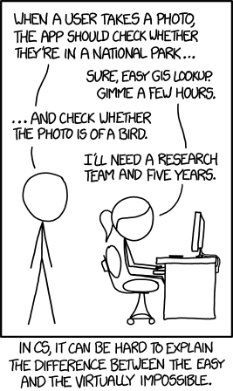
CS 142, Spring 2024
Lecture 37: closing thoughts
Thank you to Marty Stepp and Stuart Reges for parts of these slides

Slide 2




Outside of Edmonds
Online courses
Coursera, Udacity, edX
CS lectures on YouTube
Online tutorials
Codecademy
Khan Academy
Stack Overflow
W3 Schools
Practice coding
TopCoder
Project Euler
CodeFights
HackerRank
CodeStepByStep :)

Slide 3

Internships
You could get a summer job based on what you learned this year.
A few companies hire summer interns with only intro CS skills.
A lot of CS interview questions are actually about 142/143-esque topics:
references / linked lists, array lists, hashing, complexity, recursion, binary trees, graphs, ...
Don't assume you are unqualified.
Job ads usually list a huge amount
of requirements that the company
isn’t actually expecting.
You can do it!

Slide 4
Freshman internships
Warning: There are lots of lists of freshman and sophomore internships. Most have many that do not exist anymore due to Covid.
Microsoft Explore
https://careers.microsoft.com/v2/global/en/exploremicrosoft
Google STEP (Student Training in Engineering Program)
https://buildyourfuture.withgoogle.com/programs/step
Google Summer of Code
https://summerofcode.withgoogle.com/
Meta University
https://www.metacareers.com/careerprograms/pathways/metauniversity
Fermi Lab
https://internships.fnal.gov/community-college-internships-cci/
US Department of Energy
https://science.osti.gov/wdts/cci
Research Experiences for Undergraduates
https://reufinder.com/programs-for-community-college-students/

Slide 5
Freshman internships 2
Khan Academy internships
https://www.khanacademy.org/careers/interns
NSA internships
https://www.intelligencecareers.gov/nsa/students-and-internships
Breakout Mentors (mentor students age 9-14 as they learn programming)
http://breakoutmentors.com/
Salesforce Futureforce TechLaunchpad
https://info.codepath.org/futureforce-tech-launchpad
Green River College Internships List
https://www.devs.greenrivertech.net/internships

Slide 6
CS Interviews
Interviews vary company to company, but they usually involve at least some of:
Solving coding problems at a whiteboard or on a shared screen
No compiler access so you can’t guess and check
Usually, you can pick any language
Syntax and exact built-in method names are not important
Describing an algorithm you would use to solve a particular problem
Discussing the pros and cons, and complexity (both space and time) of a programming solution
Overall – they want to see your reasoning ability

Slide 7
Create a CS Resume or CV
Resumes used to get Computer Science jobs tend to be in a bit of a different format.
Make sure to include
projects: either from a class or written on your own
languages: divide into "proficient" and "working knowledge of"
technologies and tools: Git, command line, etc.
standard categories: work experience, education, awards, extra curricular projects / interests and activities

Slide 8
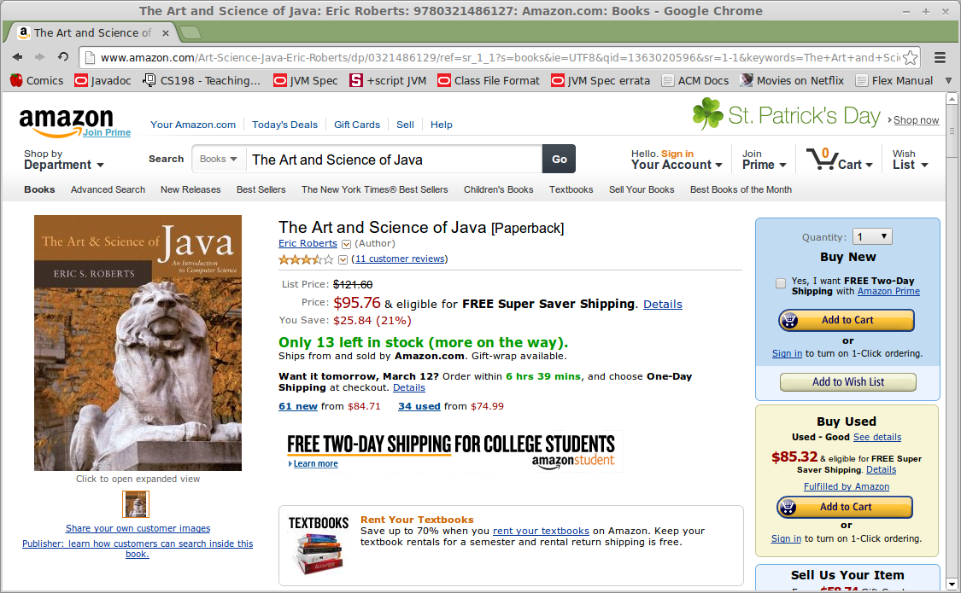
Create a project of your own
If there is a CS topic that interests you, go learn more about it!
Learn how to make a web site (resume? blog? photos?)
Teach yourself a new language and try rewriting 14X HW in it.
Grab cool data from reddit /r/datasets and process it
Create a tool to help you solve a small annoying problem you have in your everyday life
Any personal project can look great on your resume if you are excited about it
Fonts, colors, and layout are specified in CSS. You can learn its basics in a weekend.
Page content is specified in HTML. You can learn its basics in a weekend.

Slide 9
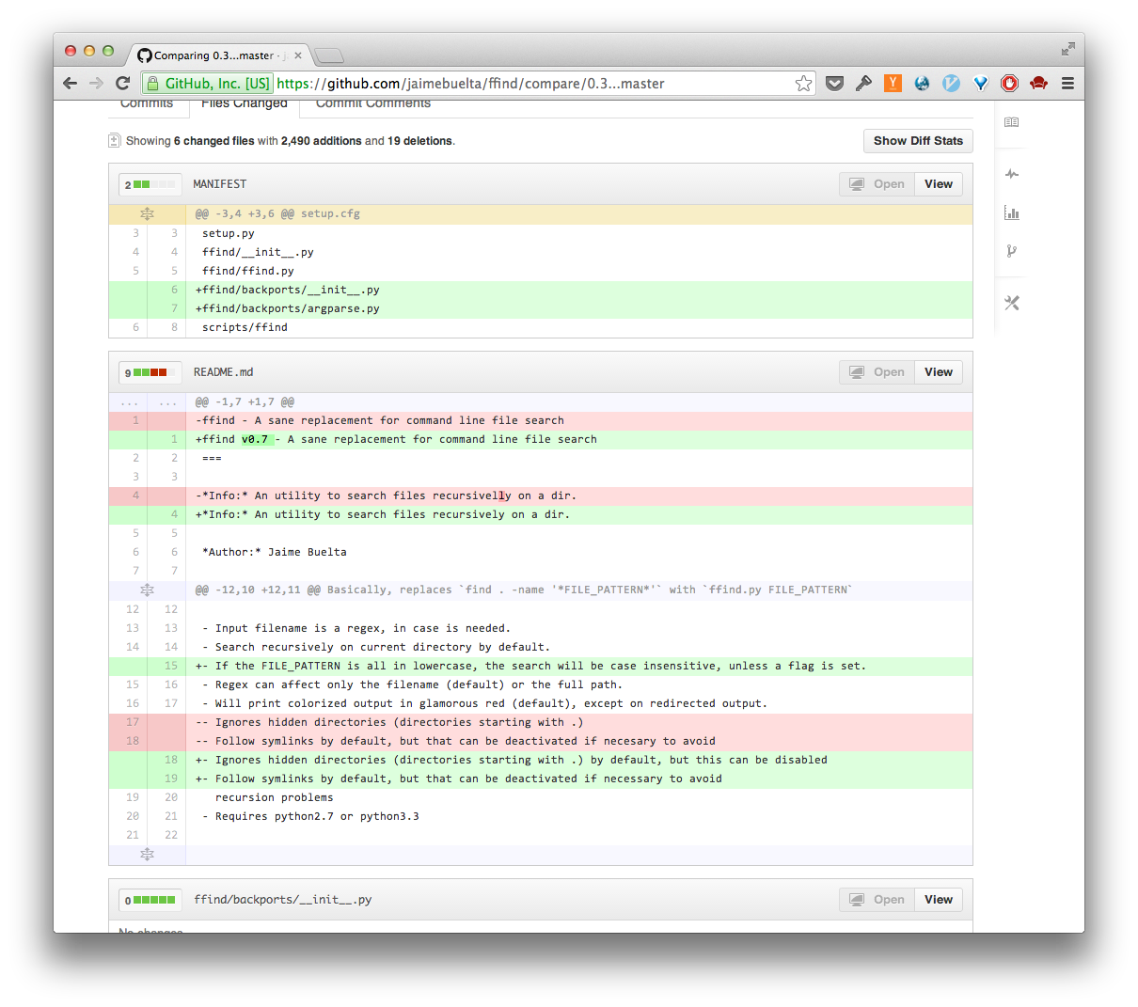

Teach yourself Git
Git is a version control system for managing files in a project.
GitHub is a web site that helps host Git projects.
Many companies and courses use Git/GitHub.
Git can be tricky, but you can learn its basics in a short time.
The Edmonds CS Support Club did a workshop on this earlier this quarter
http://guides.github.com/
Please do not post your 142 project solutions publicly!

Slide 10
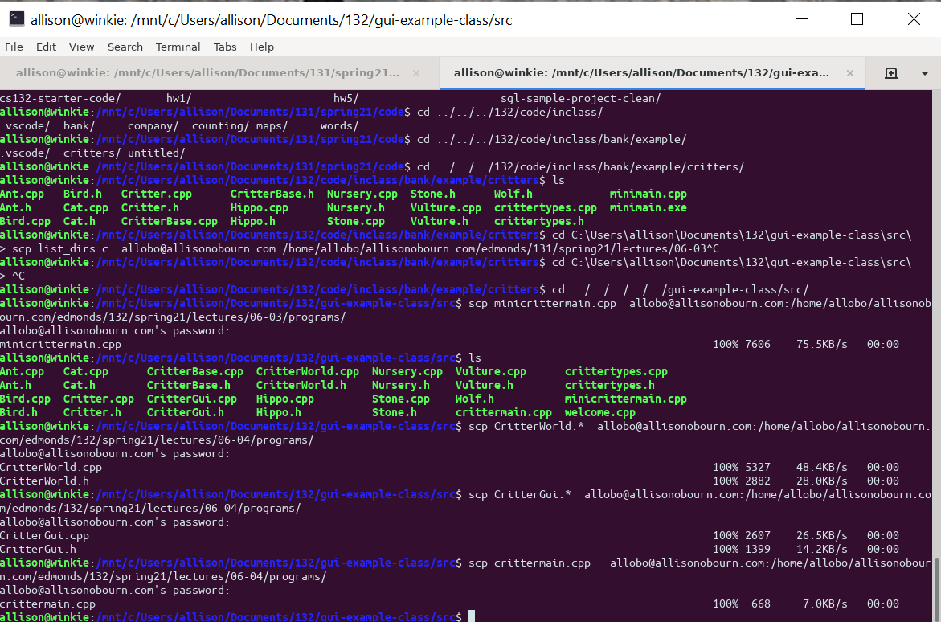
Teach yourself the terminal
Computer scientists tend to use terminals a lot and companies expect you to know how to get around one
There are a huge number of commands! No one knows all of them.
You will likely take a class where you will learn this once you transfer
It can be helpful to learn a little on your own earlier as this information comes a little late in some programs
There are lots of terminals – I recommend bash (a Unix terminal)
If you have Windows, install Windows Subsystem for Linux or Cygwin

Slide 11
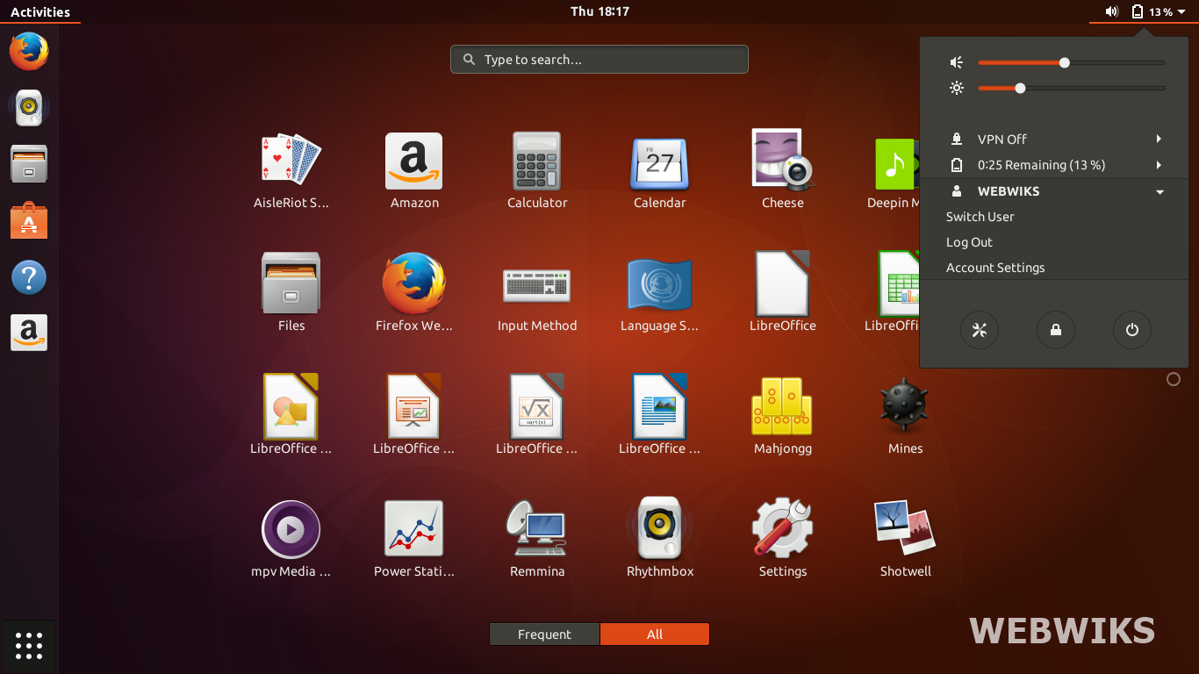
Teach yourself Linux
Linux is a free open source operating system for PCs and Macs.
You can install it on any computer, or on a virtual machine (VM).
Many courses and companies use Linux; knowing it is useful.
Get a free VM at: http://virtualbox.org/
Get Ubuntu Linux at: http://ubuntu.com/

Slide 12
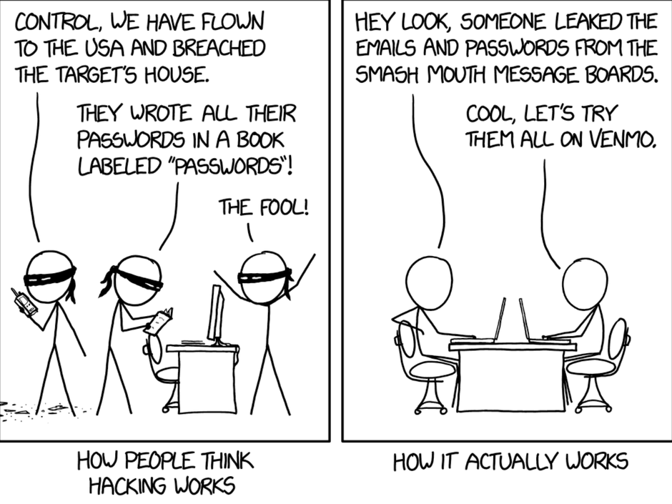
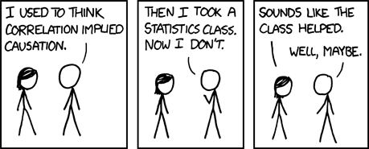
Read about CS topics
Challenge: Pick a CS topic or sub-field, and go read about the basics of it over the break.
suggestion: Pick a topic that aligns with a CS "track."
Machine Learning, Neural Networks, Computer Vision, ...

Slide 13
Thanks for a great quarter!

